Slide 1
Fellowship Boot Camp 2021
Age Friendly Health Systems
Roopali Gupta, MD
Associate Professor of Health Sciences
Division of Geriatrics, Gerontology and Palliative Medicine

Slide 2
Overview of Age-Friendly Healthcare
Need for Age-Friendly Care
Define an Age-Friendly Health System in terms of the “4Ms”
Overview of each of the “4Ms”

Slide 3
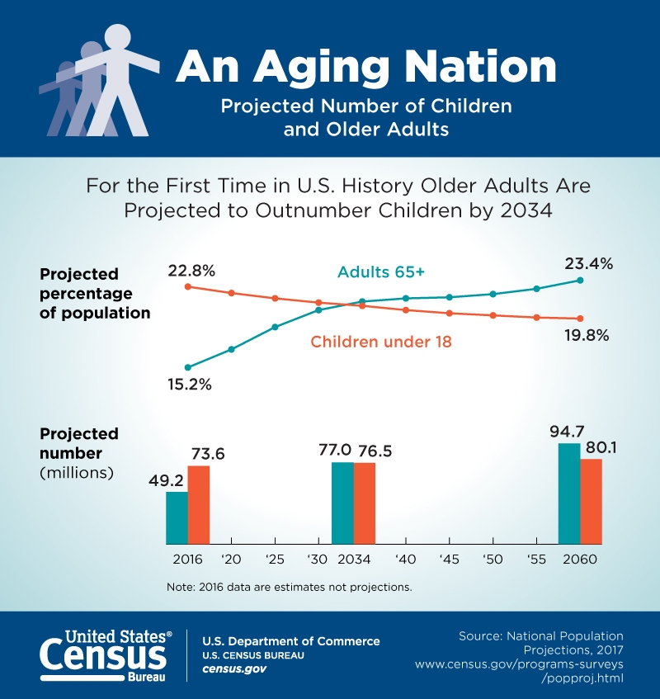
An Aging Nation
https://www.census.gov

Slide 4
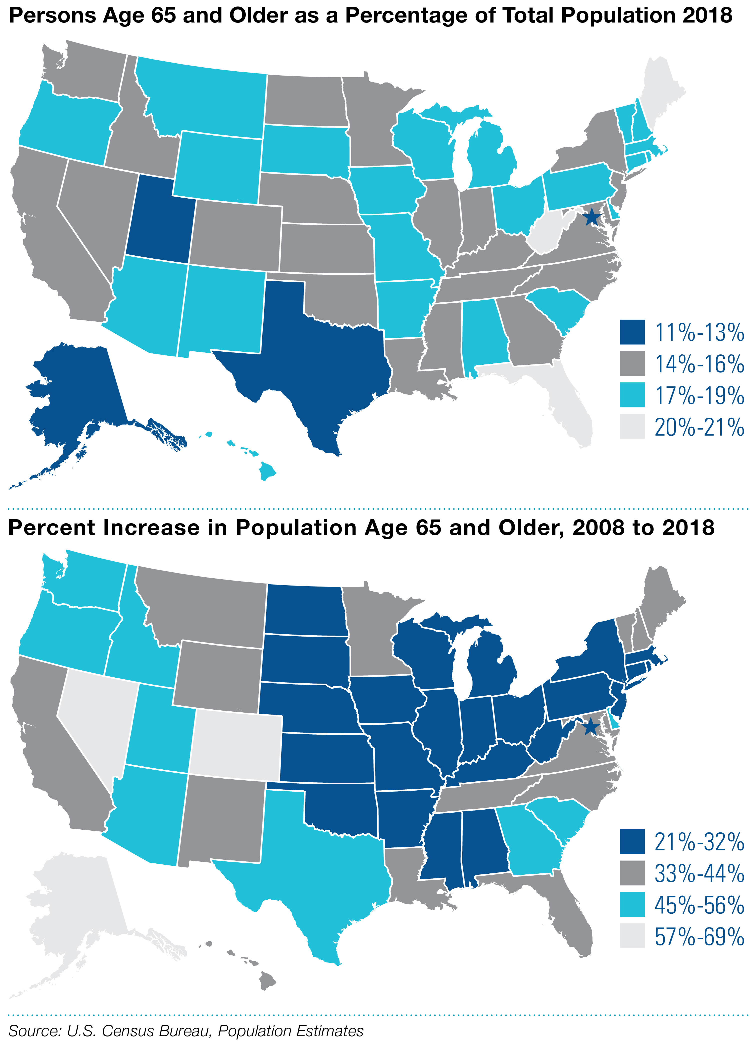
https://www.census.gov

Slide 5
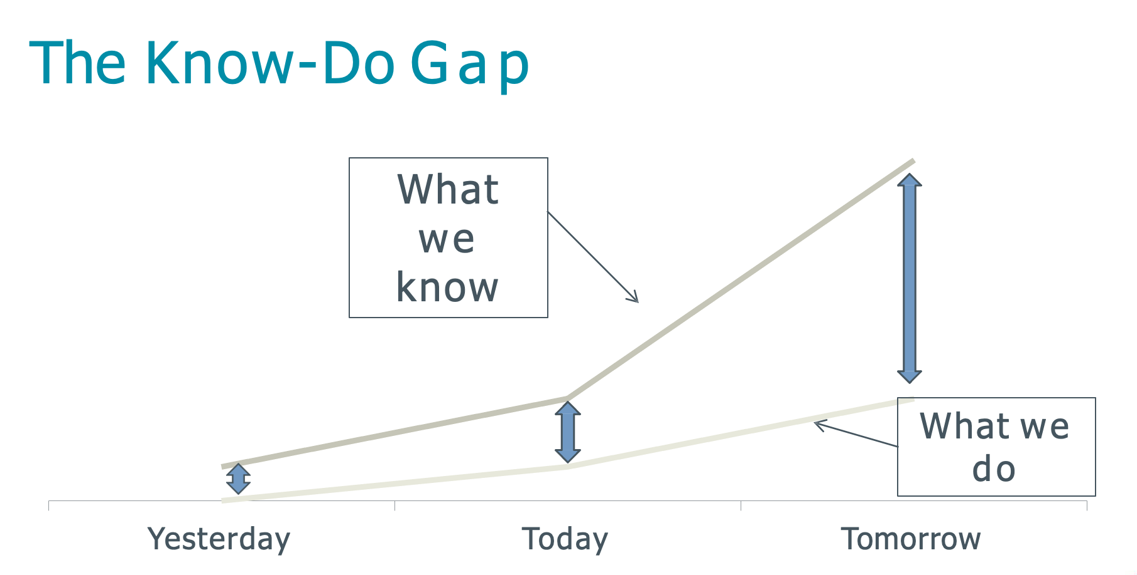
  Few have been implemented.
  Geriatric models of care can be difficult to spread and scale.
  Many evidence-based geriatric practices have been described

Slide 6

The Evolution of the 4Ms of Age-Friendly Care
Research review identified 90 care features
Similar concepts removed → 13 discrete care features
Selection of the “vital few”: the 4Ms
Methods: National experts from multiple organizations reviewed 17 care models with the HIGHEST LEVEL OF EVIDENCE for improving care in older adults
Notes:
In 2016, IHI, JHA, AHA, CHA set aim that 20% of health systems would be age friendly by end of 2020.
They convened
Tested in 5 pioneer health systems around the country

Slide 7

What are the 4Ms of Age-Friendly Healthcare?

Slide 8
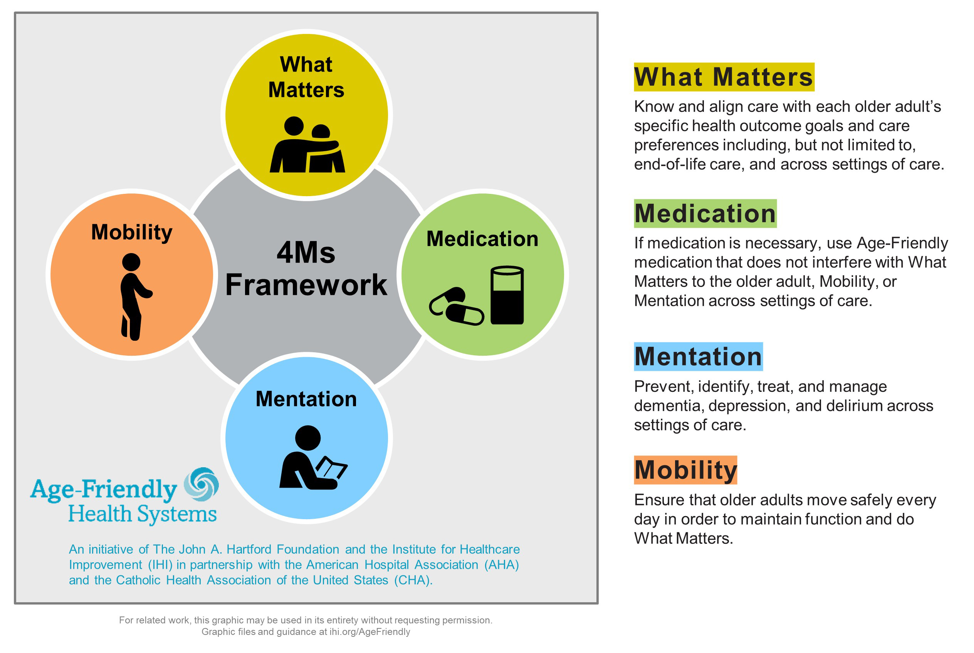
Age Friendly Healthcare: The 4Ms

Slide 9
Assess
Know about the 4Ms for each older adult in your care
Age-Friendly
Health Systems
The 4Ms: What Matters, Medication, Mentation, Mobility
Act On
Incorporate the 4Ms into the plan of care

Slide 10
Age Friendly Healthcare: the 4Ms

Slide 11
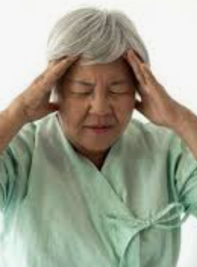
Mentation: The 3 Ds
Dementia (Major Neurocognitive Disorder)
Depression
Delirium

Slide 12
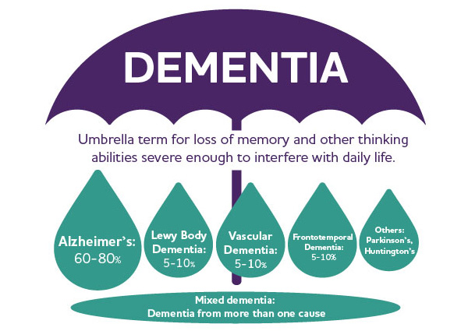
Dementia

Slide 13
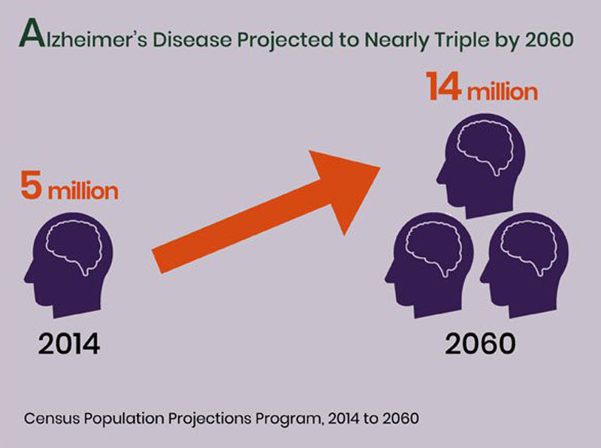
Alzheimer’s Disease (a form of dementia)

Slide 14
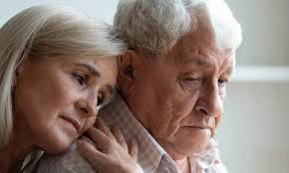

Raise your hand if you have had a family member, loved one, or patient impacted by dementia
Raise your left hand if you have seen the impact that dementia can have on caregivers

Slide 15
Age-Friendly Health Systems Description Worksheet:
Mentation
Please take a few moments to recall what your practice was in your primary outpatient clinic in residency
Complete the Dementia/Depression column in the IHI AFHS Appendix C document based on your recollection
http://www.ihi.org/Engage/Initiatives/Age-Friendly-Health-Systems/Documents/IHIAgeFriendlyHealthSystems_GuidetoUsing4MsCare.pdf

Slide 16
Mini-Cog Demonstration

Slide 17
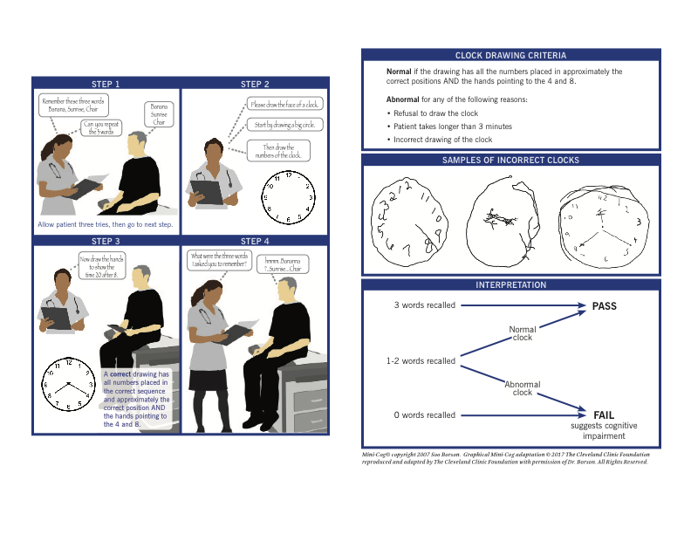
Mini Cog Scoring

Slide 18
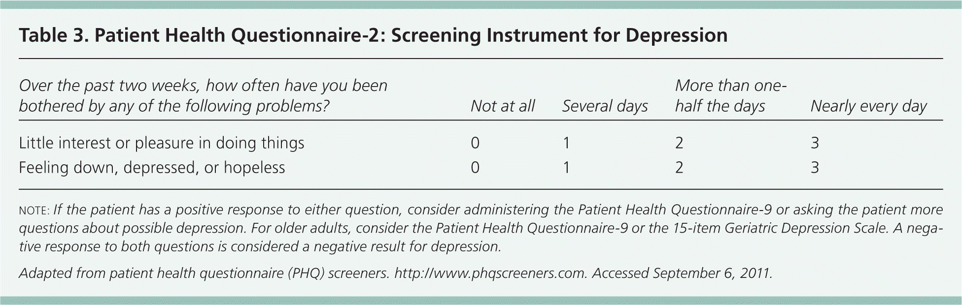
Mentation: Depression Screening
GDS (Geriatric Depression Scale)
PHQ-9 (Patient Health Questionnaire)
PHQ-2 (Patient Health Questionnaire)

Slide 19
Age Friendly Healthcare: the 4Ms

Slide 20
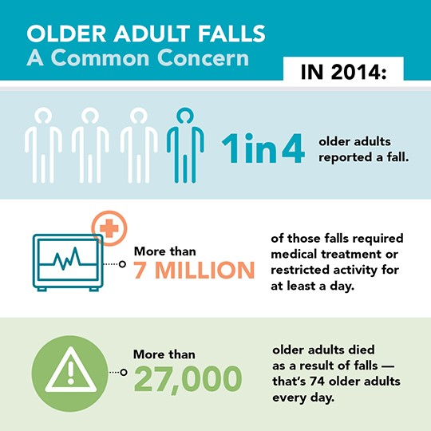
Older Adult Falls

Slide 21
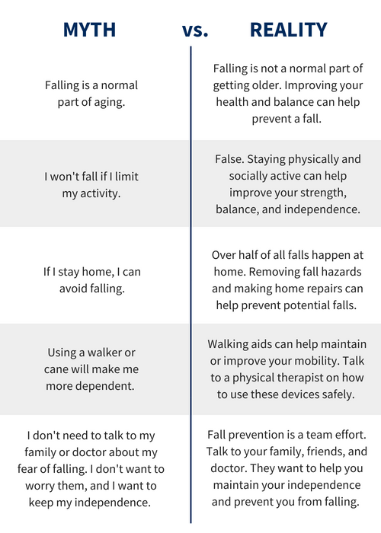
Falls: Myth vs Reality

Slide 22


MOBILITY
Raise your hand if you have had a patient or loved one whose life has been devastated by a fall
Notes:
Current Care Planning: ask what Matters Today
Advance Care Planning: ask what would Matter

Slide 23
Age-Friendly Health Systems Description Worksheet:
Mobility
Please take a few moments to recall what your practice was in your primary outpatient clinic in residency
Complete the Mobility column in the IHI AFHS Appendix C document based on your recollection

Slide 24
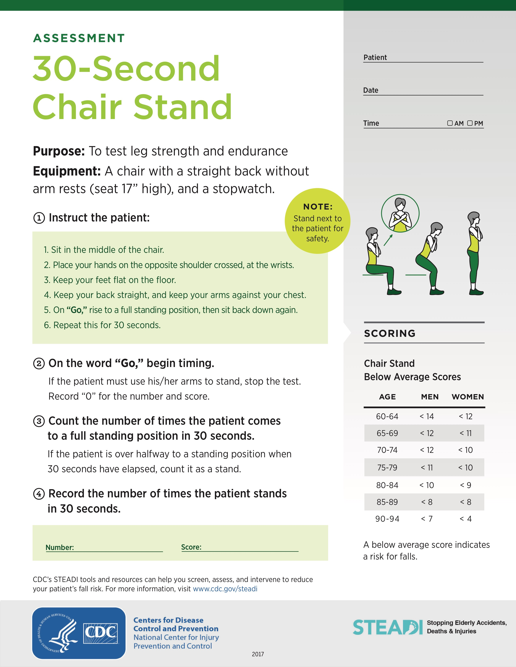
Assessing Fall Risk

Slide 25
Assessing Fall Risk
Count the number of times that you were able to come to a full standing position!

Slide 26
How did you do?

Slide 27
Age Friendly Healthcare: the 4Ms

Slide 28

Rates of Medication Use Increase with Age
Based on a representative sampling of 2206 community dwelling older adults:
  87% use at least one prescription medication
  36% use ≥ 5 prescription medications
In a sample of Medicare beneficiaries discharged from an acute care hospital to a SNF:
  Average number of medications prescribed= 14
JAMA Intern Med. 2016 Apr;176(4):473-82.
J Hosp Med. 2016;11(10):694. Epub 2016 Jun 3.

Slide 29
Unique Challenges for Older Adults
premarketing drug trials often exclude geriatric patients
age-related changes in pharmacokinetics and pharmacodynamics:
  ⬆️ volume of distribution from the proportional increase in body fat relative to skeletal muscle with aging
  ⬇️ drug clearance from the natural decline in renal function with age, even in the absence of renal disease
  ⬇️ hepatic function may lead to variability in drug metabolism among older adults

Slide 30
Risks of Polypharmacy for Older Adults
Use of more medications independently associated with increased risk for adverse drug events (ADE)
Increased potential for drug-drug interactions
Increased possibility of prescribing cascade
Increased difficulty with adherence, especially if compounded by visual or cognitive impairment

Slide 31
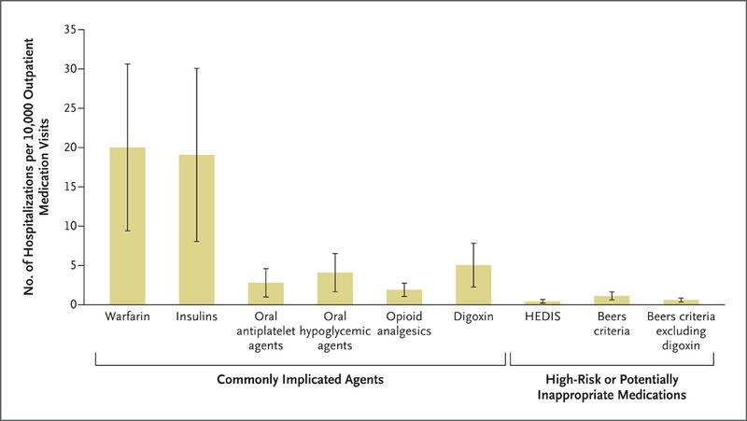
Emergency Hospitalizations for Adverse Drug Events in Older Americans
Notes:
Beers List- first published in 1991 (Dr. Mark Beers was a junior faculty member at UCLA)- based on survey results of a 13 member expert panel – identified by consensus 30 therpeutic classes/medications that should be avoided in older adults living in nursing homes…attention to linking with evidence came in subsequent drafts

Slide 32
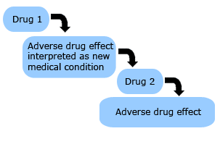
Prescribing Cascade
Occurs when a new drug is prescribed to treat symptoms from an unrecognized adverse drug event related to an existing therapy

Slide 33
Prescribing Cascade Example #1
Cholinesterase Inhibitor (Donepezil Hydrochloride)

Slide 34
Prescribing Cascade Example #1
Cholinesterase Inhibitor (Donepezil Hydrochloride)
Urinary Incontinence

Slide 35
Prescribing Cascade Example #1
Cholinesterase Inhibitor (Donepezil Hydrochloride)
Anticholinergic Medication
(Oxybutinin)
Urinary Incontinence
A prescribing cascade involving cholinesterase inhibitors and anticholinergic drugs. Arch Intern Med. 2005;165(7):808.

Slide 36
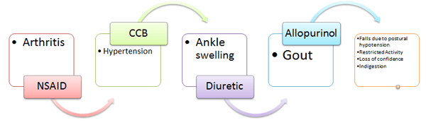
Prescribing Cascade Example #2

Slide 37
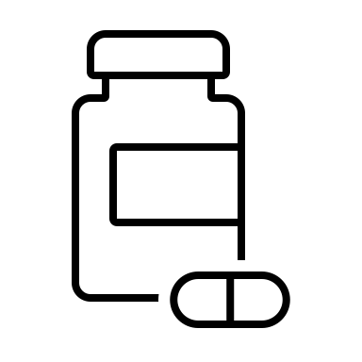

MEDICATIONS
Raise your hand if you have ever taken care of an older patient for whom you have identified the use of inappropriate medications?
Notes:
Current Care Planning: ask what Matters Today
Advance Care Planning: ask what would Matter

Slide 38
Age-Friendly Health Systems Description Worksheet:
Medication
Please take a few moments to recall what your practice was in your primary outpatient clinic in residency
Complete the Medication column in the IHI AFHS Appendix C document based on your recollection

Slide 39
Medication Appropriateness Index
Is there an indication for the drug?
Is the medication effective for the condition?
Is the dosage correct?
Are the directions correct?
Are the directions practical?
Are there clinically significant drug-drug interactions?
Are there clinically significant drug-disease interactions?
Is there unnecessary duplication with other drugs?
Is the duration of therapy acceptable?

Slide 40
Age Friendly Healthcare: the 4Ms

Slide 41
what Matters
How do you ask older adults about what matters to them?

Slide 42
what Matters
Current Care Planning:
What matters most to you? (as opposed to “What is the matter?”)
What gives your life meaning?
What brings you joy?
What are some goals you hope to achieve in the next 6 months?
Advance Care Planning:
Who would you want to make medical decisions for you?
What are your most important goals if your health situation worsens?
Notes:
Current Care Planning: ask what Matters Today
Advance Care Planning: ask what would Matter

Slide 43
Age-Friendly Health Systems Walk Through: what Matters
Please take a few moments to recall what your practice was in your primary outpatient clinic in residency
Complete the what Matters column in the IHI AFHS Appendix C document based on your recollection

Slide 44
What Matters Most: Example of Goal-Aligned Care
Question | Response | Goal-Aligned Health Plan
What matters to you? | “Getting to my grandkid’s soccer game” | Manage chronic pain by measuring ability for your patient to attend granddaughter’s soccer game rather than based solely on a classic pain scale of 1-10

Slide 45

"I have reached an age when, if someone tells me to wear socks, I don't have to."
Albert Einstein (1879-1955)

Slide 46
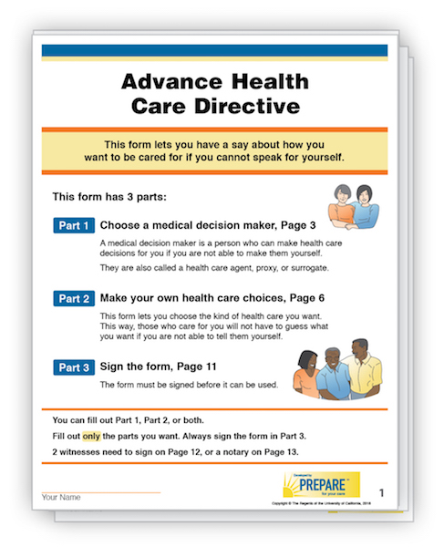
Advance Health Care Directive

Slide 47
Summary
Most of us already do some of the 4Ms some of the time for some of our older patients
The goal of an Age-Friendly Health System is to implement all of the 4Ms reliably for every older adult every day
    Prevent avoidable harms to our patients
    Deliver care that is consistent with what matters most to each older adult and their family

