Slide 1
Geriatrics Fellowship Bootcamp 2021
Welcome to UCSD Geriatrics
Khai Nguyen, MD, MHS, HMDC
Clinical Services Chief
Division of Geriatric Medicine
July 7,2021

Slide 2


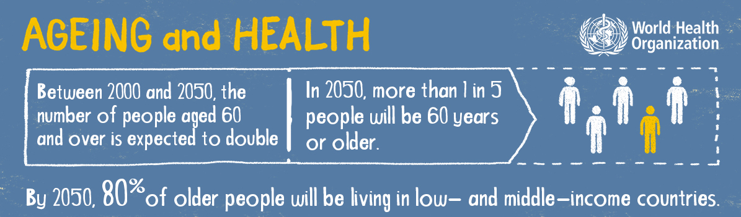

Slide 3
Objectives: Geriatric Service lines
Age-Friendly Health Systems
Outpatient
Inpatient
Home-based
Post-Acute

Slide 4

On to Our Geriatric Adventure!

Slide 5

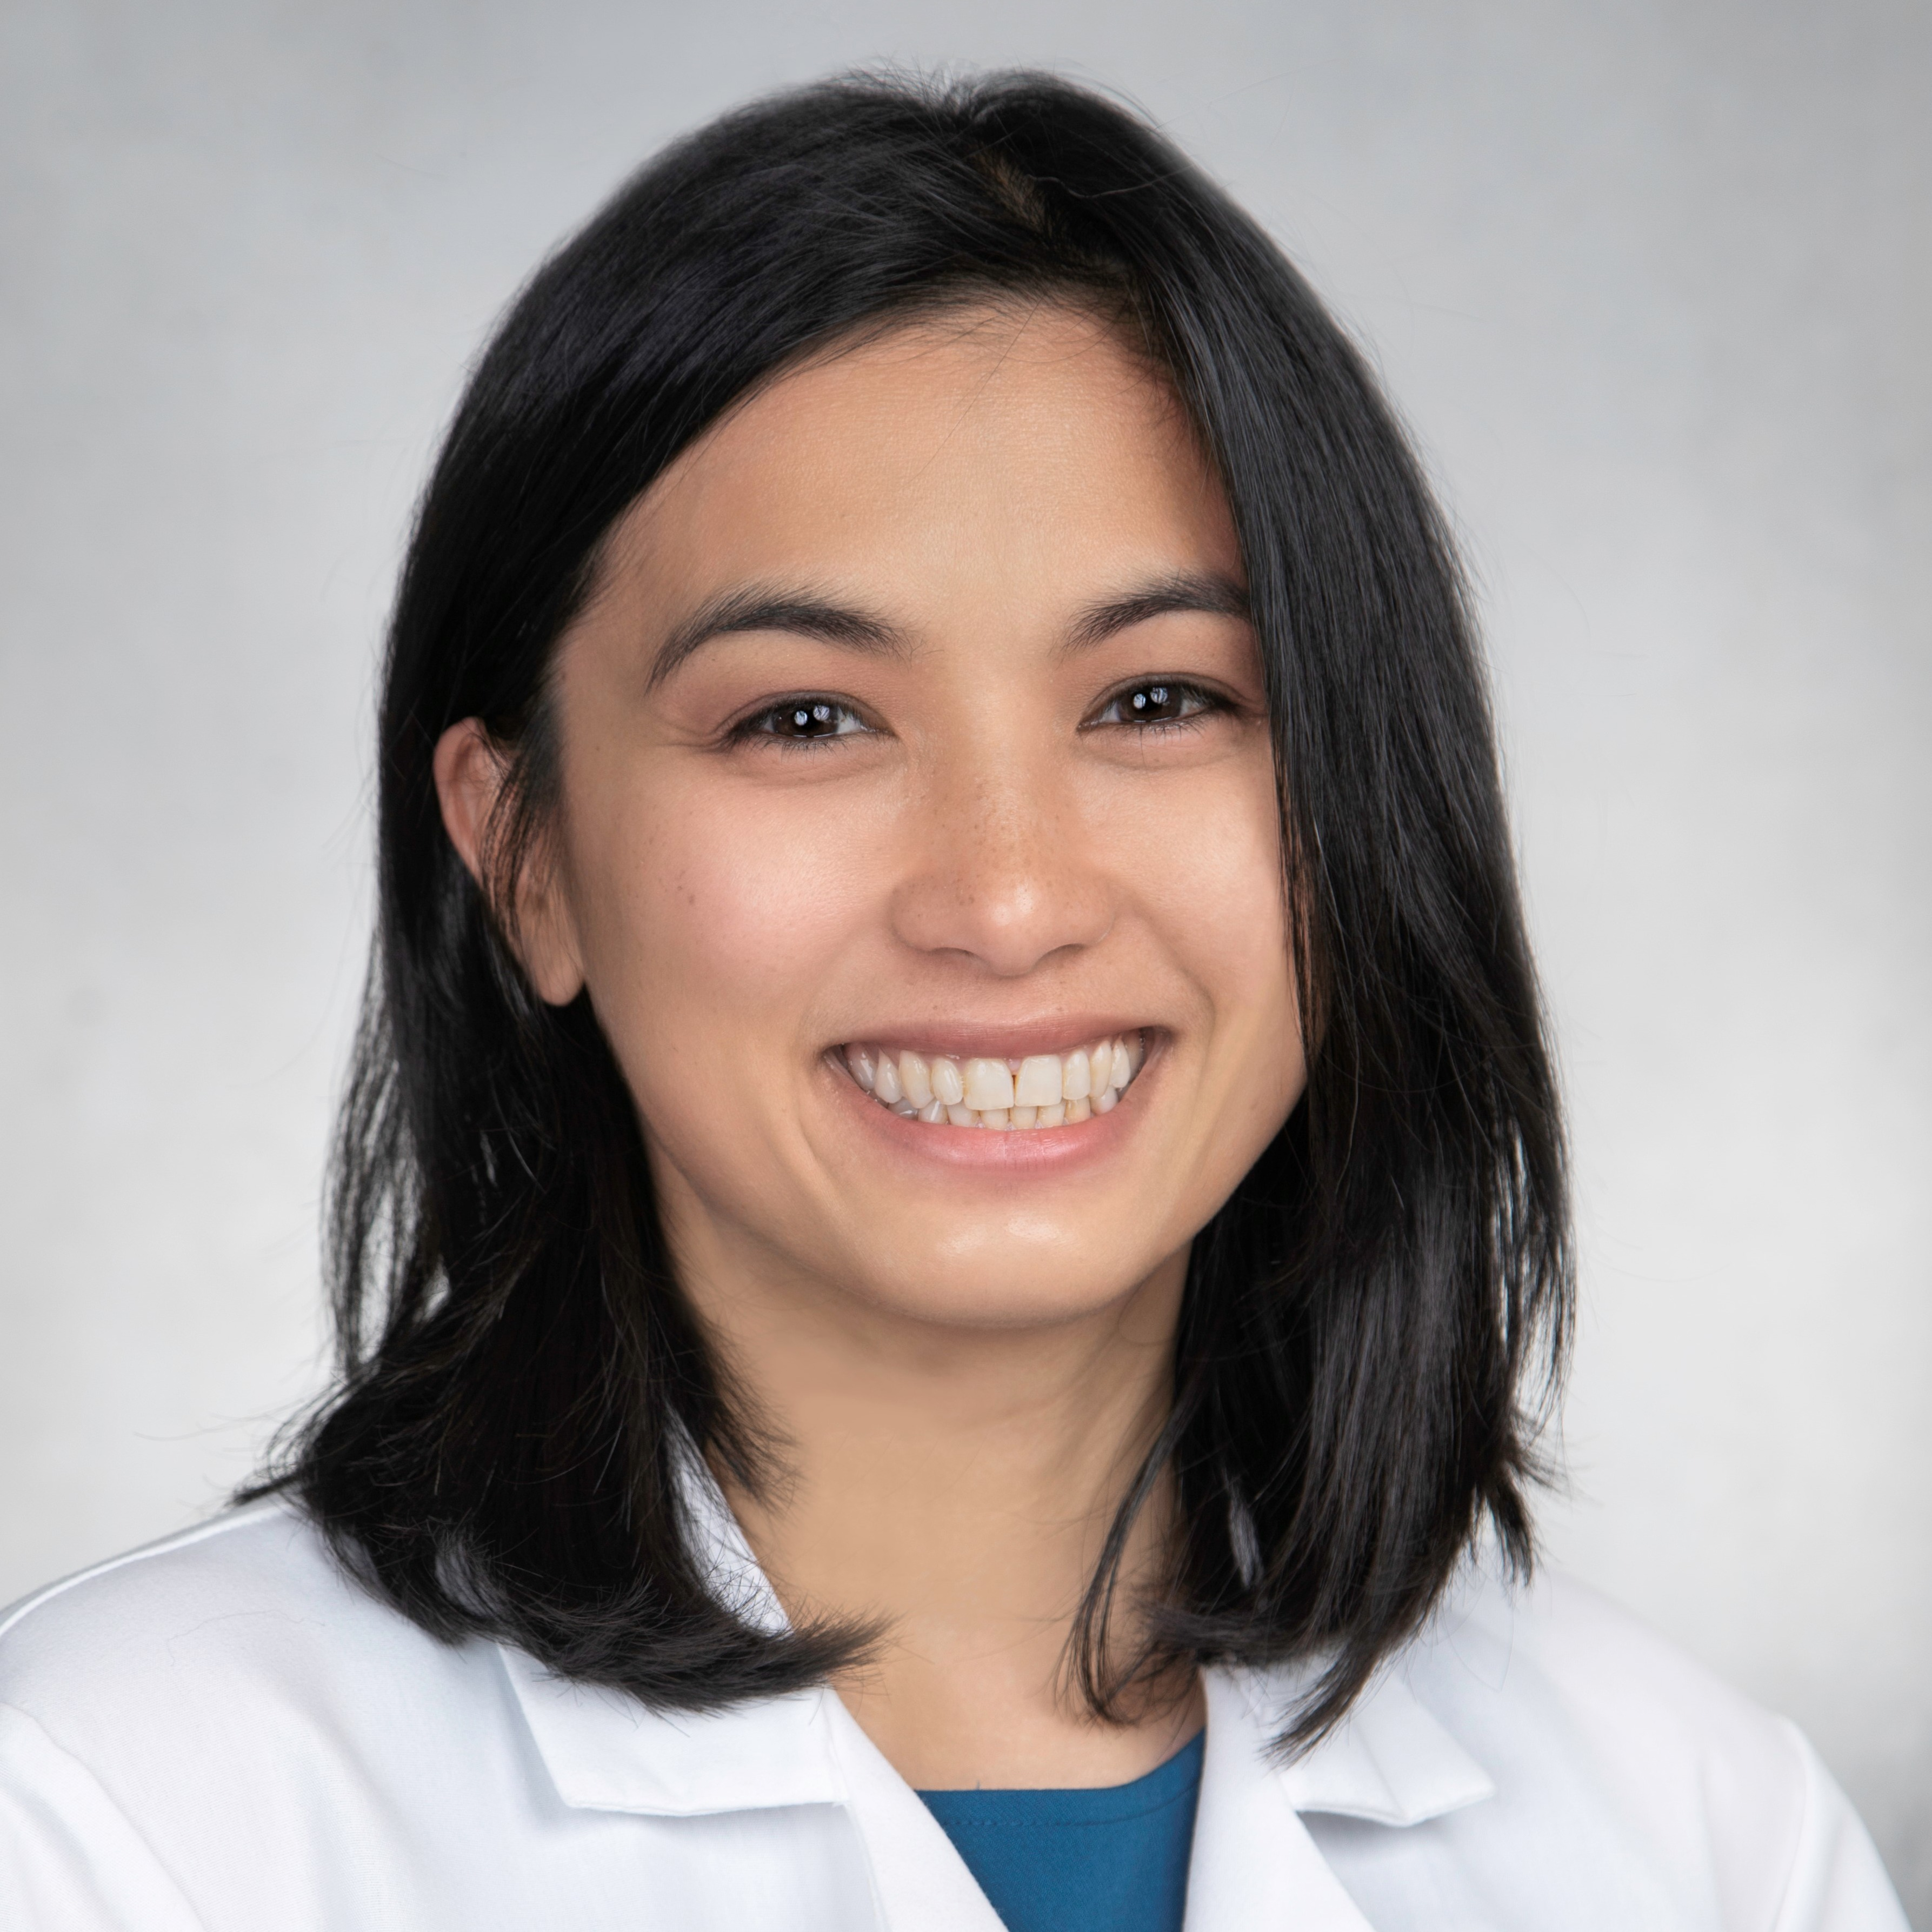
GERIATRICS #13 in USNWR
Among UCSD Health’s Top Specialties

Slide 6
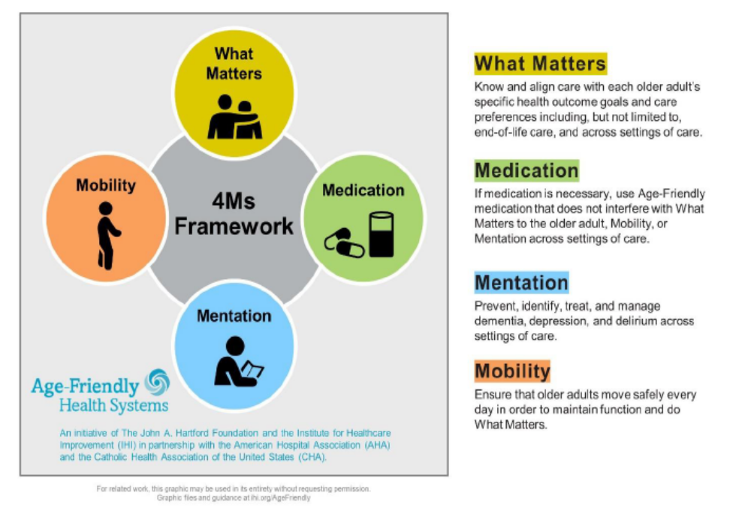
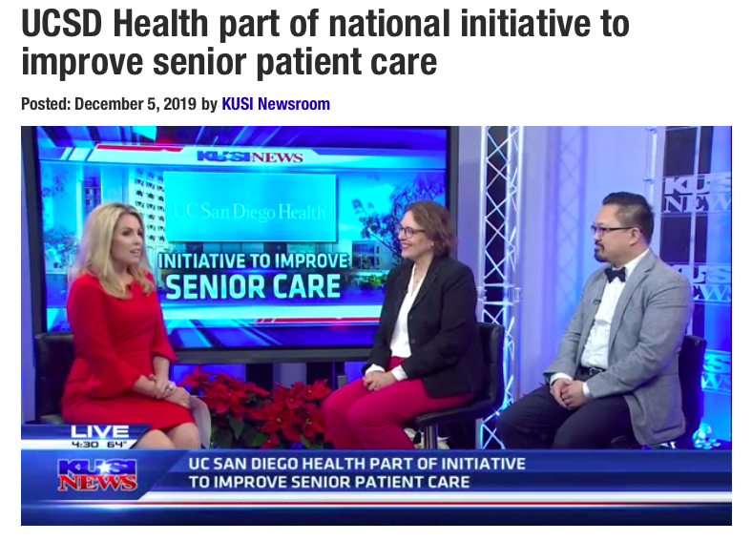
Principals of Age-Friendly Health Systems –
The 4Ms Framework

Slide 7
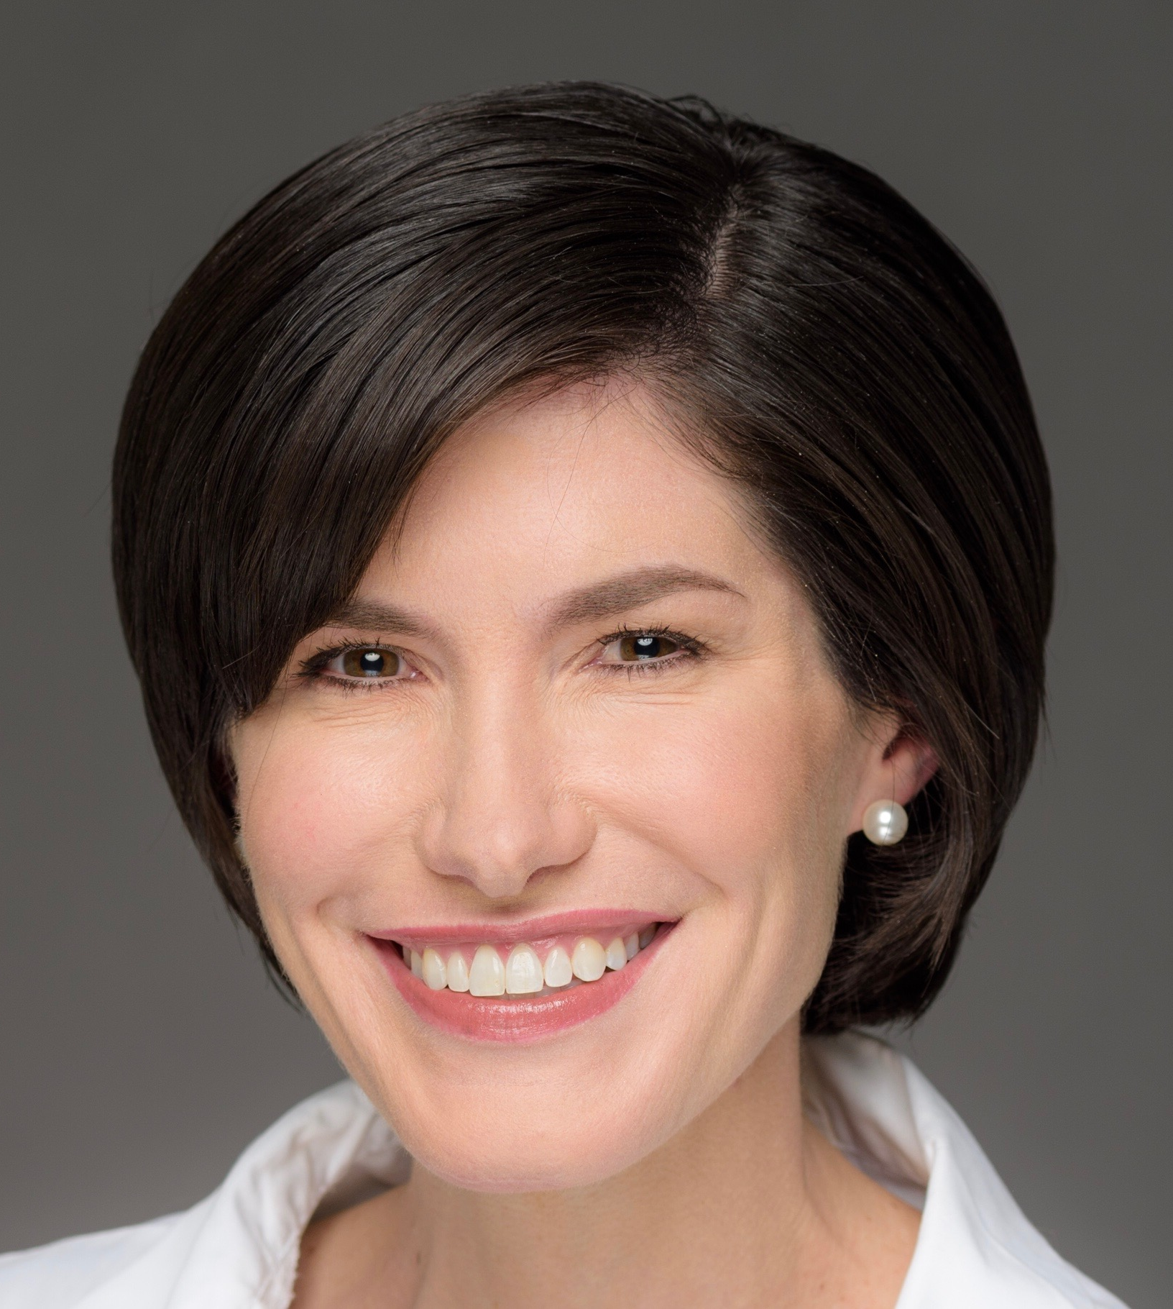
Age-Friendly Health System Medical Director

Slide 8
Geriatrics Programs & Protocols
Existing Inpatient Services:
  Senior Behavioral Health
  Geriatrics Trauma Consults
  Geriatrics HC/JMC Consults
Opportunity:
  Senior Pt Risk Registry
  PHSO Pt Registry

Slide 9
Program | Notes
NICHE Exemplar Status | 200+ Geriatric Resource Nurses Website with wealth of educational resources for institution Elder Care Task Force - semi-annual workshops, abbreviated Beers Criteria, sensory exercises, new tools for staff (hearing assistive devices, activity kits), newsletter…
Trauma Consult Service at Hillcrest | New as of July 2018
Senior Emergency Care Unit (SECU) at Jacobs | Specialized care and resources for at-risk patients age > 65 GENIE nurses – geriatric assessments and care coordination/referrals New space designed to meet needs of seniors and maximize outcomes
Senior Behavioral Health Unit at Hillcrest | Inpatient geriatric psychiatry w/geriatrics consult service – geriatric medicine management of all patients
Telemedicine Program | West Health/West Health Institute telemedicine program w/ local assisted living facilities Weekly clinics w/geriatrician and other providers (geriatric psychiatry, pharmacy, emergency medicine)
Medicine for Seniors | Outpatient Clinic at Perlman (6 PCPs) Primary Care and Consults – patients age 65+
Memory, Aging and Resilience Clinic (MARC) | Referral clinic for comprehensive memory evaluations. Geriatrician present for one session/week Other team members – geriatric psychiatrist, neuropsychologist, social worker

Slide 10
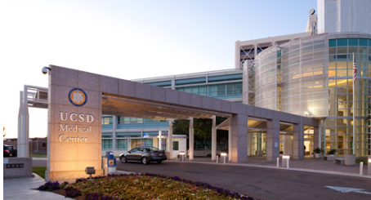
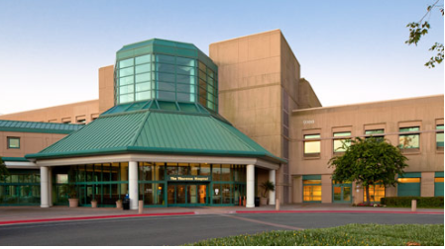

Why Does it Matter to UCSD?
According to FY 2017:
  35% of inpatient patients across facilities are age 65+
  10% are 80+
29%
40%
47%

Slide 11
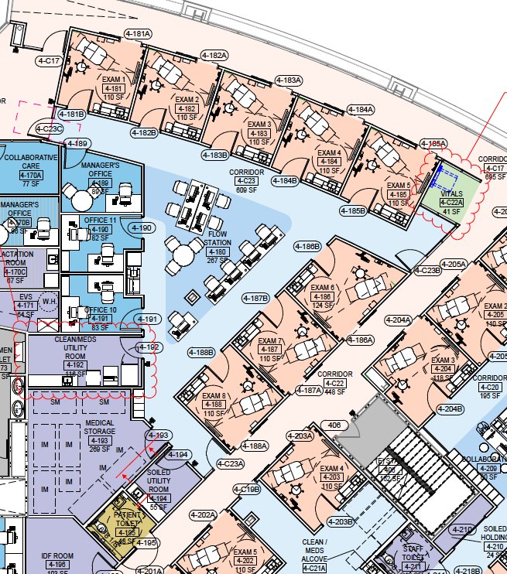
Outpatient
Medicine For Seniors now Geriatric Medicine
  Formerly at Perlman Medical Offices in La Jolla
RCFE – Memory Care / Assisted Living Facility
  Silverado Encinitas
  Silverado Escondido
  Monarch Cottage in La Jolla

Slide 12
Home-Based: UCSD at Home
(Population Health Services Organization)
Physician and NPs doing home visits
  Patients in PHSO
    ACO
    MA

Slide 13
Post-Acute Care: Skilled Nursing Facility Program
(Population Health Services Organization)
SNF – Dr. Aireen Gutierrez & NP
  3 SNFs and growing

Slide 14
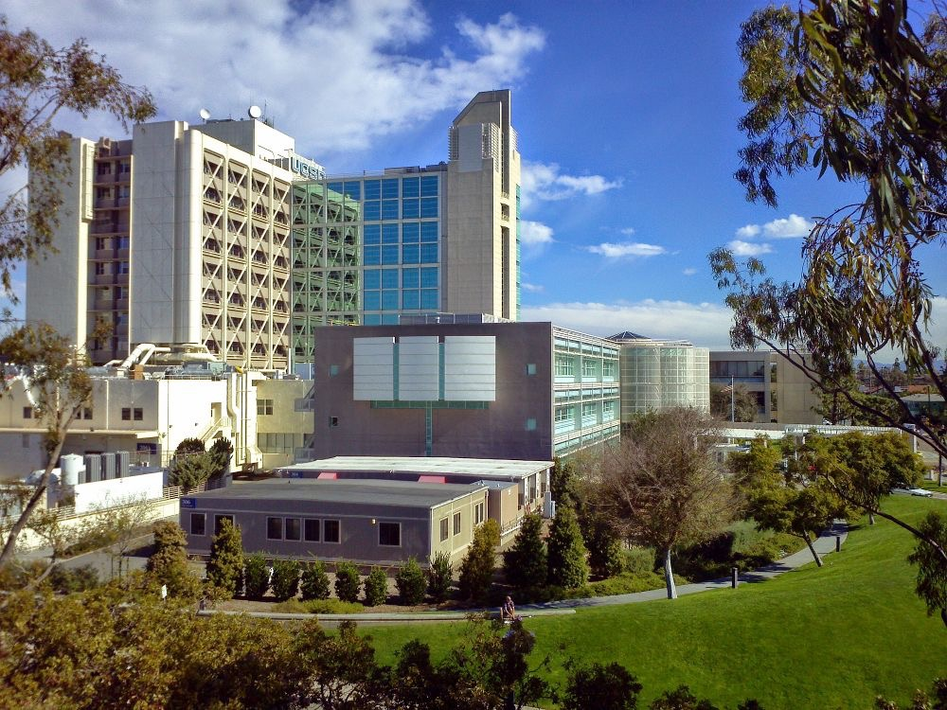
Inpatient
HC: Senior Behavioral Health
Trauma Service
Inpatient Consults
JMC: Inpatient Consults
SECU

Slide 15
Geriatricians, be-aware!
Aging Care and Health Care Challenges
Improve care for the elderly discharging from the hospital
Nearly one in five Medicare patients discharged from a hospital is readmitted within 30 days
Improving care transitions from the hospital to other settings
Reducing readmissions for high-risk Medicare beneficiaries
Document measurable savings to the Medicare program.

Slide 16
Why Do these numbers matter?
90% of Medicare patients die of chronic diseases
Treating this population during the last 6 month of life consumes 1/3rd of all Medicare spending

Slide 17
Geriatrics
THANK YOU

