Slide 1
Senior Behavioral Health
A Primer, by Ian Neel, MD

Slide 2
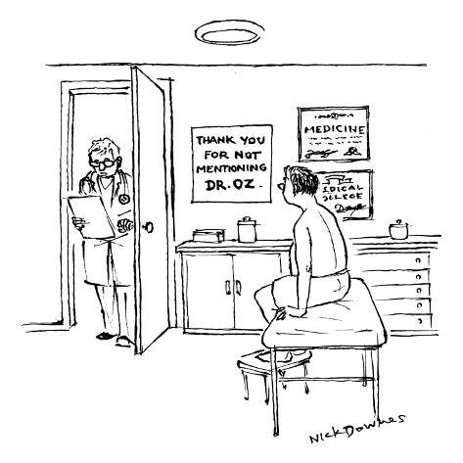
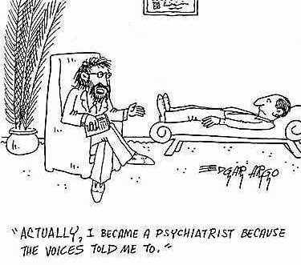
Unit Overview
Co-management Service

Slide 3

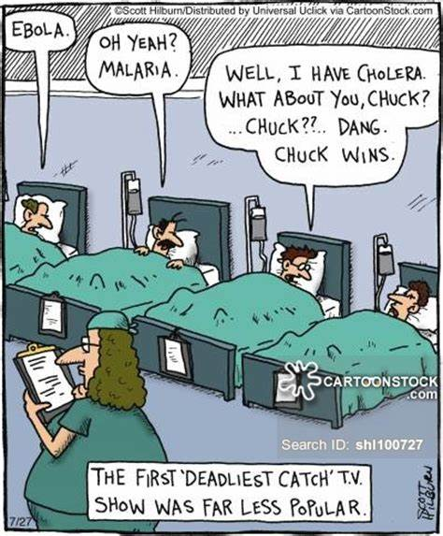
Unit Overview
Interdisciplinary Team
Diverse mixture of patients

Slide 4
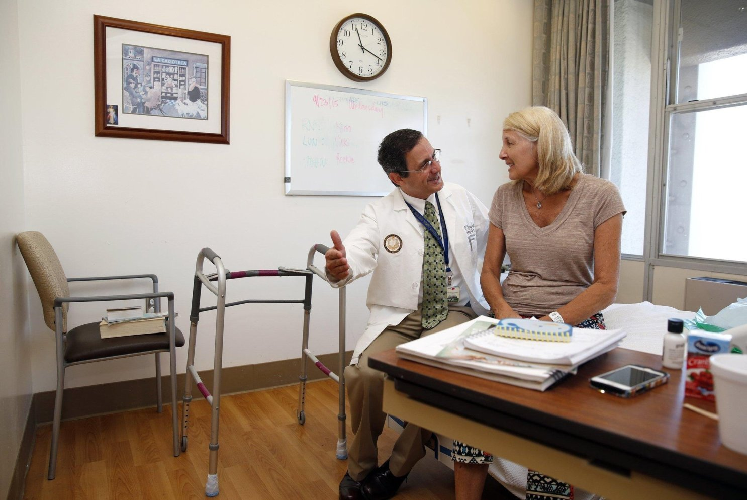
Unit Overview
  14 bed unit
  Only geriatric psychiatry program in San Diego that is supported by both a boarded geriatric psychiatrist and geriatric internal medicine physician
  Well known in the community and even nationwide in leading care for dementia
  Secured unit with no restraint use
    Patient who are high elopement risk or high violence risk do not meet criteria for admission
  Architecturally designed for older adult patients
    Single occupancy rooms
    Bright light
    Handrails
    Special furniture
    Ligature risk in mind

Slide 5
Unit Overview
Groups
  Activities designed for both cognitively intact and those with neurocognitive disorders
    Pet therapy!
  Occupational therapist on staff for programming
Neuropsychological Testing
  Neuropsychologist on staff for testing and individual psychotherapy
Social work services
Goals of Care
Trainees Galore
  Training site for geriatric psychiatry fellowship, UCSD psychiatry residents, Navy psychiatry residents, UCSD neurology residents, occupational therapy students, nursing students, psychology inters/practicum students, number of medical students from University and other medical schools

Slide 6
Key people
Geriatric Medicine Attending, Medical Director, Geriatric consult service at Senior Behavioral Health : Ian Neel, MD
Geriatric Psychiatry Attending/ Medical Director, Senior Behavioral Health: Kavita Demla, MD
Nurse manager: Deborah (Debbie) Crutchfield, RN
Neuropsychologist: Ashley Malooley, PhD
Occupational Therapist: Mariel Schmidt, OT
Social Workers: Anna Belle Beaman, MSW and Benjamin Chon, MSW

Slide 7
Unit Overview
  Now accepting patients on involuntary holds
    Expectation to present during legal proceedings including certification hearings, Riese petition hearings, Permanent Conservatorships hearing, if board certified → involuntary ECT hearings
  Age of admission has been lowered from 65 years old to 60 years old
  Extremely busy service
    Average daily census of 12.3 patients
    Average length of stay: 17.1 days

Slide 8
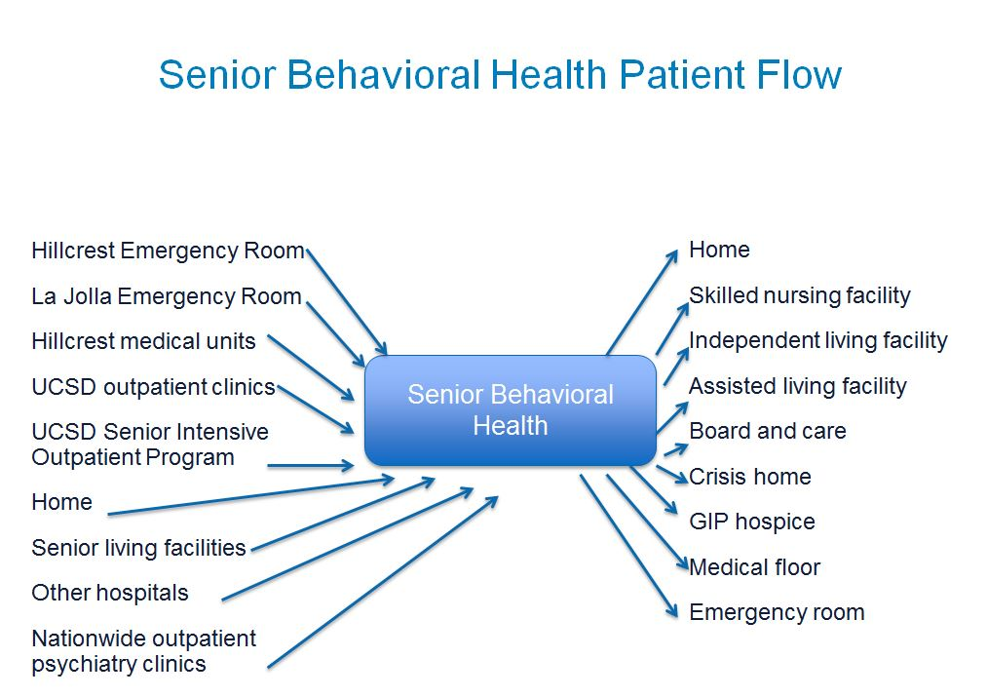

Slide 9
Unit Overview
What’s the difference between co-management and a medical/psychiatric unit?
  Scope of practice
  Room capabilities

Slide 10
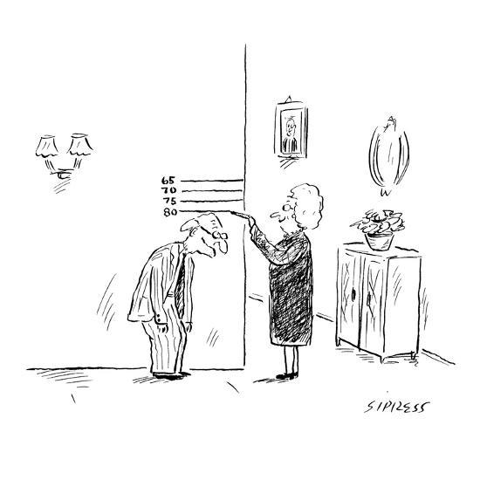
Unit Overview
The typical SBH patient

Slide 11
Fellow Expectations
Geriatric Psychiatry Fellows:
  4 month rotations for each fellow year 2019-2020
  Expectation to be able to run interdisciplinary rounds by mid point in rotation
  Family updates & family meetings
  Oversight and education of residents/medical students on rotation
    Including orientation, teaching and delegating work
  Admissions/ discharges Monday-Friday
  Response to medical emergencies including rapid responses, codes, fall evaluation on the unit
    Potential “transfers” to the medical service
  Court proceedings
  Consultations to other services
  Sign out to night float residents Monday-Thursday
  Presenting for journal club
  ECT training
Geriatric Medicine Fellows:
  6 week rotation
  First three weeks – building up census
  Second three weeks – practicing being an attending
  Responsibilities on rounds
  Regular communication with admissions coordinator for determining medical appropriateness of admissions
  Family updates & family meetings
  Oversight and education of residents/med students on rotation
  Weekly and PRN meetings with geriatric medicine faculty for performance review and mentoring
  Identification of case report-worthy patients for AGS

Slide 12
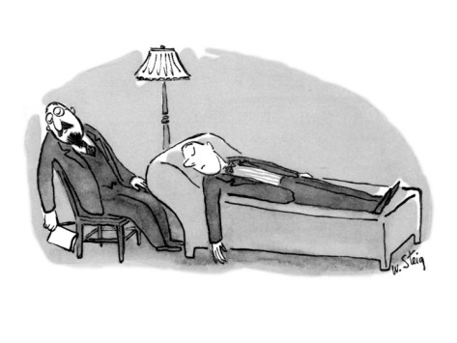
Fellow Expectations
Call
  No call expected for fellows

Slide 13
Epic How-To
Brief orientation to admission/discharge medication reconciliation
When in doubt talk to the attendings! Dr. Neel is always available to discuss/walk you through it

Slide 14
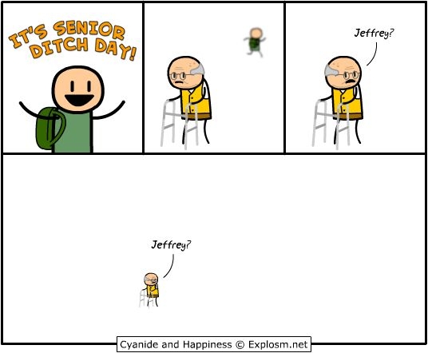
Get To Work!

