Slide 1
Intro to Transitions of Care and the Community Living Center
EB Sladek, MD
Geriatrician, VA San Diego

Slide 2
Overview
Brief overview of transitions of care
Review post-hospital discharge options
Brief review of post-acute payment structure

Slide 3
Transitions of Care
____% of hospitalized patients ≥ 65yo discharge to a care facility
____% of Medicare SNF patients are readmitted to the hospital
Those with chronic conditions (125 million) see ____ MDs/year
More than half of hospitalized Medicare patients see _____ or more MDs during their stay
21%
25%
16
10%
National Transitions of Care Coalition

Slide 4
Perils of Transitions of Care
1.5 million harmed by medication errors → | 3.5 Billion annually
1 in ____ patients have been found to have medication discrepancy on hospital discharge
1 in ____ patients discharged home from hospital have adverse event within 3 weeks
_____% of these are avoidable medication-related events
3
5
60%
National Transitions of Care Coalition

Slide 5
“Transitions of Care” papers in Pub Med

Slide 6
Transitions of Care
The term ‘medication reconciliation’ is relatively new and was coined in 2005 when National Patient Safety Goal (NPSG) 8 was introduced by The Joint Commission.
Up to 80% of serious medical errors involve miscommunication during the hand-off between medical providers.
Solet DJ, et al: Lost in translation: challenges and opportunities in physician-to-physician communication during patient hand-offs. Academic Medicine, 2005;80:1094-9

Slide 7
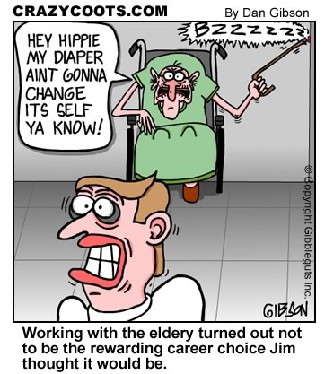
What is a Nursing Home?

Slide 8
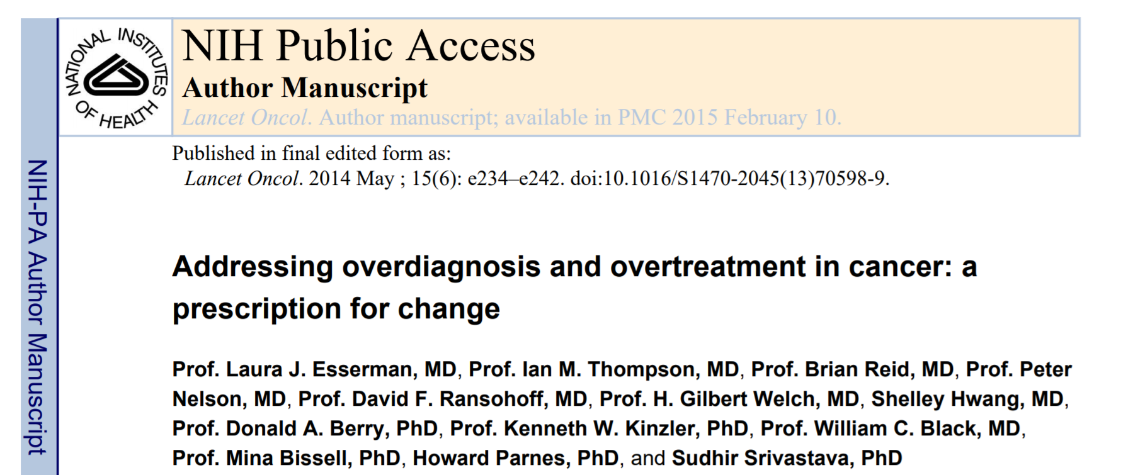
What’s in a name?
IDLE: “indolent lesion of epithelial origin”
Important to be precise and sensitive with our language
Notes:
https://well.blogs.nytimes.com/2013/07/29/report-suggests-sweeping-changes-to-cancer-detection-and-treatment/

Slide 9
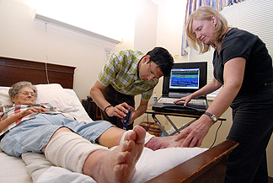
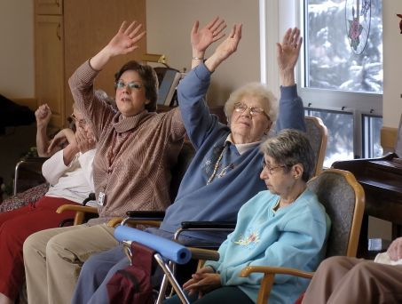
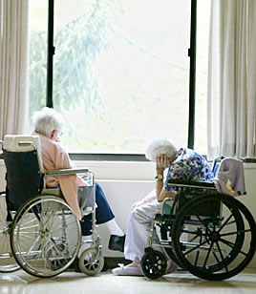

Options for Hospital Dispo

Slide 10
Let’s take an example
Mrs. B: 70yo woman history of COPD, hypothyroidism, and osteoporosis falls and breaks her hip.
Admitted to medicine because of her “complicated medical history”
POD #4 s/p ORIF
Medically stable – vitals normal, CBC/lytes normal
What now, boss?

Slide 11

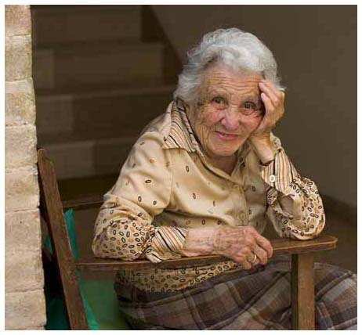
Which of these would be the best dispo?
A) Long Term Acute Care Facility
B) Acute Inpatient Rehab Facility
C) Subacute Rehab Facility
D) Skilled Nursing Facility
E) Home with Home Health Care
F) Hospice
G) Stay in the hospital forever
H) Take her home with you

Slide 12


What else do you want to know?
Prior level of function
Pain control?
Last BM?
Home environment?
How well has she progressed with PT?
Is she motivated to do rigorous PT?
Any other active medical problems?

Slide 13
Medicare Part A: Sites of Care
High
Acute Inpatient Hospital
LTACH
Hospice
Intensity of care needs
IRF
Sub-Acute
SNF
Low
Home Health

Slide 14
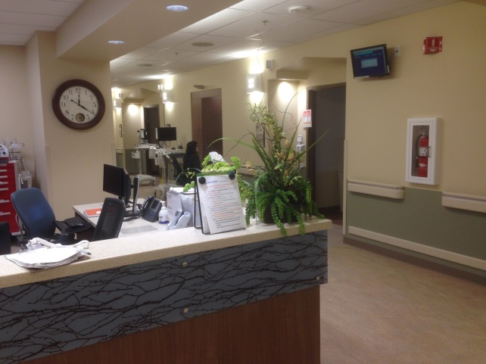
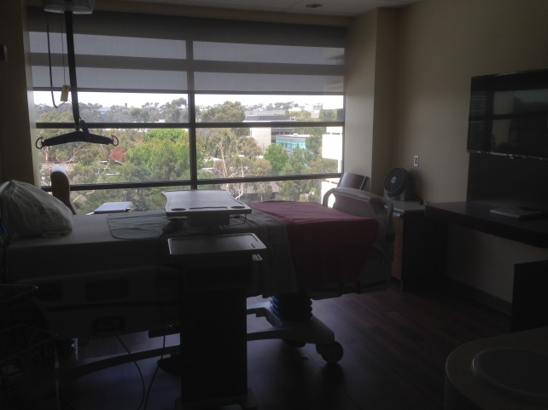
Community Living Center
(CLC)

Slide 15
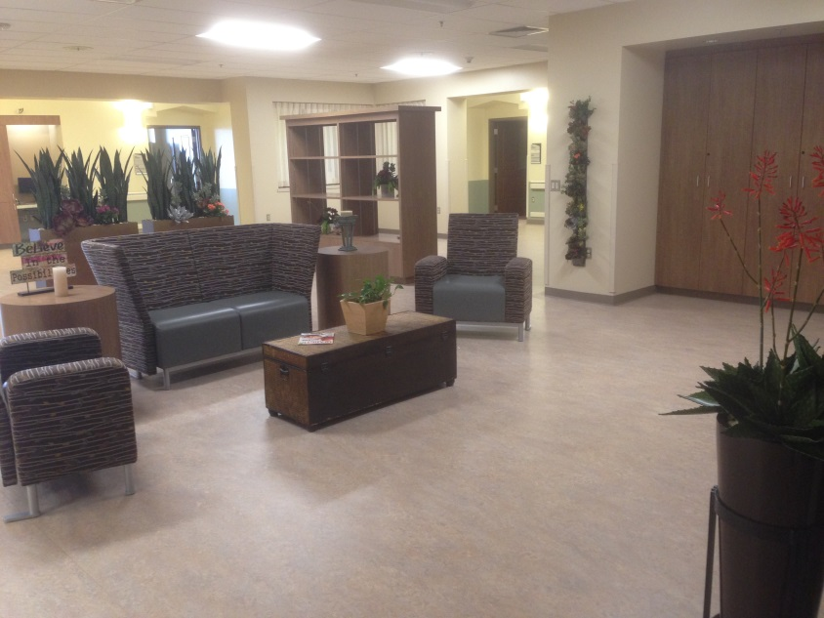
Community Living Center (CLC)
A Community Living Center (CLC) used to be called a VA nursing home. Also referred to as Geriatrics and Extended Care
A unit where Veterans receive nursing home level of care
Veterans may stay for a short time (for skilled needs) or long term (for custodial care)

Slide 16
CLCs Nationwide
132 VA Community Living Centers across the united states
Usually are on or close to the campus of a VA medical center
Community Living Centers provide SNF level of care:
  Short-term skilled nursing care (e.g., wound care or IV care)
  Short-term Restorative care and physical and occupational therapy
  Some have long term custodial care

Slide 17
When there’s NOT a pandemic, Community Living Center resembles "home" as much as possible.
    There are recreational activities (bingo, poker, happy hour, pet therapy)
    There are family friendly places for visiting.
    Veterans are invited to decorate their rooms.
    Visiting hours are not restricted.

Slide 18
VA San Diego CLC
Located on 4th floor South wing
3 sub-units:
    Palliative care beds (12 beds) ➔ MD,NP, Geriatrics fellow
    Skilled nursing beds (18 beds) ➔ MD,NP, Geriatrics fellow
      4 beds can swing to inpatient rehab → PMRS
**CARF/CIIRP (Comprehensive Integrated Inpatient Rehabilitation Program) Specialty Program.

Slide 19
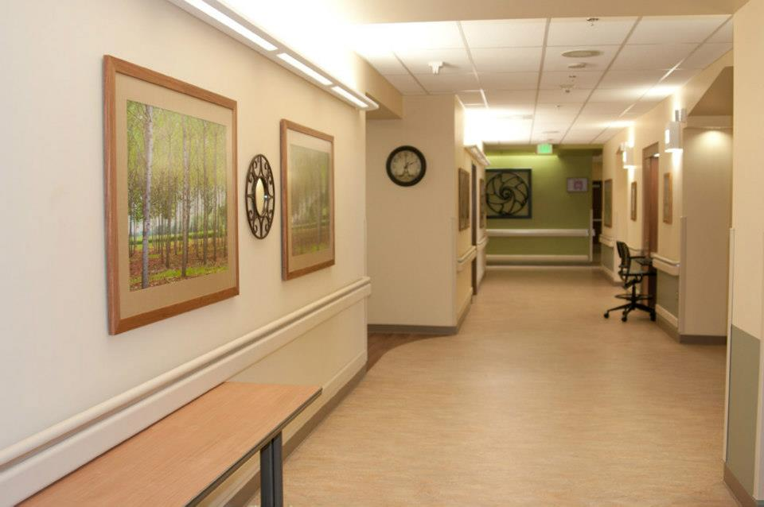
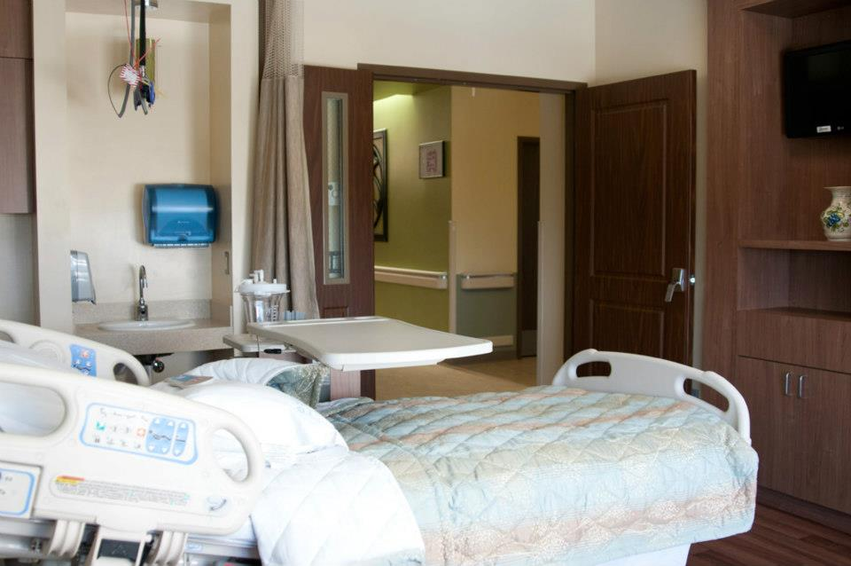
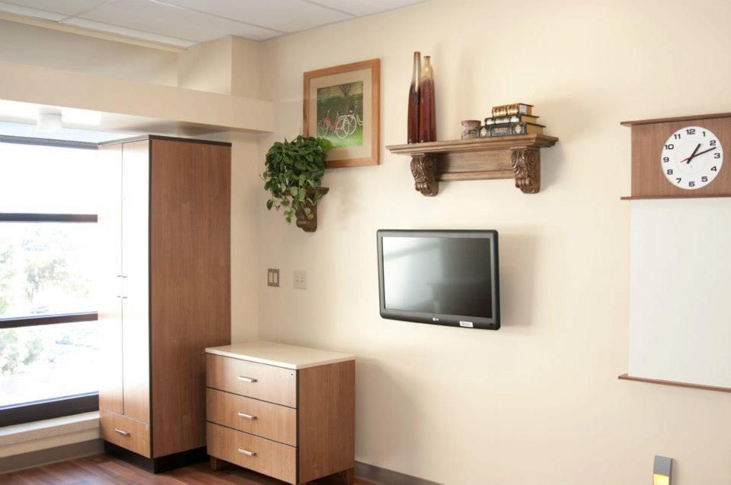
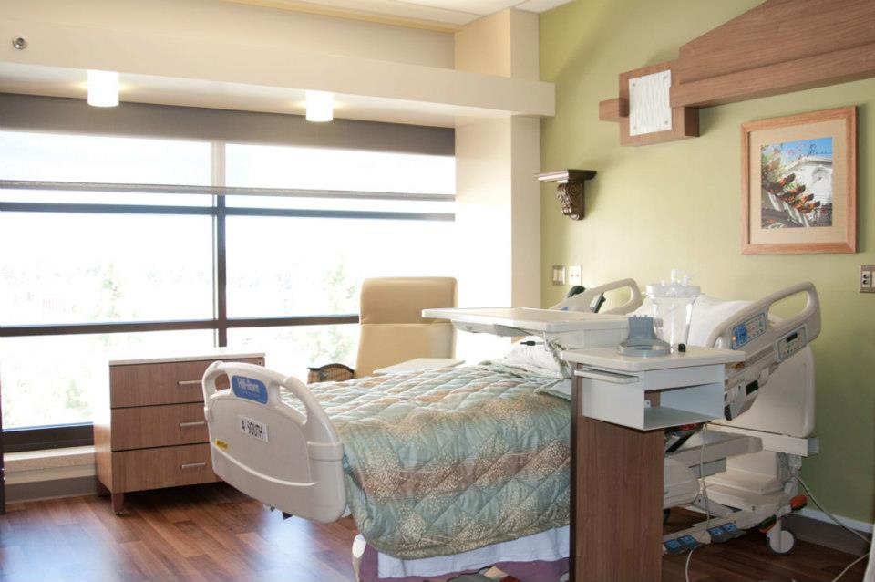

Slide 20
VA San Diego CLC
Patients generally followed by Nurse Practitioners (NP)
UCSD Geriatrics fellows follow their patients independent of NPs
Patients are covered at night (7p-7s) by nocturnist hospitalist
Patients are covered during holidays and weekends by NPs

Slide 21
VA San Diego CLC
No admissions during weekends or holiday
No provider on-site on weekends and holidays (on call at home). (No weekend calls for fellows)
Labs done ≤ weekly
Consultant services can follow patient when they are transferred to CLC

Slide 22
Services available in CLC:
  Nursing
  Physical, Occupational and speech therapy
  Recreational therapy
  Nutrition
  Psychology
  Pharmacy
  Chaplain services
  Social Worker
Sub-speciality services can be consulted (surgery, nephrology,…)

Slide 23
Interdisciplinary Team Meeting
There are interdisciplinary rounds and care planning meetings on CLC (Tuesdays at 10:00)
Patient due for care plan are discussed in depth with the entire team
A note is written by provider

Slide 24
The IDT conference focuses on:
  Establishing the patient’s progress toward medical goals
  Considering possible resolutions of any problems that could impact the patient’s progress toward these goals
  Reassessing the goals previously established, if needed
  Monitoring and revising the treatment plan, as needed

Slide 25
Consulting for CLC Admission
A consult is placed in CPRS. To place a consult:
  choose COMMUNITY LIVING CENTER
  click CLC rehabilitation (do not choose CARF/CIIRP)
Consults are placed from different services within the VA and occasionally for veterans that are in other facilities
The consult is reviewed, evaluated, and a decision is made
If eligible and a candidate, will accept and transfer/admit.(will need discharge summary)

Slide 26
2017
325 consults placed and reviewed
147* admissions
Average length of stay was 24 days

Slide 27
Key elements to consider for admission to 4S-CLC
Is there a skilled need?
Can the patient get that care somewhere else?
  Other insurance? VA Contract Nursing Home?
Is the patient medically stable to be in SNF level of Care?
Are there Beds available, are there enough RNs in CLC?

Slide 28
SNF level of care
Patients should be medically stable and appropriate for SNF level of care
Need tele monitoring | Chronic vent
Need daily labs | Peritoneal Dialysis
Need IV pain medication | PCA
Need Neuro-checks | Airborne Precautions
Are neutropenic | Large bore chest tubes
Have central line | Need Strict I&O’s
Vital signs more often than Q8 hr | Medication more frequent than Q4 hr
Not a candidate

Slide 29
IV Antibiotics
Is it Necessary?
  PO option?
  Need ID consult
Can it be done at home home or SNF?
  Home with PICC/home health
  (patient or family be able to follow instructions)
  At SNF in community
  (Medicare will pay 20 days only)

Slide 30
Wound care
Is it Necessary?
  Complex wound, need special care
  >1 x day dressing change
  +/- Wound VAC
Can it be done at home or SNF?
  Home with home health (patient or family be able to follow instructions)
  Outside SNF (Medicare will pay 20 days)
      Home with Home Health with WV ➔VA pays
      SNF with WV ➔ VA doesn’t pay, Medicare does
Wound VAC::

Slide 31
Physical Therapy
Is it Necessary?
  Will veteran benefit? Will he improve?
  Are goals realistic and achievable?
  NEED PT and/or OT consult and evaluation before considered
Can it be done at home or SNF?
  Home with home health (patient or family be able to follow instructions)
  Outside SNF (Medicare will pay 20 days)

Slide 32
Placement
4S-CLC does not admit veterans for long term (custodial) care
4S-CLC does not admit veterans who have no skilled needs
4S-CLC does not admit veterans whose primary need is Psychiatric
4S-CLC does not admit veterans for pre-placement if discharge plan is not clear

Slide 33
Placement
Examples that get rejected:
  Homeless veteran who just got a ICD placed, primary team worried that will get infected on the street
  Homeless patient with multiple admissions for CHF, primary team want to educate about diet and medication compliance and “observe him for a while”
  Veteran who needs mental rehabilitation
  Veterans who refuse to work with physical therapy

Slide 34
Geriatrics Fellows role in CLC
Fellows will admit, manage and discharge the patient under supervision of the attending on that service.
Fellows are expected to write complete History and physical, weekly progress note, interdisciplinary team notes and discharge summary notes.
Fellows are expected to communicate effectively with consultant services
Fellows will attend interdisciplinary rounds and care planning meetings on CLC (Tuesdays at 10:00)

Slide 35
Geriatrics Fellows role in CLC
Each fellow will have 3-5 patients.
Fellows are expected to answer their pages(or cellphone) from 7am to 7pm Monday to Thursday regarding their patients.
During Fridays, Saturdays and Sundays the attendings and nurse practitioners will cover the patients.
Pts are covered at night by medicine nocturnist attendings.
It is expected that fellows start at 7:00a with the daily nursing report.

Slide 36
Geriatrics Fellows role in CLC
Fellows will be responsible for reviewing and evaluating requests for admission to CLC according to admission and exclusion criteria(under supervision of attendings)
Fellows are expected to attend internal medicine discharge rounds everyday at 8:15a, to discuss possible candidates for admission from other services.
It is expected that fellows actively participate in teaching and educational activities (teaching IM/FP and med students that rotate in CLC, case presentations, QAPI initiatives)

Slide 37

Welcome! We can’t wait!!

