Slide 1


V.A. Home Based Primary Care (HBPC)
Richard T. Nguyen, MD FACP
Medical Director, Home Based Primary Care (HBPC)
richard.nguyen2@va.gov Cell 619 436-6994

Slide 2
Medical CaRe Geography
Acute
Hospitalization
Primary Care Ambulatory Clinic
Home Based Primary Care
Post-Acute Care
(SNF)

Slide 3

VA Home-Based Primary CARE (HBPC) OVERVIEW
National Initiative, Department of Veterans Affairs, Veterans Health Administration (VHA), VHA Handbook 1141.01

Slide 4
WHAT IS va Home Based Primary Care (HBPC)?
Comprehensive longitudinal Primary Care delivered in the home
Multidisciplinary Team: Provider, Nurse/Case Manager, Social work, Psychologist, Rehabilitation Specialist, Dietition, Pharmacist
Serves Veterans with serious chronic, disabling disease
When routine clinic-based care is not effective
For those “too sick to go to clinic”

Slide 5
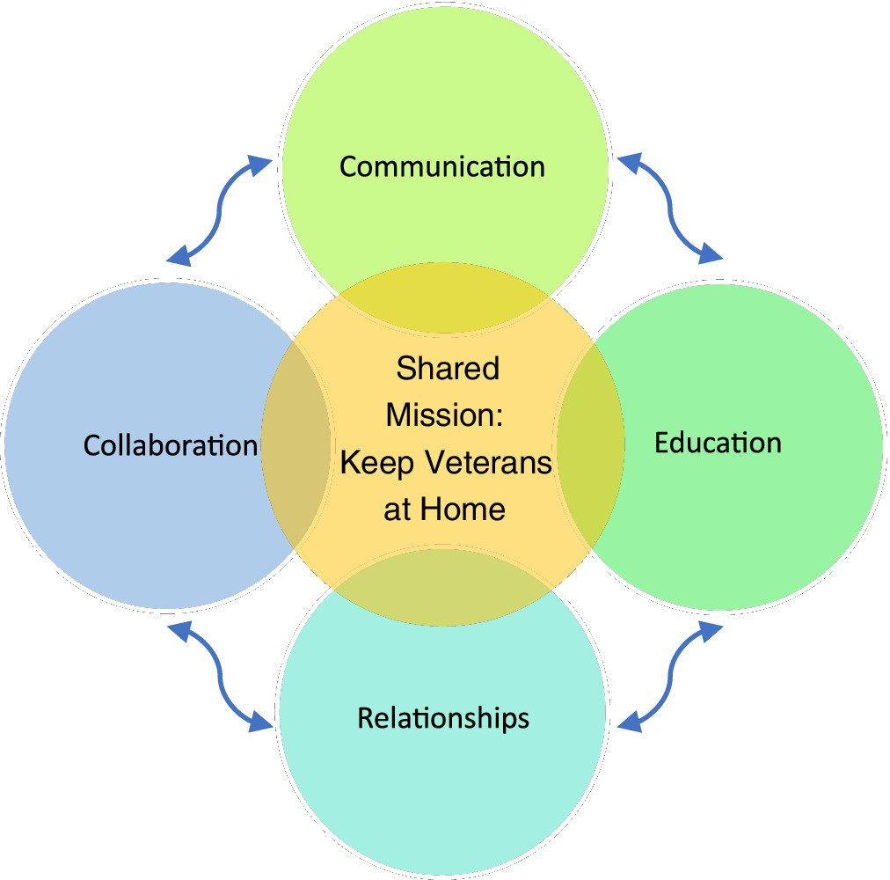

Slide 6
Home Care Medicine
Care of Complex Patient At Home: develop and oversee patient-centered care plans with patients related to their health and condition(s) and expected or realistic trajectory with emphasis on personal goals, such as prolonging life, function, and achieving rehabilitative or palliative aim
Medication Management: Use evidence-based practices to maximize medication adherence, identify undesired medication effects and adverse drug reactions, eliminate medications that are no longer effective, are duplicative, carry a greater burden than benefit, and/or no longer have an indication, and to offer all medically indicated, appropriate medications
Functional Impairment and Rehabilitation: Recognize and manage the care of functionally impaired patients at high risk for poor outcomes, including those with falls, deconditioning, skin breakdown, hip fracture, fraility, dysphagia
Cognitive, Affective, and Behavioral Health
Caregiver Assessment and Support
Patient and Staff Safety:
Interprofessional Care, Communication, and Professionalism
Palliative and End of Life Care

Slide 7
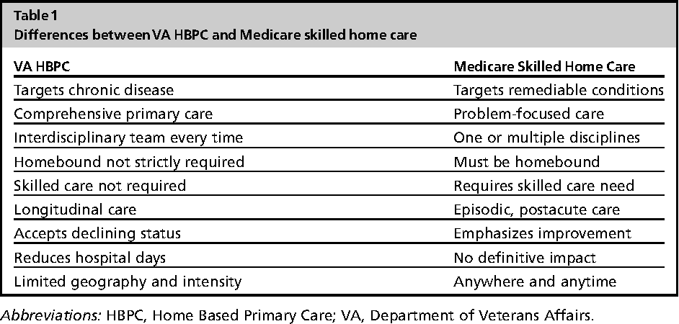

Slide 8
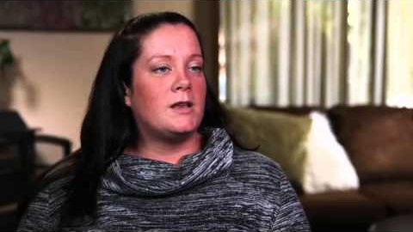

Slide 9
Work Load and Learning ACTIvities
Own patient panel of 8 to 12 patients with goal to see 5-6 patients once a week and continue to follow-up/see patient panel list at least once a quarter and may see and interact with those patients more frequently if needed. Will use V.A. Government Vehicle
Weekly IDT(Interdisciplinary Team Meeting): Tuesdays 8am-11am
Collaborate and work with other disciplines for broaden views and care coordination logisitics (i.e. Nurse Care Manager, Social Work, Physical Therapy)
Sit down didactics covering essential topics including Medical Home Care Models, American Academy Home Care Medicine Competencies, Screening Tools and Metrics

Slide 10
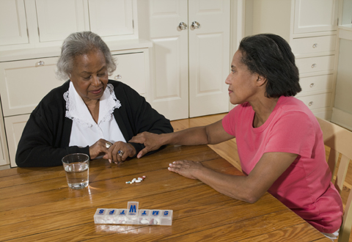
GoALS and ACHEIVEMENTS for V.A. HBPC
Solidify Attitudes, Knowledge, and Skills to Practice Effective and Safe Home Care
Work Collegially and Collaboratively with Multi-Disciplinary HBPC Team
Preserve the bedrock of Primary Care which is longitudinal care (build and own your patient panel and will continue to follow with your panel throughout the academic year)
Gain experience with V.A. Health Care Delivery System
Have Fun and Enjoyment with self rewarding intangibles

Slide 11

Questions? richard.nguyen2@va.gov
Cell 619 436-6994

