Slide 1
Intro to Geriatrics Quality Improvement (QI) Curriculum
Lindsey Yourman, MD
Associate Clinical Professor
Medical Director of Geriatrics Quality Improvement
UCSD Division of Geriatrics, Gerontology, and Palliative Care
7.7.2022

Slide 2
Introductions
Name
Prior formal QI instruction
Something that bothers you or that you would change about the healthcare system for older adults
What you hope to gain from QI curriculum
Notes:
[ ] review prior email with fellow details/background

Slide 3
My QI Path
Know-Do Gap in Geriatrics
  PACE
UCSD, start Geriatrics QI Science Fellowship
  UCSF Implementation Science Certificate

Slide 4
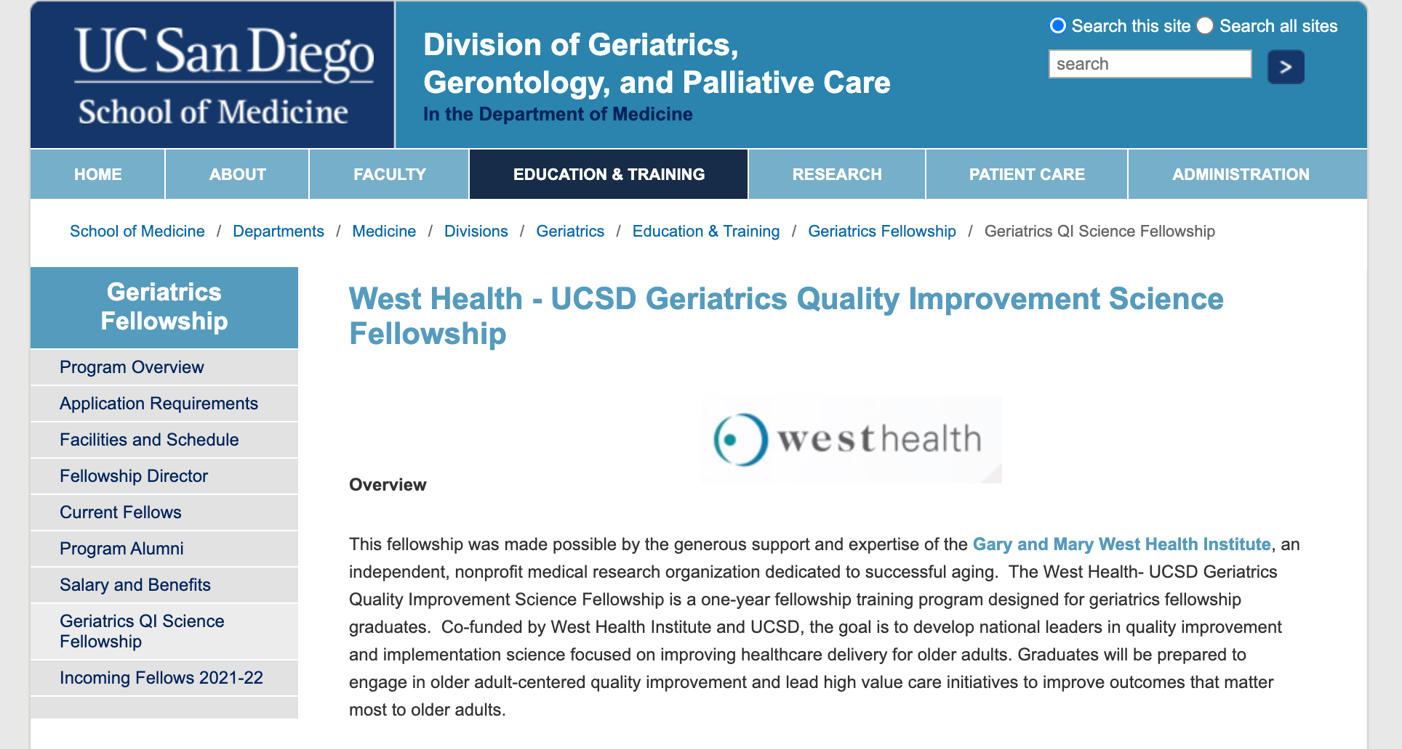
Geriatrics QI Science Fellowship
Geriatrics QI Science Fellowship (ongoing opportunity)
  1 year of training designed to develop national leaders in Geriatrics Quality Improvement Science

Slide 5
Geriatric QI themes
Identify and measure person-centered outcomes that matter most to your older patients
Consider how health system quality improvement metrics can harm older adults, ageism in healthcare, and other healthcare disparities among older adults
Learn how to leverage health system priorities and quality metrics in order to advocate for what your patients care about
Implementation Science: learn how to make it easier for all of us to do the right thing for older adults

Slide 6
Agenda
Overview of QI Curriculum
QI vs. Research
Lean approach to QI
  Initial State and Patient Safety
Next Steps for QI Learning and Project

Slide 7
Overview: Objectives
Purpose: Empower you to close the Know-Do Gap (aka Evidence-Practice Gap) in healthcare for older adults and lead Age-Friendly Health System transformation
Objectives:
Understand the difference between QI and Research
Use a systematic approach to complete a QI project with Group ACP (Lean, A3)
Optional:
Submit a QI abstract to AGS (December 2022)
Submit a QI abstract to UCSD GME QIPS Conference
Present your QI project at Geriatrics Grand Rounds (June 2023)

Slide 8
QI Learning
Monthly Didactics
  Systematic Approach to QI
Experiential Learning
  Required QI Group Project:
    Shared Medical Appointments for Advance Care Planning
  Optional QI Project:
    VA panel-based
    Population Health Committee
    Other

Slide 9
Overview: Didactics and Experiential Curriculum
Date | Didactic | Experiential
July 2022 | Intro to QI, Initial Condition Module: Age-Friendly Health System Module | Learning: Age-Friendly Health System Walkthrough Learning: VA Panel Metrics
August 2022 | Problem Statement | ACP Project: Intro to Group Visits for Advance Care Planning
September 2022 | Target Condition | ACP Project: Advance Directive, Advance Care Planning Module
October 2022 | Performing a gap analysis (Patient Safety) and Proposing Countermeasures (writing QI abstract) | Presentation: Patient Safety Case ACP Project: Gap Analysis
November 2022 | Making a Plan | ACP Project: QI abstract for Group ACP work
December 2022 | No formal Didactics this month Module: Health Equity | Conference Abstract submissions: GME (required, Date TBD), AGS (QI abstract optional)
January 2023 | Results (Check) and Next Steps (Act)
February 2023: | Continuous Quality Improvement and Team Science
May 2023 | No formal Didactics this month | Conferences: GME (required, Date TBD), AGS
June 2023 | Wrap Up | Presentation: Geriatrics Grand Rounds (optional)

Slide 10
Classical Research vs. Quality Improvement
 | Classical Research | Quality Improvement
Primary Goal | To discover widely generalizable knowledge e.g., Does X improve a specific outcome compared to patients without X? X = e.g., drug, procedure, tx narrowly defined, etc. Specific outcome = e.g., sx, health outcomes, patient behavior | To bring new knowledge into daily practice e.g. Does X improve a specific outcome compared to before we had X here? X= e.g. process change, training, work-flow redesign, etc. Specific outcome = e.g., health outcomes, cost/efficiency/process measures at system level
Hypothesis | Stick with it until bitter end | Adjust through multiple PDSA cycles to work out kinks
Method | Qualitative, Quantiative Unit of analysis, randomization level = patient | PDSA (Plan-Do-Study-Act) Unit of analysis: patient or system measures (may not involve randomization)
Duration | Longer, Data collection for definitive results | Short, Rapid tests of change
Sample | Representative | Unit level
Informed consent | Must be obtained if human subjects are involved (or justified to waive) | Generally not required
Biases | Control for as many biases as possible | Embrace context/stabilize biases from test to test
Tests | One large blind test | Many sequential, observable tests
Data | Gather as much data as possible, just in case | Gather just enough data to learn and complete another cycle
Data Analysis | Enumerative statistics (eg. T tests, chi square, p-values) | Analytic Statistics (eg. Statistical process control, run & control charts)
Results | Understand change | Make Change
Notes:
[ ] provide examples of QI studies vs. research. Consider using Intro Change Real World Settings QI Science from the QED Curriculum
Classical Research question: Does treatment X reduce pain scores and improve quality of life among patients with sickle cell disease
QI research question: What processes in the EHR can be simplified so providers can engage in disease management for patients with sickle cell disease?
[ ] provide Ven Diagram of where QI fits into research

Slide 11
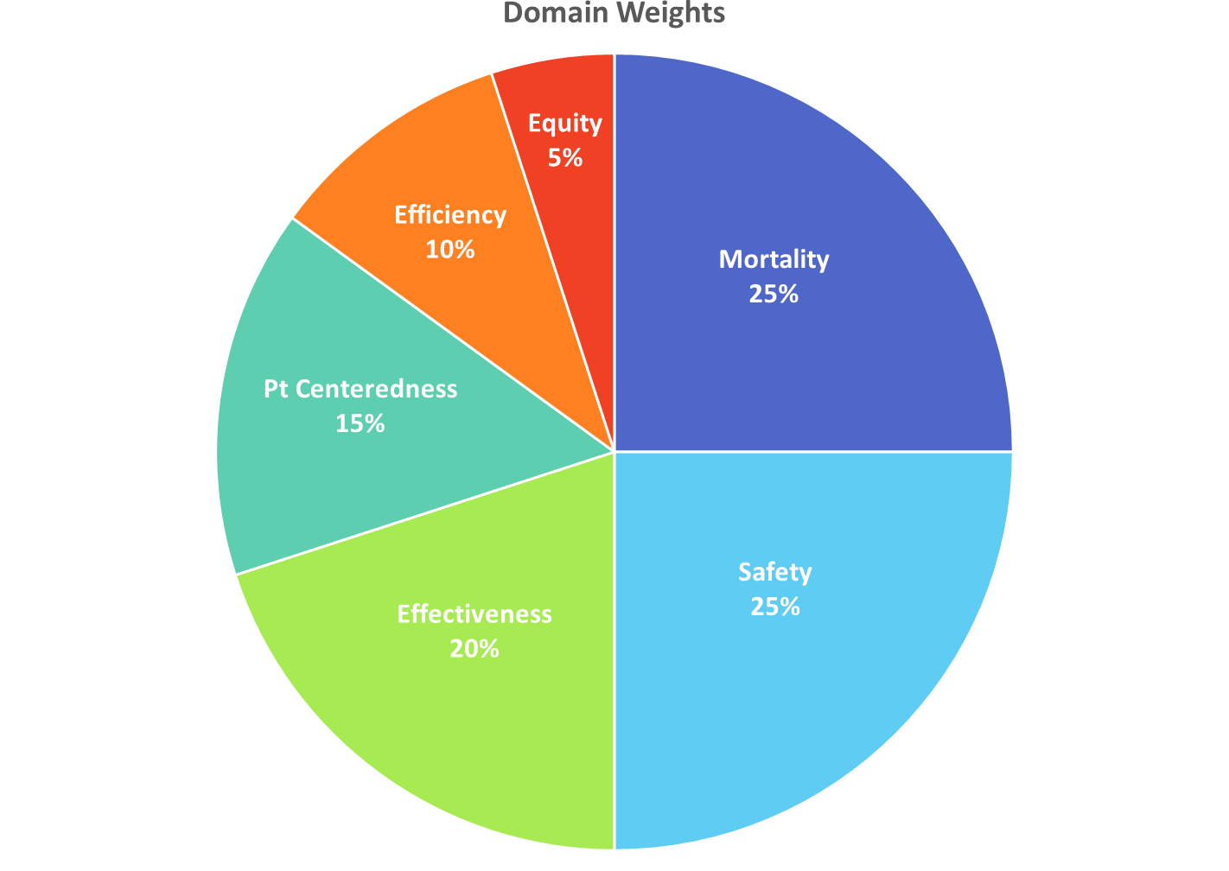
Key Quality and Safety Priorities at UCSD
TOC/Readmissions (CMS, US, V , P)
Vizient Q&A Scorecard
Safety
Healthcare Associated Infections (HAIs) (M, CMS, V, L, P)
Patient Safety Indicators (PSIs) (CMS, V, L)
Pressure Ulcer Prevention (M, L) Falls (M, L)
LOS & Direct Cost =
= Mortality
Experience =
Experience
HCAHPS (M, CMS, US, V, L, P) CG-CAHPS
Provider and Team Member
TOC & Excess Days =
= Harm
Mortality (M, CMS, US, V)
Wellness
Population Health
Public Hosp Redesign & Incentives
in Medi-Cal (PRIME) / Quality Incentive Program (QIP)
Vizient.UCSD.edu
M = Magnet CMS = CMS Reporting US = USNWR V = Vizient L = Leapfrog P = PRIME / QIP
Notes:
- Organizational problem is usually characterized in terms of (safety, effectiveness, efficiency, patient-centeredness, and equity)

Slide 12
Lean approach to quality improvement
Lean is a methodology used to continuously improve any process by empowering employees to eliminate waste while maximizing customer value
People who actually do the work are best suited to improve and innovate
A production method derived from Toyota in 1930 that is increasingly used in healthcare
  buzz words include waste elimination, standard work, mistake-proofing
Why? Language spoken by executives that is understood by the team

Slide 13
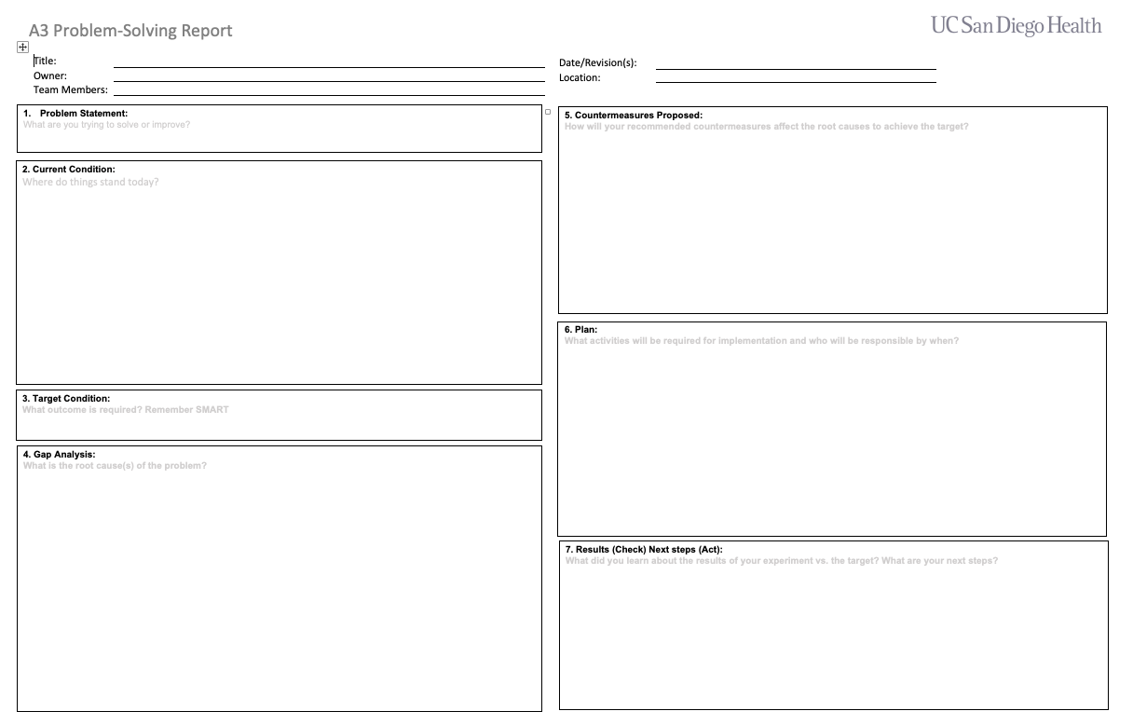
A3 (lean) approach to QI
A simple and strict guide that front line staff can use to problem solve

Slide 14
A3 Initial State, Qualitative: 4Ms Process Walkthrough
M | Specifically, look for how we | Current practice and observations
WHAT MATTERS: Know and align care with each older adult’s specific health outcome goals and care preferences including, but not limited to, end-of-life and across settings of care | Ask the older adult What Matters most and document it Align the care plan with What Matters most
MEDICATION If medication is necessary, use Age- Friendly medication that does not interfere with What Matters to the older adult, Mobility, or Mentation across settings of care | Review high-risk meds and document Avoid, dose adjust, or deprescribe high-risk meds and doc/communicate
MENTATION Prevent, identify, treat, and manage dementia, depression, and delirium across care settings of care | Hospital: delirium Ambulatory: dementia, depression
MOBILITY Ensure that each older adult moves safely every day in order to maintain function and do What Matters | Screen for mobility and document results Ensure early and safe mobility
Notes:
[ ] Have Janic

Slide 15
A3 Initial State, Qualitative: Tips for a patient-centered walkthrough
Let staff know and ideally partner with staff to do a walk-through as part of an assignment.
Go through experience as the patient and family member would from start to finish
  What are they thinking?
  What are they feeling at this moment?
Between the two of you (the patient and family member) write down a list of what needs you found and desired changes

Slide 16
A3, Initial State, Quantitative
Patient Panels at the VA
Dr. Bailey will help you to gain access to metrics for your patients

Slide 17
Patient Safety Case
Be looking for a case when something went wrong and
  a patient was harmed or
  a patient was nearly harmed
Ideal case includes
  system failures rather than individual errors
  allow to talk about general policies and procedures in health system

Slide 18
Action Items- volunteer to email/remind
Assignment | Due Date | Comment
IHI Module PFC 203 Providing Age-Friendly Care to Older Adults | Second QI Session/Intro to ACP: Friday July 29, 2022 | Select one resource (pdf) that you think could be useful in future QI work
4Ms Process Walkthrough | Second QI Session/Intro to ACP: Friday August 5, 2022 | Fill out in your clinical setting (ideally VA)
Patient Data Request | First VA Continuity Clinic | Remind Dr. Bailey re: patient data request for panels
Patient Safety |  | Start thinking about a case
*IHI: Institute for Healthcare Improvement

Slide 19
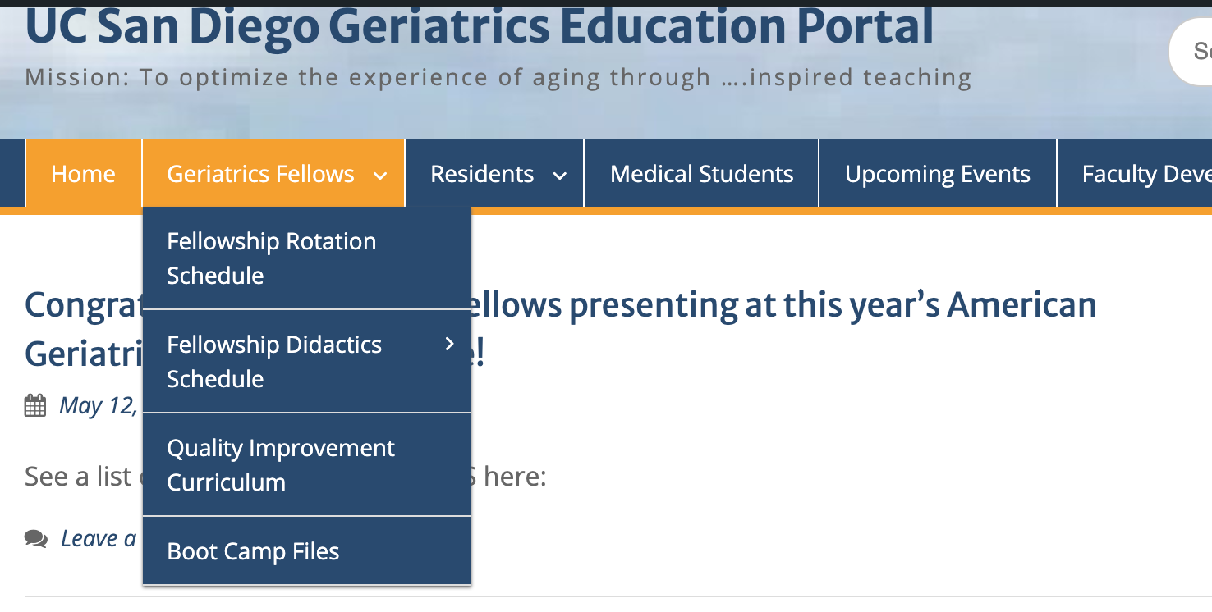
4Ms Process Walk Through
Access IHI Modules
UCSD A3 Template

Slide 20
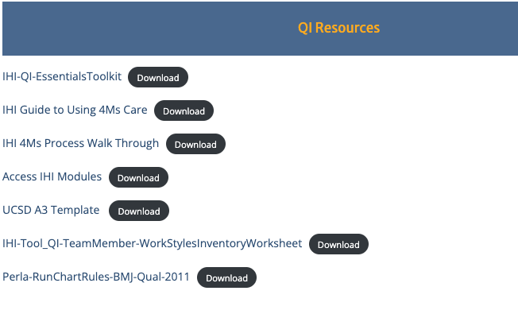


Module Access: Age-Friendly Health System and IHI

Slide 21
Cell Phone Exchange
Lindsey Yourman
Please text me your full name and email so I have it!
415-971-4962
lyourman@health.ucsd.edu

