Slide 1
Introduction to Veterans Care and Benefits
Colin Thomas, MD, MPH
Chief, Medicine Service
VA San Diego Healthcare System (VASDHS)
Clinical Professor of Medicine, UCSD

Slide 2
Department of Veterans Affairs
History of Veteran Care and Benefits
1636
Pilgrims passed law requiring colony to care for disabled soldiers
1776
Continental congress passed law providing pensions to disabled soldiers
1811
first domiciliary and medical facility for Veterans authorized by Federal Government
1865
1917
State Veterans Homes established
1921
Disability, Insurance, Vocational Rehab
1930
Consolidation of Veterans functions into Veteran’s Bureau
1944
Veteran’s Administration
1989
GI Bill and Homestead Act
Cabinet Level Department

Slide 3
Department of Veterans Affairs
Veterans Health Administration (VHA)
Veterans Benefits Administration (VBA)
National Cemetery Administration (NCA)
Office of Information and Technology (OI&T)
Notes:
Cemetaries: Miramar, Point Loma, Arlington

Slide 4
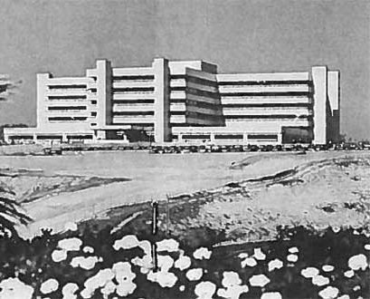
VA San Diego Healthcare System (VASDHS)
Built 1969, opened 1972
Building cost $35.5 million
Originally 811 Beds
Currently 228 Beds
  MED/SURG (94)
  ICU (18)
  Mental Health (40)
  Spinal Cord (26)
  Community Living Center (39)
  Domiciliary (40)
Outpatient Clinics
  Kearney Mesa
  Oceanside
  Chula Vista
  Escondido & El Centro
Notes:
$35.5 million in 1969 = $283 million in 2022
80,000 patients
230,000 annual patient encounters

Slide 5
Veteran’s Benefits
Eligibility
  90 days of military service (24 months if enlisted after 1980)
  Honorable Discharge
Disability Compensation
  Any condition that impairs the ability to perform full work functions
  $150-4,000/month
Veteran’s Pension
  Permanently and totally disabled (unemployable)
  Age 65 or older
  Below income limit ($13,752 for single Veteran with no dependents)
Education and Job Training
Loans for housing and small business
Medical Care
Burial

Slide 6
Veteran’s Medical Care
Comprehensive care provided
  Preventive care
  Inpatient/Outpatient
  Medical/Surgical/Mental Health
  Prescription Drugs
  Rehabilitation and Durable Medical Equipment
  Alcohol and Drug Treatment
  Respite/Hospice/Palliative care
  Travel expenses (if eligible)
Tiers of eligibility
  Priority groups 1-8
Not covered
  Abortion, cosmetic surgery, in vitro fertilization

Slide 7
Geriatric Programs
Geriatric and Extended Care (GEC)
Nursing home care
  Skilled/rehab
  Custodial long term
Home Based Primary Care (HBPC)
Adult Day Health Care
Aid & Attendance
Mission Act

Slide 8
Graduate Medical Education
VA is the largest single provider of GME
>45,000 residents and fellows
  1.5 Geriatric Fellows
  53 Internal Medicine Residents
>120,000 other health professions trainees
  Nursing
  Pharmacy
  Dietetics
  Dentists
  Chaplain
  PT/OT/ST
  Phlebotomy

Slide 9

Questions?

