Slide 1

Journal Club
Rachael Petry, MD
Clinical Fellow
UCSD, Division of Geriatrics and Palliative Care
Article: Rogers, S. L., Doody, R. S., Mohs, R. C., Friedhoff, L. T., & Donepezil Study Group. (1998). Donepezil improves cognition and global function in Alzheimer disease: a 15-week, double-blind, placebo-controlled study. Archives of internal medicine, 158(9), 1021-1031.

Slide 2
Objectives and Goal
By the end of this journal club, participants should be able to:
List the major phases of clinic trials and describe how they differ from one another
Summarize the findings of one of the two major Phase 3 Clinical Trials of Donepezil use in Alzheimer Disease.
Feel comfortable utilizing the findings of this study to counsel and educate your patients (and their families) regarding pharmacological treatment of dementia.
GOAL: Understand the evidence that led to the FDA approval of donepezil for Alzheimer Disease so that we can set appropriate expectations regarding efficacy when prescribing this medication.

Slide 3
Quick Quiz
At which phase in a clinical trial may you administer safe doses of a medication to patients with the condition for which the drug was developed (at this stage the drug is presumed to have no clinical effect)?
Phase I
Phase II
Phase III
Phase IV

Slide 4
A (VERY) Quick Review of Clinical Trial Phases
National Cancer Institute (2016, February 9). What are clinical trial phases? [Video File}. YouTube. https://www.youtube.com/watch?v=dsfPOpE-GEs

Slide 5
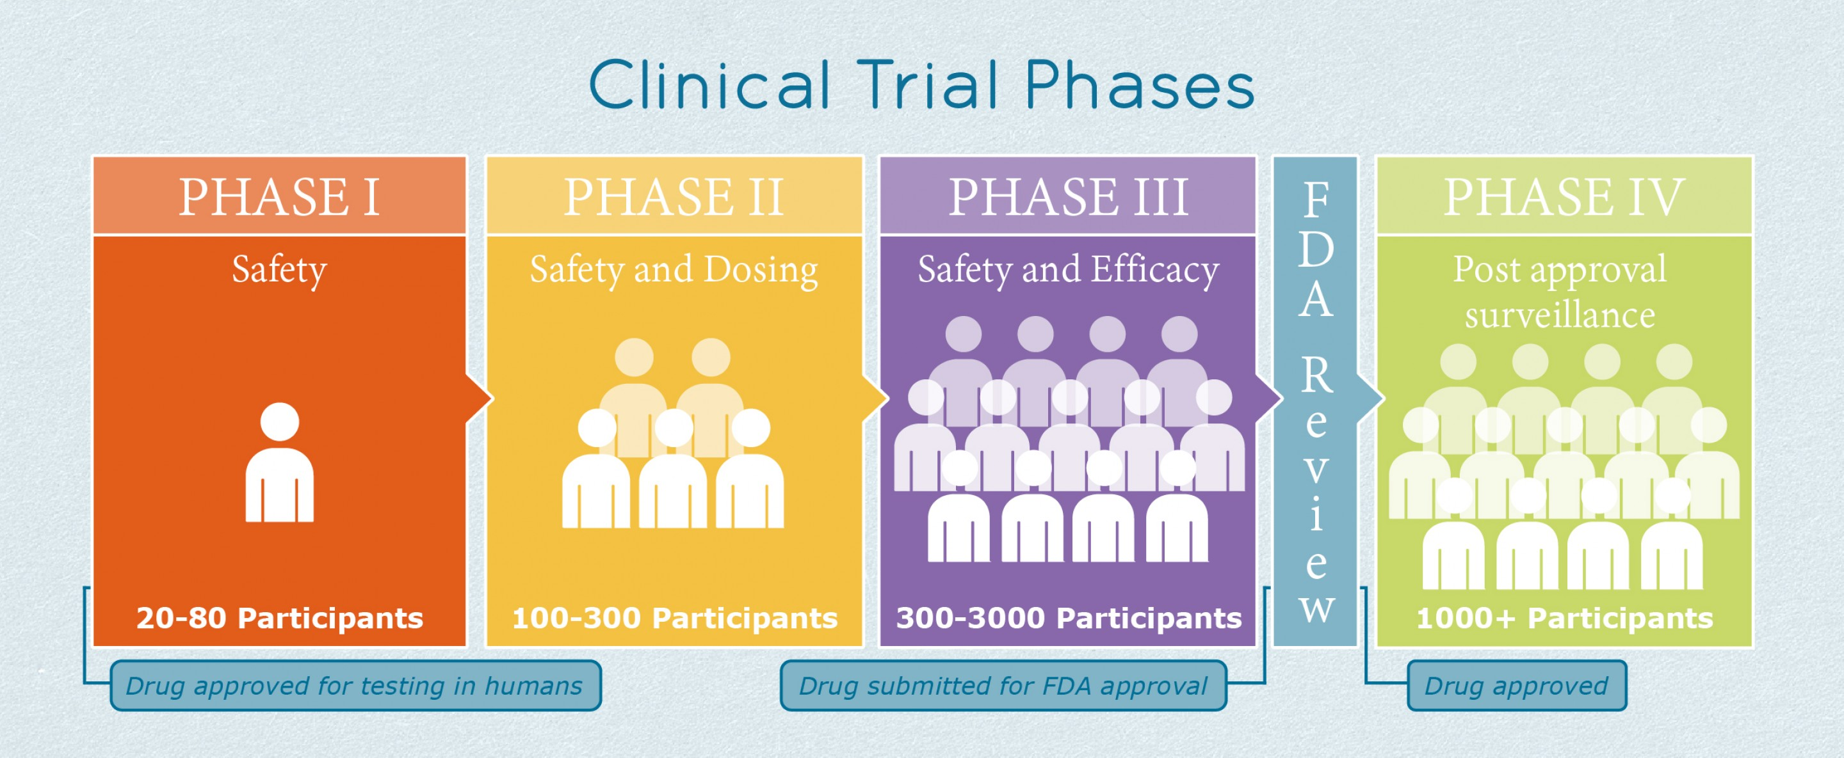
Quick Quiz- Answer
At which phase in a clinical trial may you administer safe doses of a medication to patients with the condition for which the drug was developed (at this stage the drug is presumed to have no clinical effect)?
Phase I
Phase II
Phase III
Phase IV
PHOTO URL: https://www.ildcollaborative.org/resources/phase-iii-ipf-clinical-trials

Slide 6


1983
My mother developed dementia in her later years. Whenever I went to visit her, she'd ask me, “Young man, who are you?” It was a shock to me that my mother could no longer recognize her own son.
E2020 (Aricept) Research Initiated at Eisai
Photo URLs: https://www.eisai.com/company/profile/history/products/aricept/index.html
Notes:
Dr. Hachiro Sugimoto

Slide 7
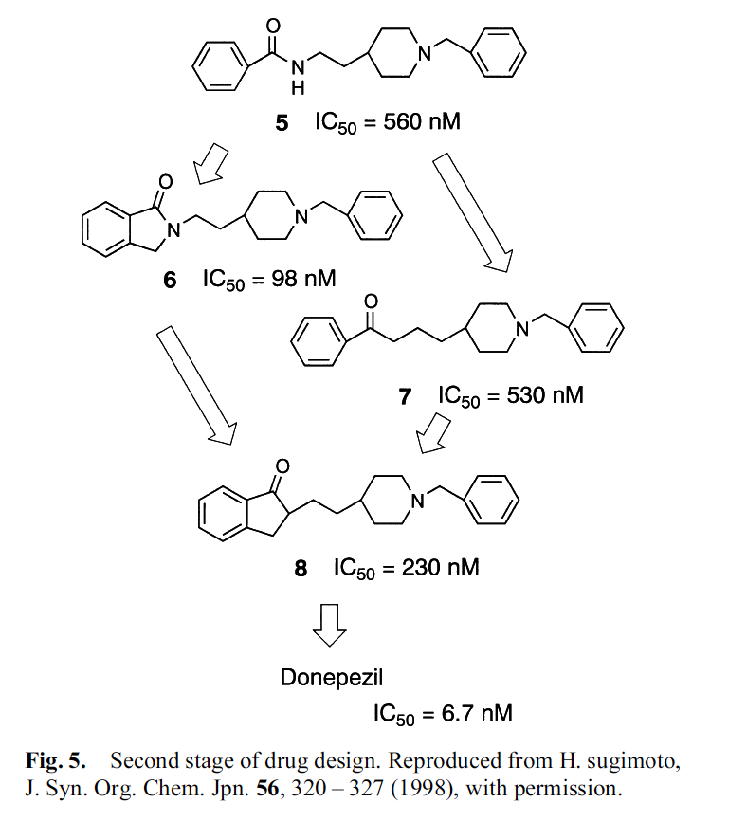






1983
March 1987
E2020 (Aricept) Research Initiated at Eisai
Aricept compound ready for testing
Cholinergic Hypothesis
Basal Forebrain Projections
Sugimoto, H., Ogura, H., Arai, Y., Iimura, Y., & Yamanishi, Y. (2002). Research and development of donepezil hydrochloride, a new type of acetylcholinesterase inhibitor. The Japanese journal of pharmacology, 89(1), 7-20.
Notes:
Dr. Hachiro Sugimoto interview:
acetylcholine deficiency hypothesis had already gained a certain level of recognition, but there were also opposing views that proposed that the hypothesis could turn out to be a failure.
For more than 20 years, studies of the brains of those with advanced age and Alzheimer's disease (AD) have consistently found damage or abnormalities in these pathways (particularly basal forebrain projections) that appeared to correlate well with the level of cognitive decline. As a result, the so-called “cholinergic hypothesis” was developed, which essentially states that a loss of cholinergic function in the central nervous system contributes significantly to the cognitive decline associated with advanced age and AD
The discovery of our seed compound was by mere coincidence. We came across the compound during random screening when searching for compounds that possessed inhibitory activity for acetylcholinesterase, which is an enzyme that breaks down acetylcholine. The compound had previously been synthesized with a different purpose in mind but, surprisingly, it ended up leading the way to the creation of Aricept.

Slide 8
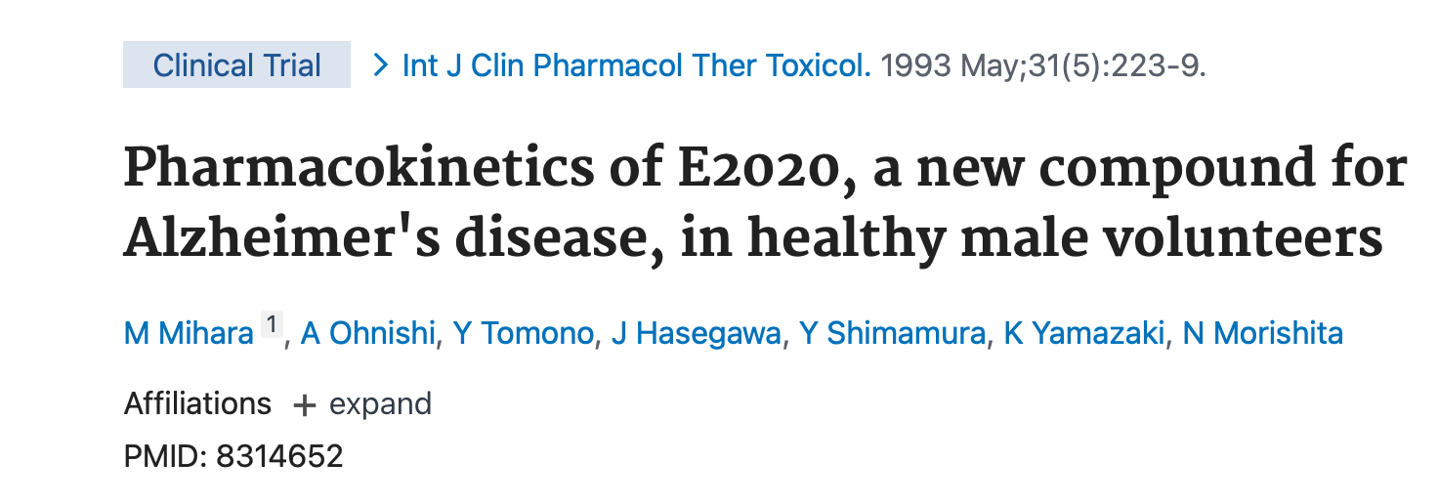
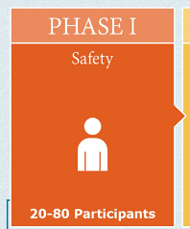
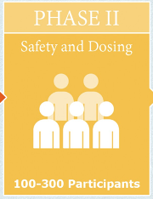
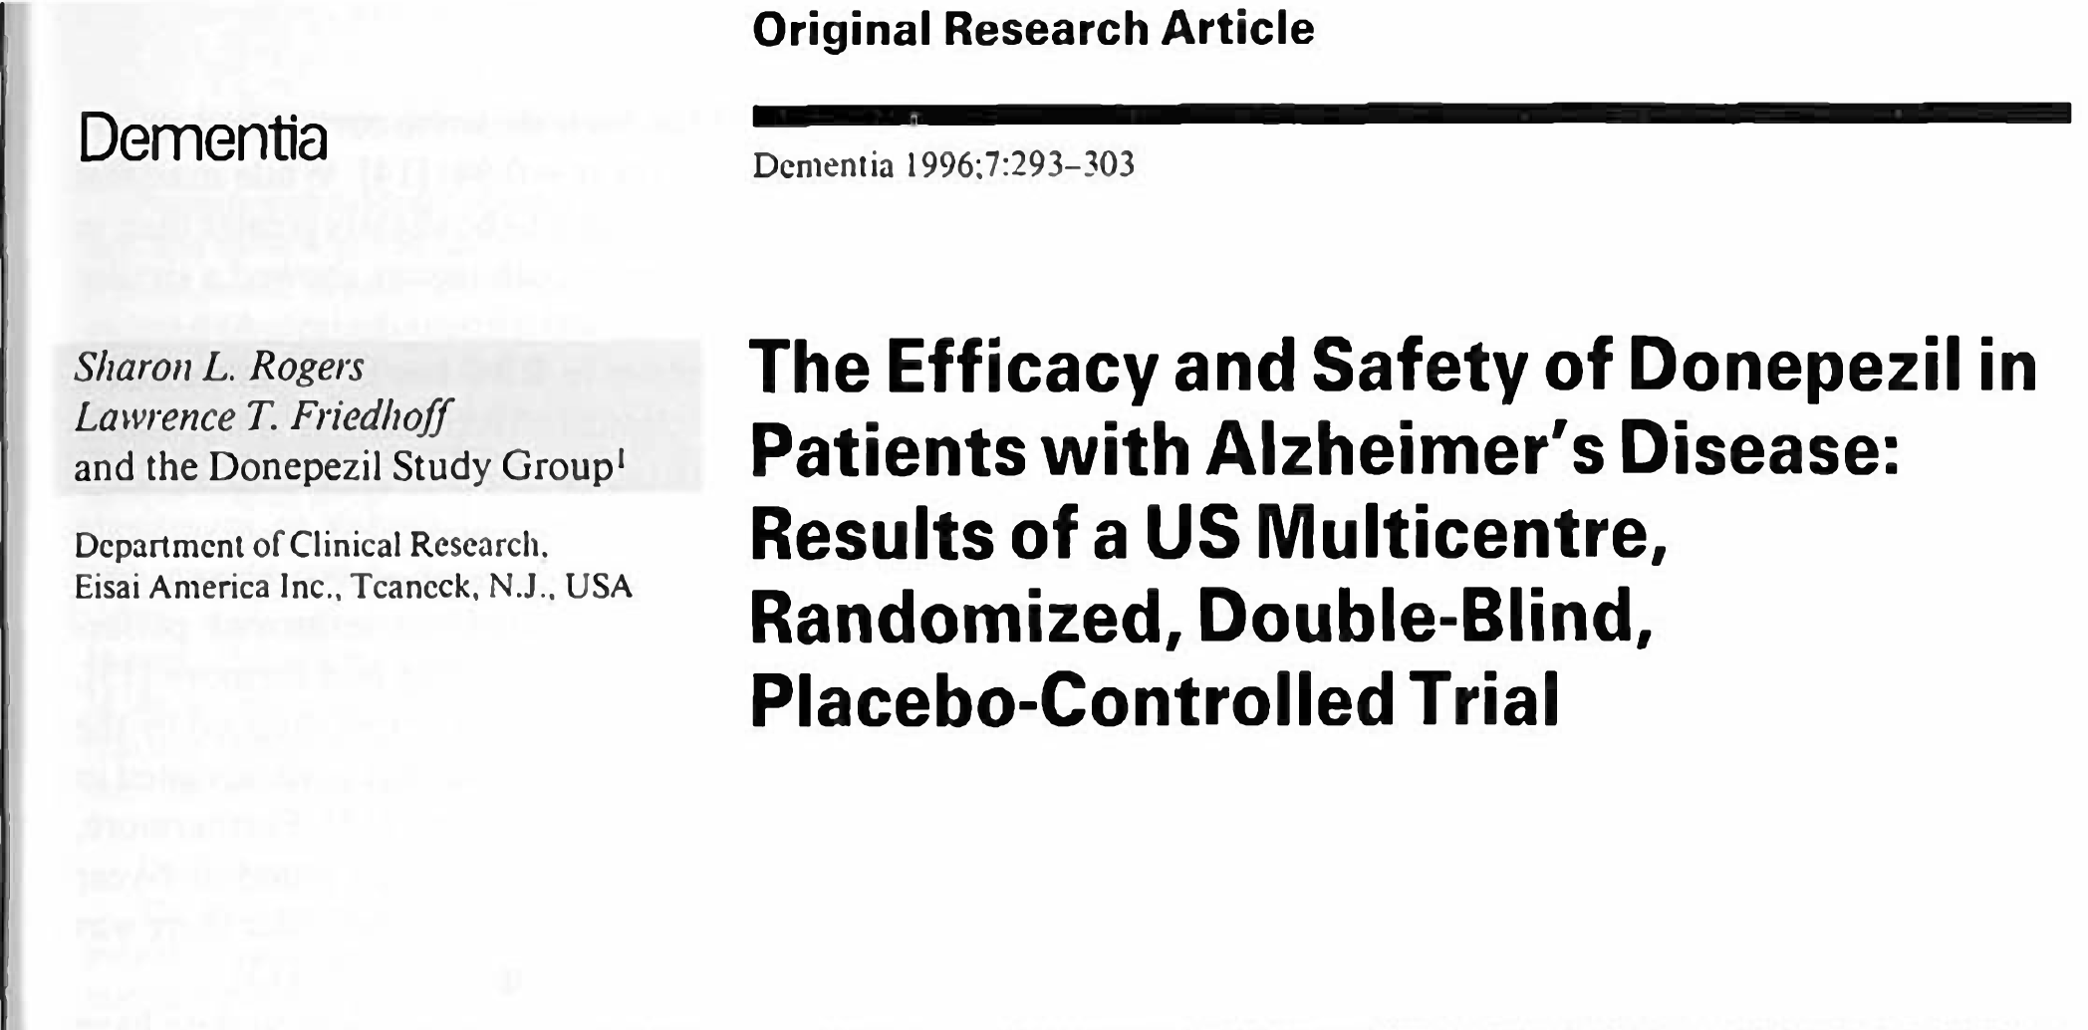
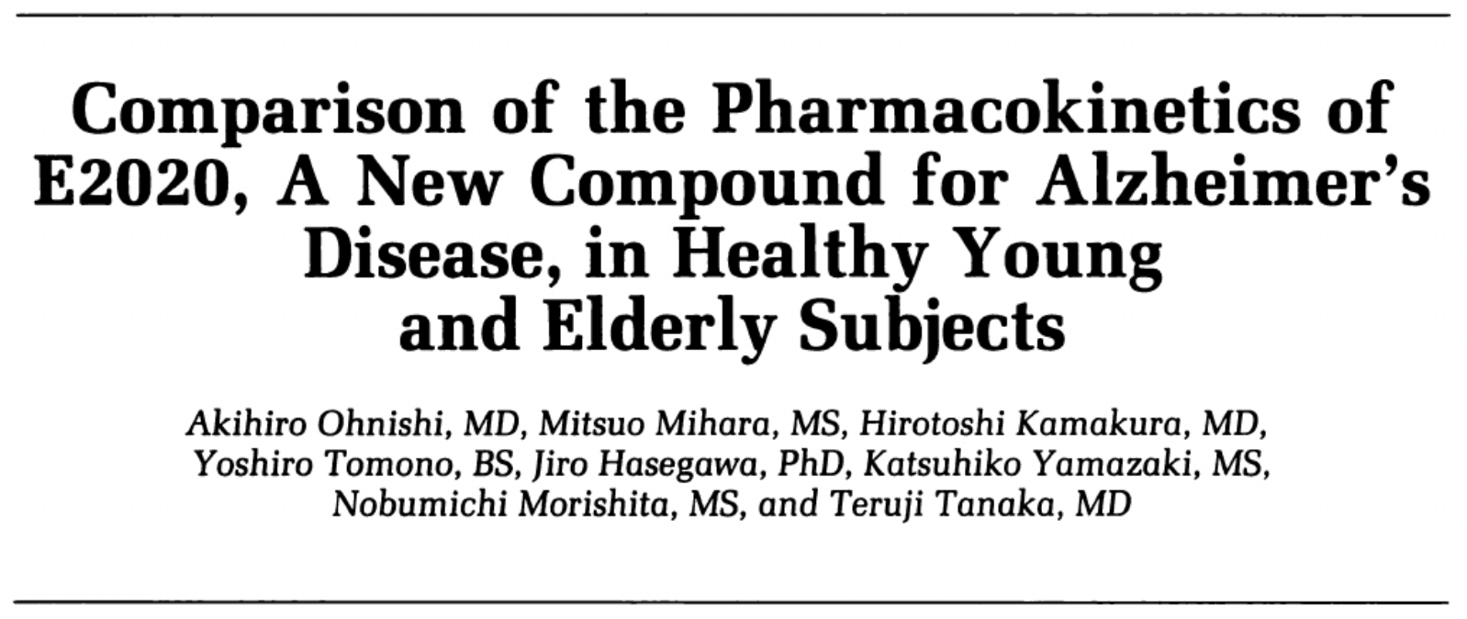
1983
1987
1987-1996
E2020 (Aricept) Research Initiated at Eisai
Aricept compound ready for testing
Phase 1-3 Trials

Slide 9
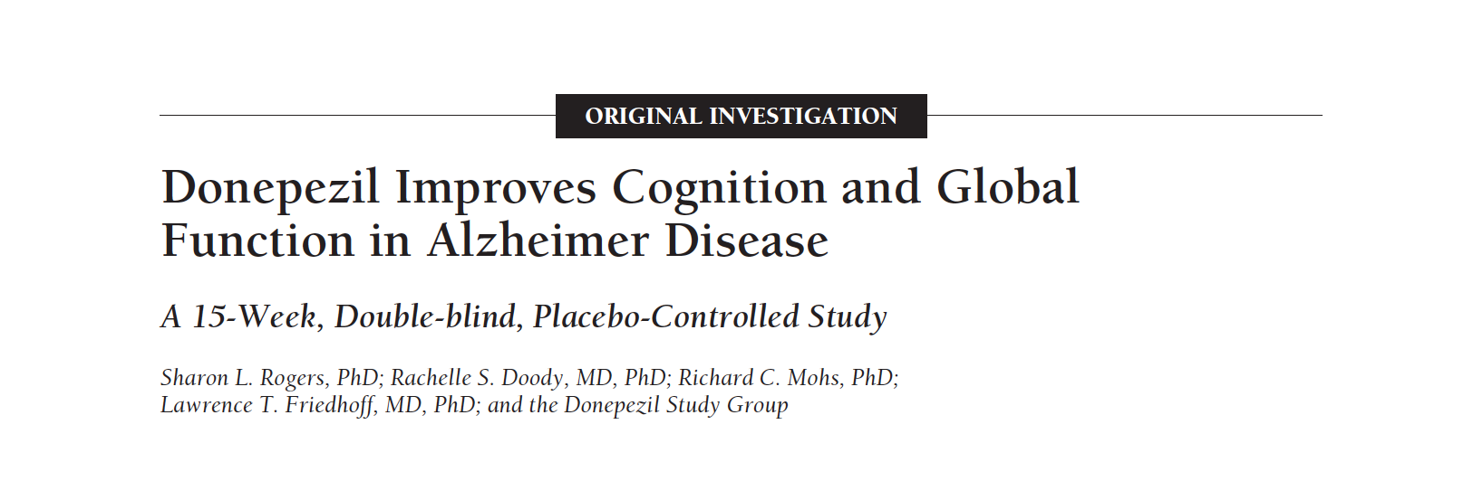
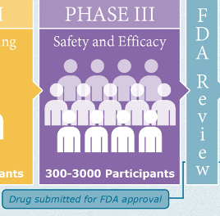
Today’s Article
OUR CLINICAL QUESTION: Over a 15-week period, does donepezil (5mg or 10mg) lead to a quantifiable clinical change in older patients diagnosed with Alzheimer Disease (AD) compared to those on no therapy (placebo)?
PATIENT’S QUESTION: What benefits should I, as a patient with AD, expect when I start taking donepezil? (is it worth it?)

Slide 10
Study Design =
Randomized, Double Blind, Parallel Group, Placebo-Controlled Study
ITT ANALYSIS
MDs
PLACEBO GROUP
MDs
PLACEBO GROUP
P
P
1
1
153 patients
153 patients -11
P
5
DONEPEZIL 5 GROUP
DONEPEZIL 5 GROUP
12 weeks
2
3 week washout
2
P
P
157 patients
157 patients -16
DONEPEZIL 10 GROUP
DONEPEZIL 10 GROUP
5
P
x7 days
Every 3 week check-ins for:
-Efficacy
-Safety
-Treatment Compliance
-Blood Draws
Eligible Study Participants
(n=468)
3
3
5
5
158 patients -29
158 patients

Slide 11

Study Subjects
Inclusion Criteria
Male OR Female
>50 years old
Diagnosis of “Probable Alzheimers”
MMSE Scores 10-26
Clinical Dementia Rating Score of 1 or 2
Ambulatory (+/- walker or cane)
“Sufficient vision and hearing”
23 USA Centers
Probable Alzheimer’s Disease: Dementia has been established by clinical and neuropsychological examination. Cognitive impairments also have to be progressive and be present in two or more areas of cognition. The onset of the deficits has been between the ages of 40 and 90 years and finally there must be an absence of other diseases capable of producing a dementia syndrome.
Screened Study Participants
(n=??)
Notes:
Things to show (define diagnosis of “Probable Alzheimers”, Show Clinical Dementia Rating Score, Show Hachinski Ischemia Score

Slide 12
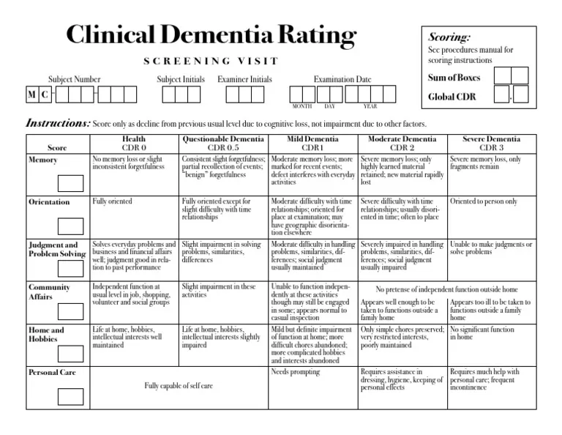
Notes:
CDR 0 = normal, 0.5=very mild, 1= mild, 2= moderate, 3= severe
Complex algorithm for scoring

Slide 13
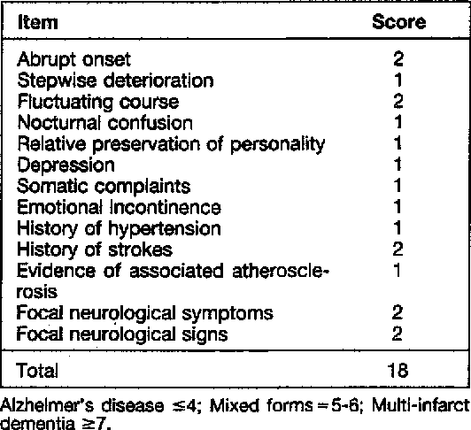
Study Subjects
Exclusion Criteria
Type 1 Diabetes
Obstructive Lung Disease or Asthma
Hematologic/Oncologic Disorders in the past 2 years
Vitamin B12 or Folate Deficiency
“Clinically Significant” active GI, renal, hepatic, endocrine or CV disease that was NOT well controlled by diet, pharmacologic treatment or other intervention
Known Psychiatric (ex. schizophrenia) or Neurologic (stroke, Parkinson Disease)
Hachinski Ischemia Score of 5 or more
Known hypersensitivity to cholinesterase inhibitors
23 USA Centers
Screened Study Participants
(n=??)

Slide 14
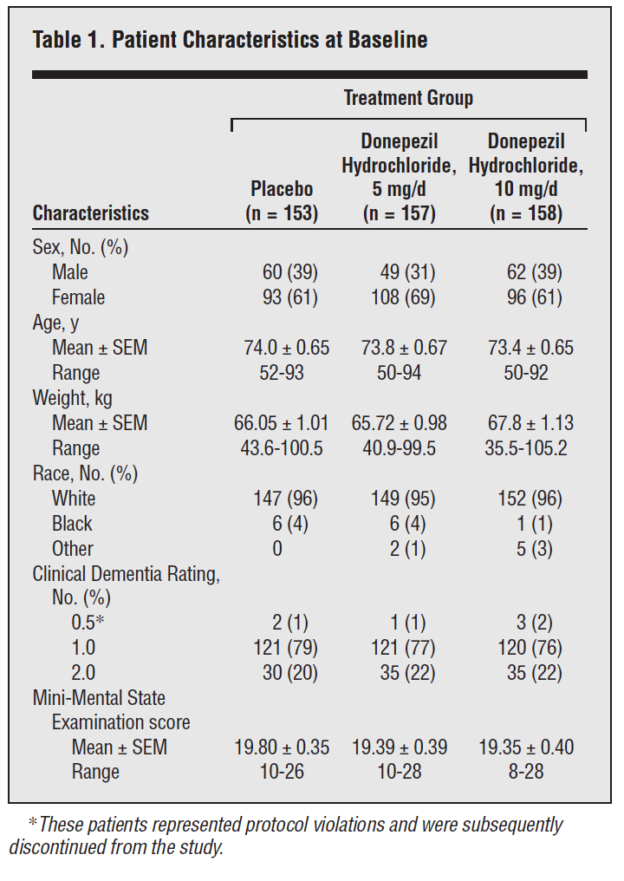
Study Subjects
Inclusion Criteria
Male OR Female
>50 years old
Diagnosis of “Probable Alzheimers”
MMSE Scores 10-26
Clinical Dementia Rating Score of 1 or 2
Ambulatory (+/- walker or cane)
“Sufficient vision and hearing”
23 USA Centers
Screened for eligibility within 2 weeks
Exclusion Criteria
Type 1 Diabetes
Obstructive Lung Disease or Asthma
Hematologic/Oncologic Disorders in the past 2 years
Vitamin B12 or Folate Deficiency
“Clinically Significant” active GI, renal, hepatic, endocrine or CV disease that was NOT well controlled by diet, pharmacologic treatment or other intervention
Known Psychiatric (ex. schizophrenia) or Neurologic (stroke, Parkinson Disease)
Hachinski Ischemia Score of 5 or more
Known hypersensitivity to cholinesterase inhibitors
Eligible Study Participants
(n=468)
Screened Study Participants
(n=??)
Notes:
Things to show (define diagnosis of “Probable Alzheimers”, Show Clinical Dementia Rating Score, Show Hachinski Ischemia Score

Slide 15

Measurements and Follow Up
Independent Variables:
Donepezil (5mg or 10mg)
Outcome Variables: level of impairment/progression of illness
  Primary Efficacy Variables: ADAS-Cog and CIBIC plus
  Secondary Efficacy Variables: MMSE, CDR-SB and quality of life assessment
Notes:
Study was not powered to detect a difference between he two dosages.

Slide 16
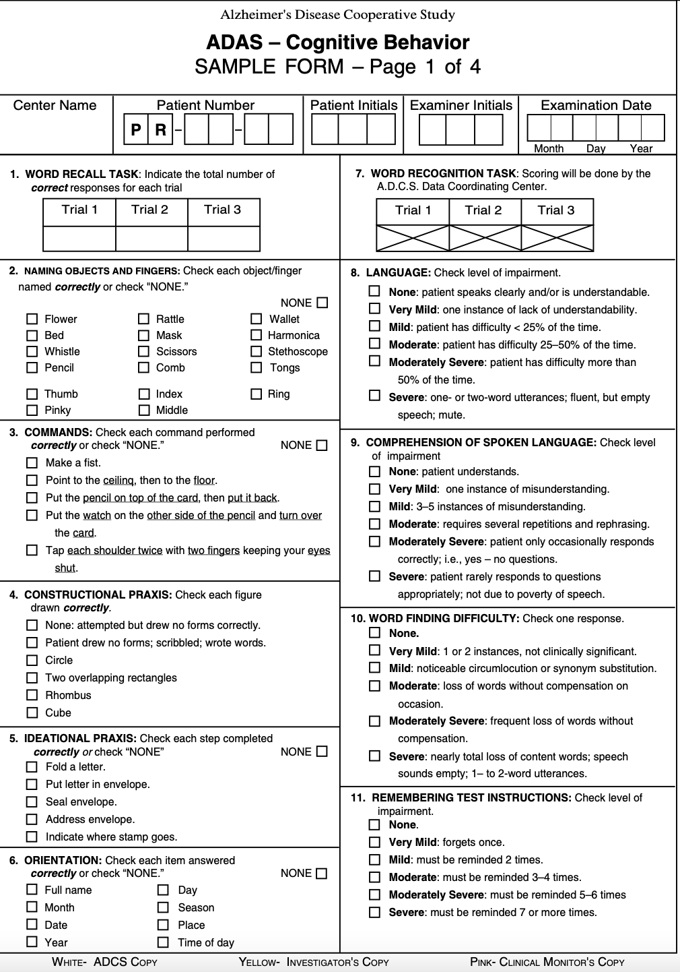
ADAS-Cog
SCORING 0-70
(70 is worst)
Notes:
The ADAS-Cog consist of 11 questions:
Word Recall Task
Naming Objects and Fingers
Following Commands
Constructional Praxis
Ideational Praxis
Orientation
Word Recognition Task
Remembering Test Directions
Spoken Language
Comprehension
Word-Finding Difficulty
Scored 0-70 (70 is the worst)
Example (for #5, if you cannot do any, you get a 5), for the naming, if you name >15 wrong you get a 5.
From what I have read, typically patients increase by 7-11 points a. year if they are untreated.

Slide 17
CIBIC Plus
General
Cognitive
Behavioral
ADL
Clinician observed rating of 4 major areas of patient function.
(with input from care-giver)
1 = “Markedly Improved”
4= “No Change”
7 = “Markedly Worse”
Notes:
The CIBIC-plus used in ARICEPT trials was a semi-structured instrument that was intended to examine four major areas of patient function: General, Cognitive, Behavioral and Activities of Daily Living. It represents the assessment of a skilled clinician based upon his/her observations at an interview with the patient, in combination with information supplied by a caregiver familiar with the behavior of the patient over the interval rated. The CIBIC-plus is scored as a seven point categorical rating, ranging from a score of 1, indicating “markedly improved,” to a score of 4, indicating “no change” to a score of 7, indicating “markedly worse.” The CIBIC-plus has not been systematically compared directly to assessments not using information from caregivers (CIBIC) or other global methods.

Slide 18


Measurements and Follow Up
Outcome Variables: level of impairment/progression of illness
  Primary Efficacy Variables: ADAS-Cog and CIBIC plus
  Secondary Efficacy Variables: MMSE, CDR-SB and QOL
ARE THESE CLINICALLY SIGNIFICANT
?
Start of Study
End of Study
Follow Up: Q3 weeks x 12 weeks
Notes:
The major question we have to ask is if these outcome variables are clinically significant. Having loved and cared for someone with AD, knowing that their MOCA is worsening from one visit to another is heartbreaking, but what is even more heartbreaking is when they forget who you are, start shouting out randomly in public or lose continence.
Think of this “patient” who initially came in for the study and scored a 40 on his ADAS-Cog. On that day, he didn’t remember any of the orientation questions. He said “the day after yesterday” when asked what day it was, and a he was chilly in the hospital, guessed “winter” as the season. During the study, he was tested every 3 weeks per protocol and his family really didn’t notice an improvement or change. At the end of his study, however, it was his birthday! He had gotten cake for breakfast, and balloons from his family. When asked his orientation questions, he knew the correct date and season and scored 4 points higher on his ADAS-Cog than previously (44).
From this point on, when you see Mr. Fredricksen I want you to keep this clinical significance in mind

Slide 19
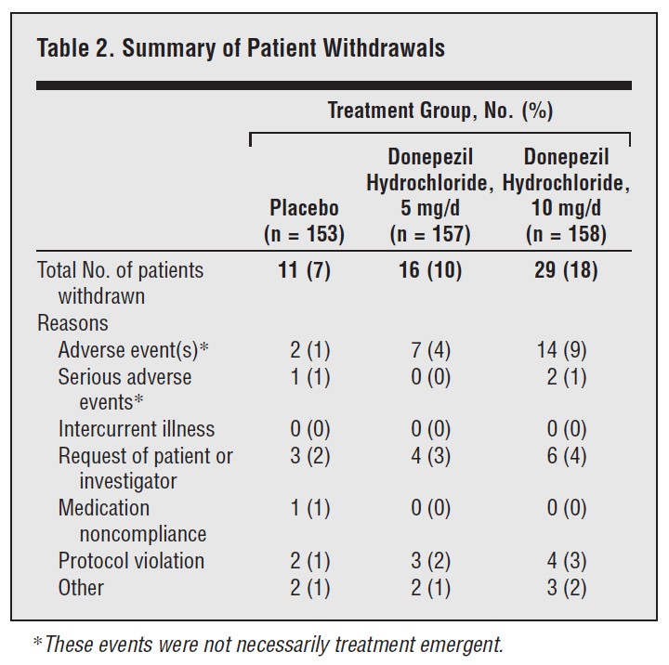
Analysis
Intention to treat analysis
  For safety analysis, true ITT
  For efficacy analysis, needed to have at least one post-baseline eval (that was be carried to end = LOCF)
Secondary analysis
  Only on “fully evaluable” patients = 80% compliance, at least 2 check-in appointments
  Helped to confirm ITT Analysis
Notes:
LOCF= last observation carried forward (if they did not finish) → makes sense as this calculation is looking for a change from baseline
But what if everyone dropped out after the very first check in? They do NOT report WHEN they dropped out.

Slide 20
Quick Quiz, #2
Which best describes how YOU counsel patients regarding the anticipated impact that starting donepezil will have on their lives?
”The Magic Bullet” = this medication has been shown to reverse symptoms associated with AD in some patients!
“Brakes on a Runaway Train” = this medication may slow down your symptoms, but this disease is progressive and incurable
“The Two-Sided Coin” = this medication may help with your symptoms, but it may also have some uncomfortable side effects that are intolerable
“The Chance”= this is one of the only medications for AD approved by the FDA due to safety and statistically significant improvements noted on cognitive testing (like the ones we administer to you in clinic) compared to those who don’t take the medicine

Slide 21
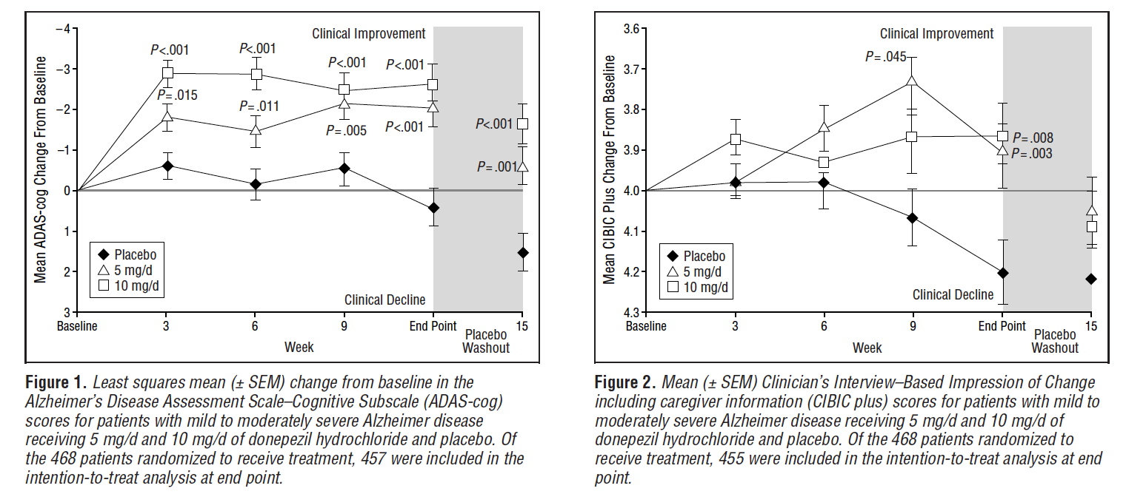
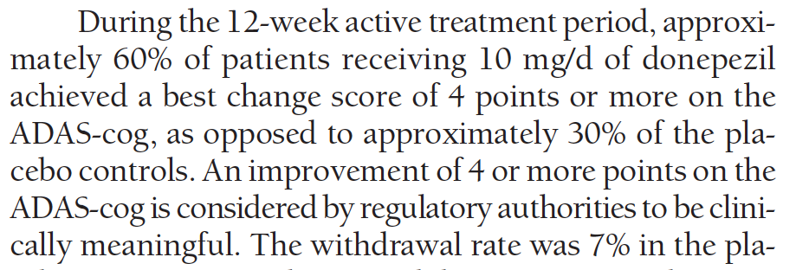
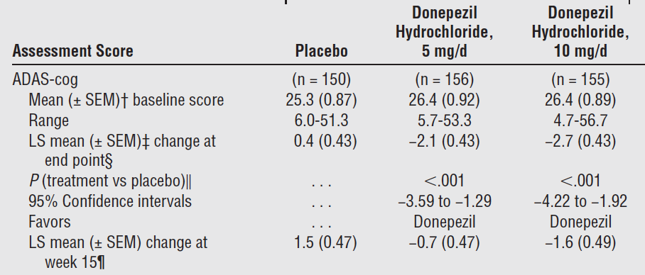

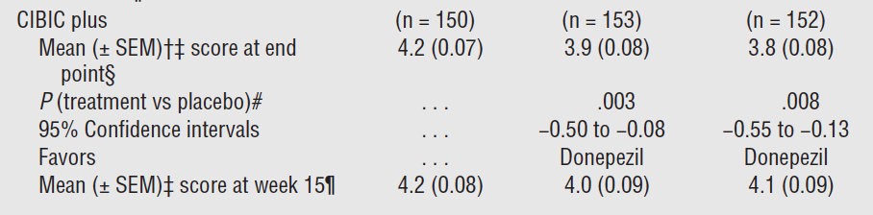
Results (Primary Outcomes)
Figure 1 (ADAS-cog) Scale 0-70
Figure 2 (CIBIC plus) Scale 1-7
AVERAGE
3.1 pts Higher
2.5 pts Higher
Notes:
Remember, higher numbers are worse on both
The CIBIC-plus is scored as a seven point categorical rating, ranging from a score of 1, indicating “markedly improved,” to a score of 4, indicating “no change” to a score of 7, indicating “markedly worse.”
48 to 57% of patients randomized to receive drug treatment achieved a 4 point or more reduction in ADAS-cog compared with 29% for placebo (THERE WAS NO P-VALUE REPORTED)

Slide 22
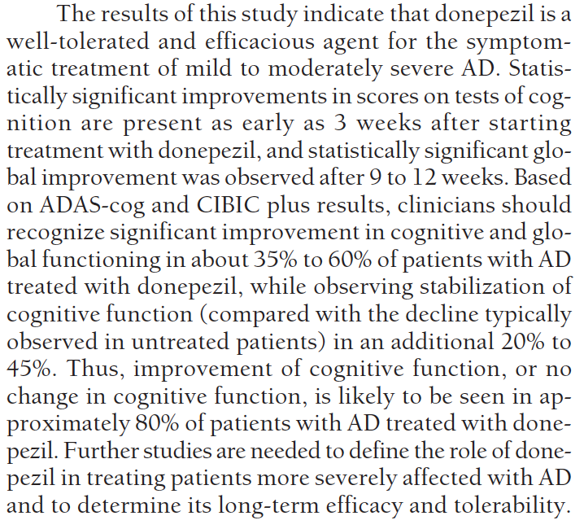

Slide 23
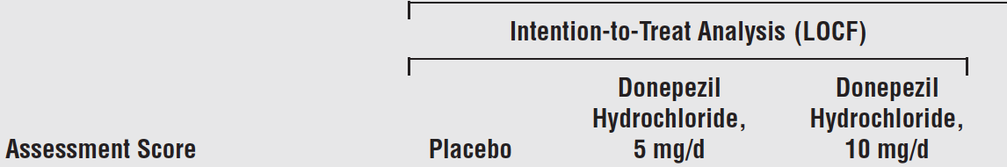

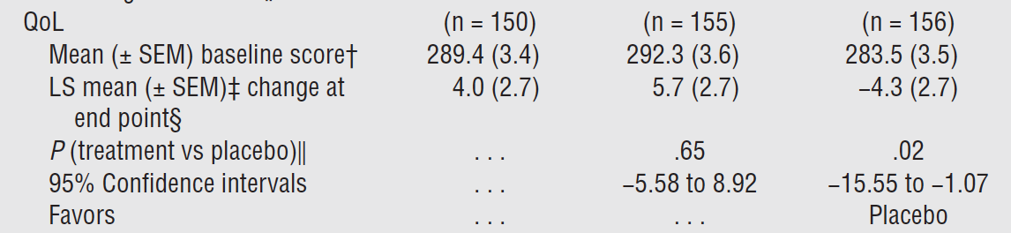
Results (Secondary Outcome = QOL)
PATIENT’S QUESTION: What benefits should I, as a patient with AD, expect when I start taking donepezil? (is it worth it?)
Notes:
Signifcant changes in MMSE by around 1-1.25 points at 12 weeks
No significant difference in change of CDR-SB score

Slide 24

1983
1987
1987-1996
Nov 1996
E2020 (Aricept) Research Initiated at Eisai
Aricept compound ready for testing
Phase 1-3 Trials
FDA APPROVAL
Notes:
November 25, 1996 Donepezil was approved by the FDA
2003 Namenda was approved

Slide 25
Reviewer’s Critique
Strict inclusion/exclusion criteria and baseline characteristics that do not reflect the US Population
Subjective Primary Outcome
LOCF Analysis with unequal dropout rates.
Observation Bias
Expectation Bias
Calculating and Comparing MEANS
Kaduszkiewicz H, Zimmermann T, Beck-Bornholdt HP, van den Bussche H. Cholinesterase inhibitors for patients with Alzheimer's disease: systematic review of randomised clinical trials. BMJ. 2005 Aug 6;331(7512):321-7. doi: 10.1136/bmj.331.7512.321. PMID: 16081444; PMCID: PMC1183129.
Notes:
Observation bias (also known as the Hawthorne Effect)
Observation bias occurs when participants in a study are aware that they are being observed by scientists and, either consciously or unconsciously, alter the way they act or the answers they give.
Expectation bias occurs when an individual's expectations about an outcome influence perceptions of one's own or others' behavior. In clinical trials, both raters and subjects may enter trials with expectations. Rater EB occurs when raters expect that subjects will improve over the course of the trial.
What are the possible biases? Consider its possible direction, magnitude, and impact.
Strengths, weaknesses, discussion points.
Describe why you think the results can or cannot be applied to your patients.
Conclude with your own decision about the utility of the study in your practice.
13.4% black USA
Using a combination of variables (one which is a “test” and one which takes the care-giver and physician observations into account) helps this study, in my opinion, be more CLINICALLY relevant. Also including a QOL assessment gets to the meat of what truly matters to FAMILIES and patients. Unfortunately, taking subjective data into account (with the CIBIC plus (which has not been systematically compared directly to assessments not using information from caregivers) and the QOL assessment (the latter of which is not validated), opens up the door to challenges of the internal validity of the study.

Slide 26
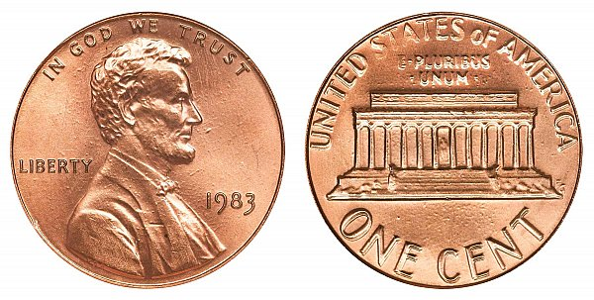
OUR CLINICAL QUESTION: Over a 15-week period, does donepezil (5mg or 10mg) lead to a quantifiable clinical change in older patients diagnosed with Alzheimer Disease (AD) compared to those on no therapy (placebo)?
At 10mg…. MAYBE (60% compared to 30% placebo) for “significant change” on ADAS-Cog
At 10mg…. MAYBE (but quality of life may be worse).

Slide 27
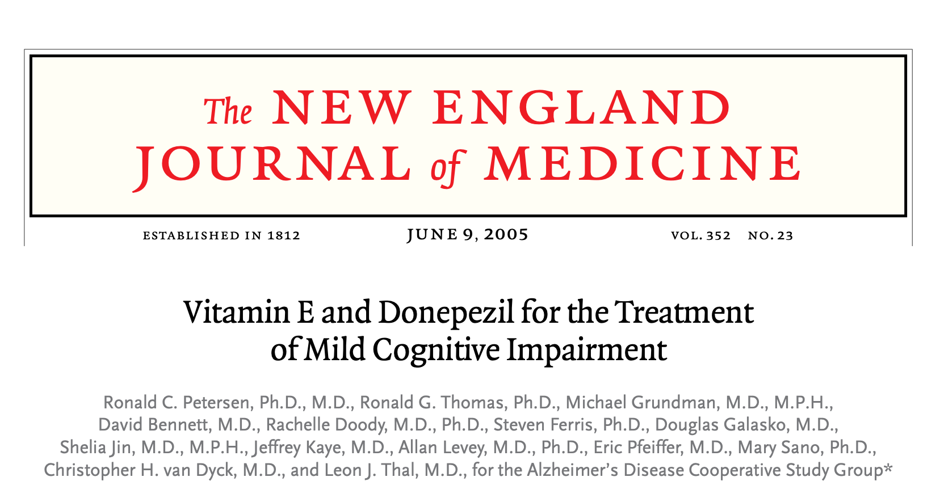


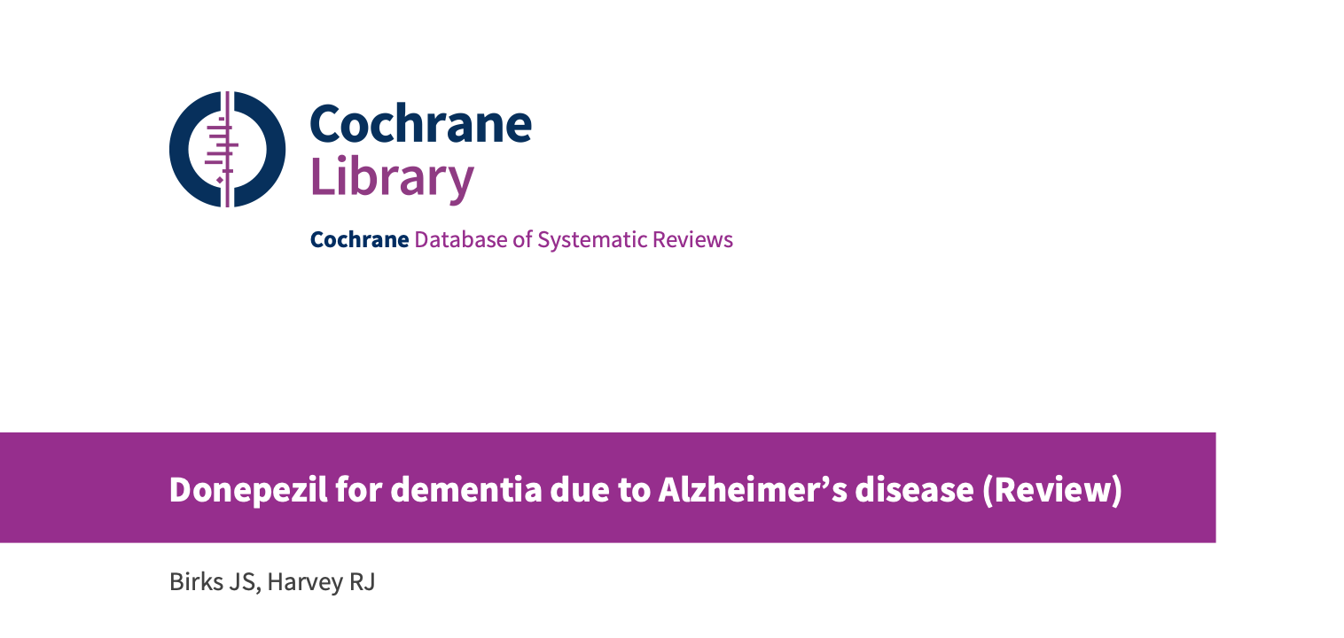
1983
1987
1987-1996
Nov 1996
2018
MY CHALLENGE: When counseling patients with AD and their families, make a vested attempt to truly understand the evidence that led to the FDA approval so that we can set appropriate expectations regarding efficacy when prescribing medications to this vulnerable population.
Rachael Petry prescribes donepezil for the first time.
Cajigal, S. (2006). FDA APPROVES DONEPEZIL FOR SEVERE DEMENTIA–EXPERTS QUESTION WHY. Neurology Today, 6(22), 1-8.
Birks, J. S., & Harvey, R. J. (2018). Donepezil for dementia due to Alzheimer's disease. Cochrane Database of systematic reviews, (6).
Petersen, R. C., Thomas, R. G., Grundman, M., Bennett, D., Doody, R., Ferris, S., ... & Thal, L. J. (2005). Vitamin E and donepezil for the treatment of mild cognitive impairment. New England Journal of Medicine, 352(23), 2379-2388.
Notes:
35 years after this drug was thought up, I prescribed it for the first time. This is a story that will continue to occur, and we are seeing it unfold with Aducanumab and the phase 3 trials (EMERGE and ENGAGE).
Many things happened between 1996 and 2018, including donepezil NOT being approved for the treatment of MCI (given no change in progression at 3 years), Donepezil being approved for severe AD (based largely on a Swedish nursing home study and a Japanese study of 325 patients showing similar small improvements in CIBIC-plus and severe impairment battery (SIB).
And finally, in 2018, a Cochrane review citing moderate quality evidence that those with mild, moderate or severe dementia 2/2 AD treated for 12-24 weeks experience small benefits in cognitive function, ADLs and clinical rated global clinical scales.

Slide 28
Quick Quiz, #2
Which best describes how YOU counsel patients regarding the anticipated impact that starting donepezil will have on their lives?
”The Magic Bullet” = this medication has been shown to reverse symptoms associated with AD in some patients!
“Brakes on a Runaway Train” = this medication may slow down your symptoms, but this disease is progressive and incurable
“The Two-Sided Coin” = this medication may help with your symptoms, but it may also have some uncomfortable side effects that are intolerable
“The Chance”= this is one of the only medications for AD approved by the FDA due to safety and statistically significant improvements noted on cognitive testing (like the ones we administer to you in clinic) compared to those who don’t take the medicine

Slide 29
References
Alzheimer’s Disease Treatment. The Aricept R&D Story. Accessed from: https://www.eisai.com/company/profile/history/products/aricept/index.html
Birks, J. S., & Harvey, R. J. (2018). Donepezil for dementia due to Alzheimer's disease. Cochrane Database of systematic reviews, (6).
Cajigal, S. (2006). FDA approves donepezil for severe dementia—experts question why. Neurology Today, 6(22), 1-8.
Kaduszkiewicz, H., Zimmermann, T., Beck-Bornholdt, H. P., & van den Bussche, H. (2005). Cholinesterase inhibitors for patients with Alzheimer's disease: systematic review of randomised clinical trials. Bmj, 331(7512), 321-327.
Mihara, M., Ohnishi, A., Tomono, Y., Hasegawa, J., Shimamura, Y., Yamazaki, K., & Morishita, N. (1993). Pharmacokinetics of E2020, a new compound for Alzheimer's disease, in healthy male volunteers. International journal of clinical pharmacology, therapy, and toxicology, 31(5), 223-229.
Ohnishi, A., Mihara, M., Kamakura, H., Tomono, Y., Hasegawa, J., Yamazaki, K., ... & Tanaka, T. (1993). Comparison of the pharmacokinetics of E2020, a new compound for Alzheimer's disease, in healthy young and elderly subjects. The Journal of Clinical Pharmacology, 33(11), 1086-1091.
Petersen, R. C., Thomas, R. G., Grundman, M., Bennett, D., Doody, R., Ferris, S., ... & Thal, L. J. (2005). Vitamin E and donepezil for the treatment of mild cognitive impairment. New England Journal of Medicine, 352(23), 2379-2388.
Rogers, S. L., Doody, R. S., Mohs, R. C., Friedhoff, L. T., & Donepezil Study Group. (1998). Donepezil improves cognition and global function in Alzheimer disease: a 15-week, double-blind, placebo-controlled study. Archives of internal medicine, 158(9), 1021-1031.
Rogers, S. , Farlow, M. , Doody, R. , Mohs, R. & Friedhoff, L. (1998). A 24-week, double-blind, placebo-controlled trial of donepezil in patients with Alzheimer's disease. Neurology, 50 (1), 136-145. doi: 10.1212/WNL.50.1.136.
Rogers, S. L., & Friedhoff, L. T. (1996). The efficacy and safety of donepezil in patients with Alzheimer's disease: results of a US multicentre, randomized, double-blind, placebo-controlled trial. Dementia and Geriatric Cognitive Disorders, 7(6), 293-303.
Sugimoto, H., Ogura, H., Arai, Y., Iimura, Y., & Yamanishi, Y. (2002). Research and development of donepezil hydrochloride, a new type of acetylcholinesterase inhibitor. The Japanese journal of pharmacology, 89(1), 7-20.

Slide 30
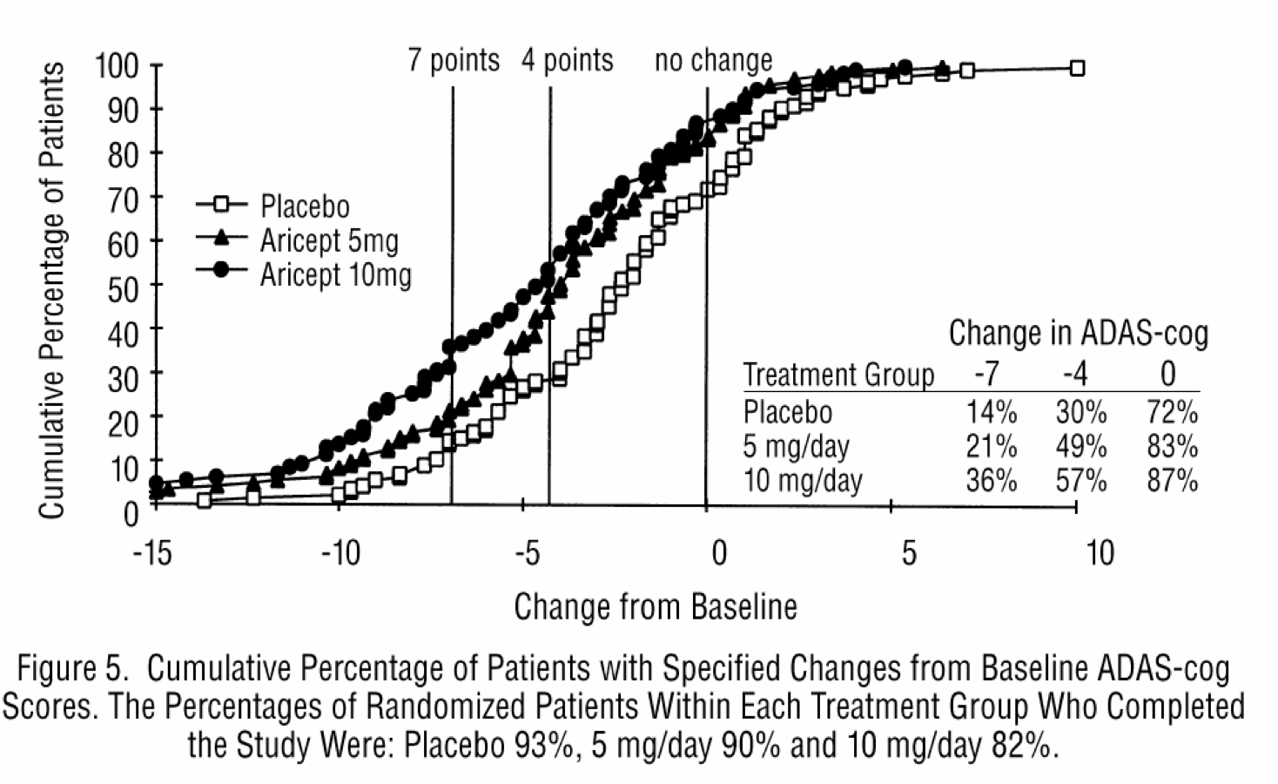
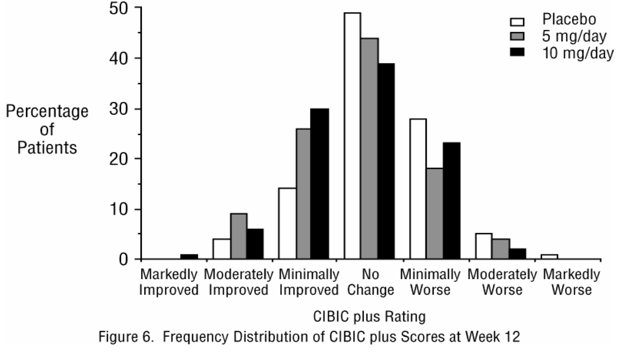
Extra Slides: Study Data Available to FDA
DRUG LABEL (from FDA): https://www.accessdata.fda.gov/drugsatfda_docs/label/2012/020690s035,021720s008,022568s005lbl.pdf

Slide 31
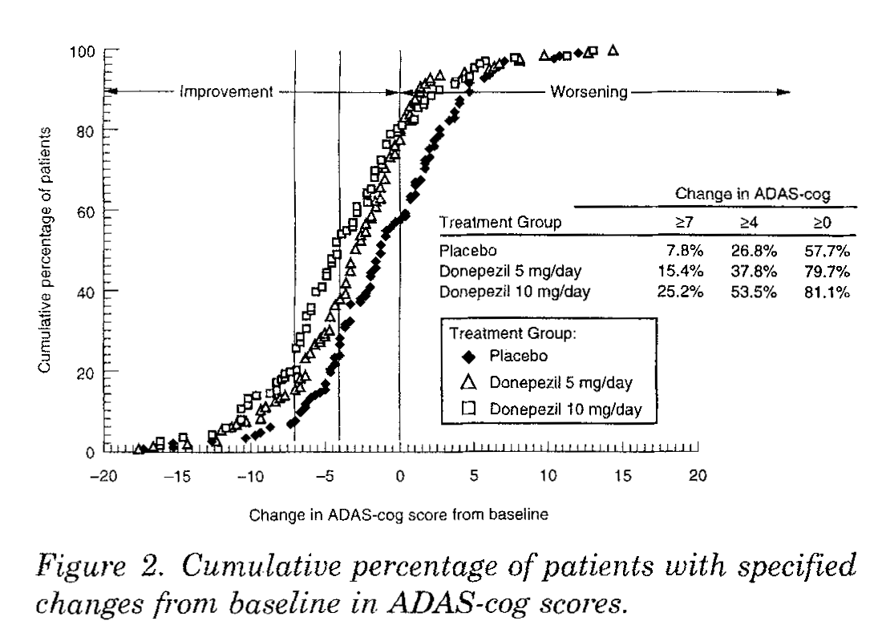
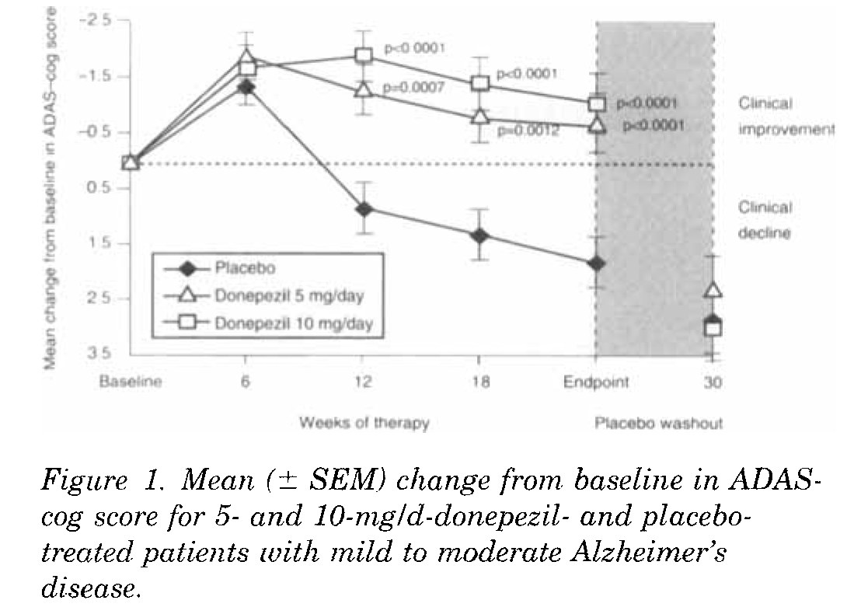
Extra Slides: The “Other” Phase 3 Trial
Rogers, S. , Farlow, M. , Doody, R. , Mohs, R. & Friedhoff, L. (1998). A 24-week, double-blind, placebo-controlled trial of donepezil in patients with Alzheimer's disease. Neurology, 50 (1), 136-145. doi: 10.1212/WNL.50.1.136.

