Slide 1

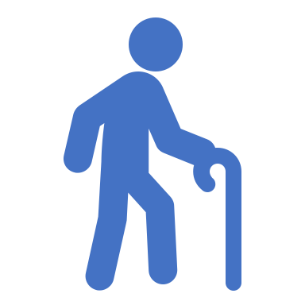
Geriatric - Trauma Consultation Service (aka Trauma Service)
James Templeman, MD
Assistant Clinical Professor
UCSD Division of Geriatrics, Gerontology and Palliative Care

Slide 2

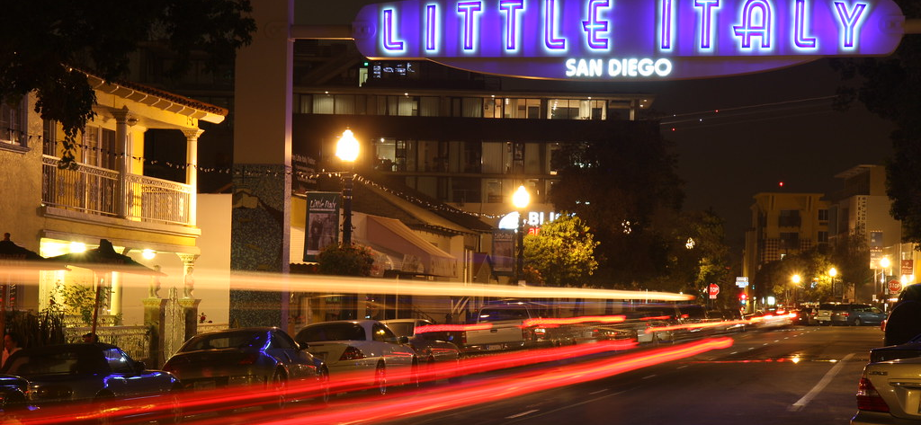


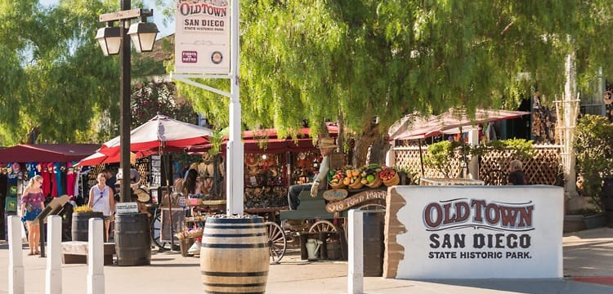
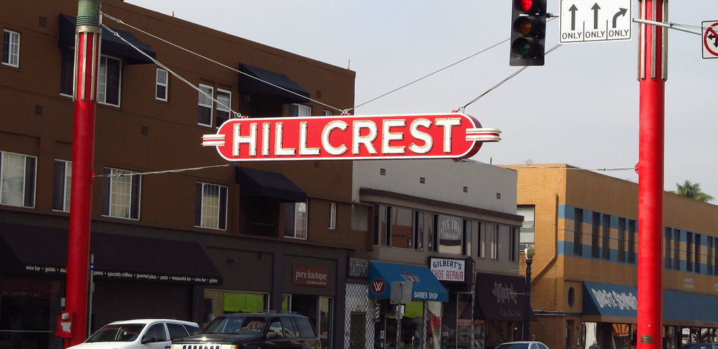
Welcome Fellows!!!
This Photo by Unknown Author is licensed under CC BY-NC-ND
This Photo by Unknown Author is licensed under CC BY-ND
This Photo by Unknown Author is licensed under CC BY-NC-ND
This Photo by Unknown Author is licensed under CC BY-NC-ND
This Photo by Unknown Author is licensed under CC BY-NC-ND
This Photo by Unknown Author is licensed under CC BY-SA-NC

Slide 3
Overview of the Geri/Trauma Service
History
Intro to Trauma
Goals
Challenges
Patients

Slide 4
UCSD Level 1 Trauma Center
Level I Trauma Center is a comprehensive regional resource that is a tertiary care facility central to the trauma system. Capable of providing total care for every aspect of injury – from prevention through rehabilitation.
Elements of Level I Trauma Centers Include:
  24-hour in-house coverage by general surgeons, and prompt availability of care in specialties such as orthopedic surgery, neurosurgery, anesthesiology, emergency medicine, radiology, internal medicine, plastic surgery, oral and maxillofacial, pediatric and critical care.
  Referral resource for communities in nearby regions.
  Provides leadership in prevention, public education to surrounding communities.
  Incorporates a comprehensive quality assessment program.
  Operates an organized teaching and research effort to help direct new innovations in trauma care.
  Provides continuing education of the trauma team members.
  Program for substance abuse screening and patient intervention.

Slide 5
Trauma Centers
Many of our patients are transferred to us from Imperial County which has no trauma system and has only limited physician specialty coverage.
We usually receive patients from El Centro Medical Center, Pioneer Hospital in Brawley or Yuma Medical Center.

Slide 6
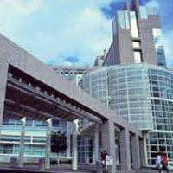
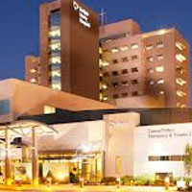
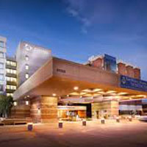
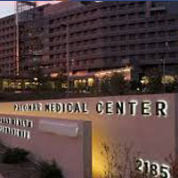
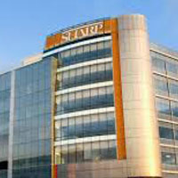

San Diego’s Trauma System
3 Adult Level I Trauma Centers
  UCSD Medical Center
  Scripps Mercy Hospital
  Scripps Memorial Hospital
2 Adult Level II Trauma Centers
  Palomar Medical Center
  Sharp Memorial Hospital
1 Pediatric Level I Trauma Center
  Rady Children's Hospital

Slide 7
For more information/ history on Trauma:
https://www.mercytrauma.org/history

Slide 8
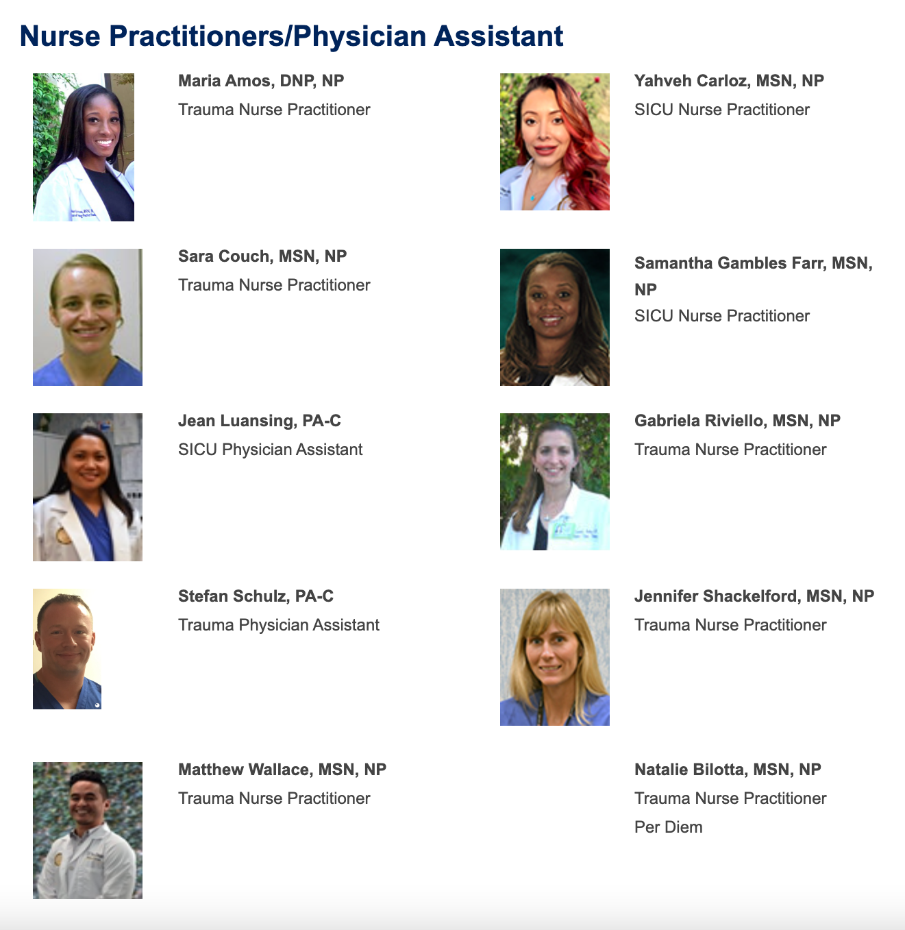
Trauma Frontline Staff
Rotating Attending
+/-
Rotating Intern (surgical or EM)
AND

Slide 9

Geriatric Consults
All trauma patients 65 and over, a consult should be placed by Trauma Team
Depending on the number of new consults, may have to triage
Geriatric Assessment (Comprehensive?), BUT can’t ignore Inpatient Medicine, transitions
May be a wide variety of issues
Some are high functioning, others are frail
Wide variety of socio-economic issues
Spanish speaking! And other mono-lingual

Slide 10
Goals of Rotation
#1 Goal is to learn geriatrics!
Inpatient care of geriatric patient
  Delirium, dementia, polypharmacy, pain, eating, pooping/peeing
Understand management of falls
Management of medical issues for inpatient and older adults**
Working with an interdisciplinary team as a consultant
Transitions of care and post hospital care
Cross-cultural implementation of 5Ms

Slide 11
Lots of detective work to figure how to help these patients!
Protecting the older patient both in the hospital and after she/he discharges!
Provide guidance for Geriatric Care

Slide 12

Trauma at Hillcrest… Some challenges
Lack of records
No medication list
Family not available
Discharge

Slide 13
Why do they need protecting?
Inappropriate medications given during the day/overnight
Inappropriate procedures
Poor understanding of delirium, dementia
Restraints!
No early mobilization
Forgetting about normal functions (eating, drinking pooping!)

Slide 14
Examples of patient
“80 year old female fell down 8 steps while walking at night. Negative LOC. Negative EtOH. Positive Blood thinners (Eliquis for A fib). Woke up in mid fall. Reports that she hit her chest during the fall, denies hitting head. Patient complaining of sternal pain.”
“90 year old male s/p mechanical fall in his bathroom earlier this morning. Was taken to Scripps and found to have bilateral SDH on CTH. CT C-spine and CT max were negative. Speaks Tagalog. History of dementia. GCS15 in trauma bay, reports taking aspirin but no other thinners. Questionable LOC, no EtOH.”

Slide 15
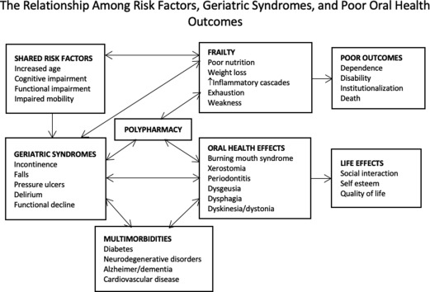
Falls

Slide 16
Falls
Definition: coming to rest inadvertently on the ground or at a lower level
MULTIFACTORIAL!!!!
What are some intrinsic factors?
  Age-related changes
  Orthostatic hypotension
  Foot problems or difficulty trimming toenails
  Urinary incontinence
  Hearing or vision impairment
  Cognitive impairment, Depression
What are some extrinsic factors?
  Psychoactive medications, Opioids
  Medications that can cause sedation or confusion, dizziness, hypotension, hypoglycemia
  Environment: clutter, shoes, pets, lights, stairs, shower, rugs

Slide 17
Sample medication list (90M)
Asa 81mg w/breakfast
Ramipril 5mg qday
Dutasteride qday @noon
B12 1000mcg @noon
Flomax BID
Metformin 850 BID
Seroquel 25mg ½ AM, ½ noon, 1 evening
Famotidine 20 BID
Atorvastatin 20 nightly
Mirtazapine 15 ½ nightly
Colchicine 0.6mg every other day PRN
Colace 250 PRN
Zofran PRN
Eye drops (travatin 1 drop nightly, cosopt 1 drop morning 1 drop evening,)
Advair inhalation 1x AM, 1x PM
Incruse ellipta daily noon

Slide 18
Common Inappropriate Meds
Androgens/testosterone
Anti-infective agents
Anticholinergic agents
Urinary and GI antispasmodics
Antipsychotics
Benzodiazepines and nonbenzodiazepine hypnotics (eg, zolpidem, zaleplon, eszopiclone)
  Digoxin (not a first-line drug for atrial fibrillation or heart failure) Dipyridamole
  H2-receptor antagonists
  Fecal softeners
  Insulin, sliding scale
  NSAIDs
  Proton-pump inhibitors
  Sedating antihistamines (H1-receptor antagonists, eg, diphenhydramine)
  Skeletal muscle relaxants
  Tricyclic antidepressants
  Vitamins and minerals
Notes:
18

