Slide 1

Week 2

Slide 2
Today
-Attendence
-Name dropbox
-OH change
-Syllabus
-Readings
-Survey
-Deadlines
-Change major/minor
-VAC, CAPS
-Questions from last class
-Resources

Slide 3
Survey

Slide 4
Deadlines

Slide 5
Important Dates
• Automatic waitlists officially end: Thursday, October 11th
• Add Deadline: Friday, October 12th
• Deadline to change grading option, change units and drop classes without “W” grade on transcript: Friday, October 26th
• Veterans Day Holiday: Monday, November 12th
• Thanksgiving Holiday: Thursday-Friday, November 22nd-23rd
• Instruction Ends: Friday, December 7th

Slide 6
High school vs. College

Slide 7
People
Professors
  Rate My Professor
  Ratemyprofessor.com
  CAPE: evaluations on webreg
Friends
TAs
  They are the one who grade
  Make sure your TA knows you
  CAT Writing Studio

Slide 8
Tips for efficient studies

Slide 9
Tips
Time Management Activities
Highlighting
Mastering one topic before moving on to the next
Choosing a single, consistent place to study

Slide 10
Time Management

Slide 11
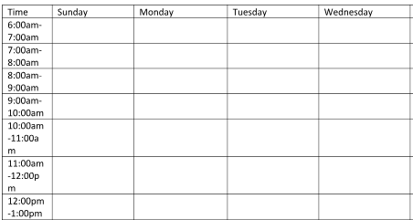
Excel Sheet

Slide 12
SPACES

Slide 13
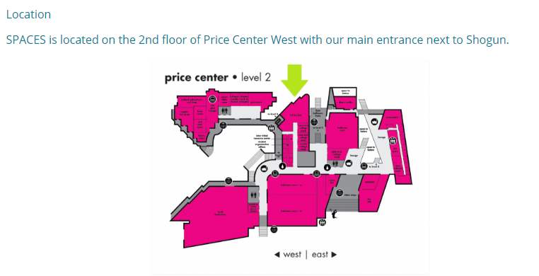
SPACES
Student Promoted Access Center for Education and Service
http://spaces.ucsd.edu/contact-us/
Mondays & Wednesdays: 9:00 AM – 4:00 PM
Tuesdays, Thursdays, & Fridays: 9:00 AM – 3:00 PM
We are closed on Saturdays and Sundays and during campus holiday closures
1,000 planners and giving them to students in early October
drop by SPACES during their operating hours to pick one up

Slide 14
Major/Minor

Slide 15
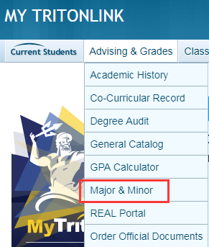
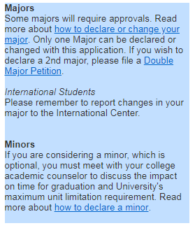
Change/Add Major/Minor

Slide 16
VAC/CAPS

Slide 17
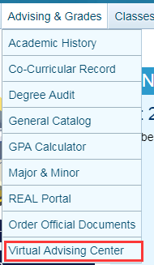
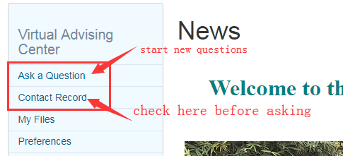

VAC/CAPS

Slide 18
Resources

Slide 19
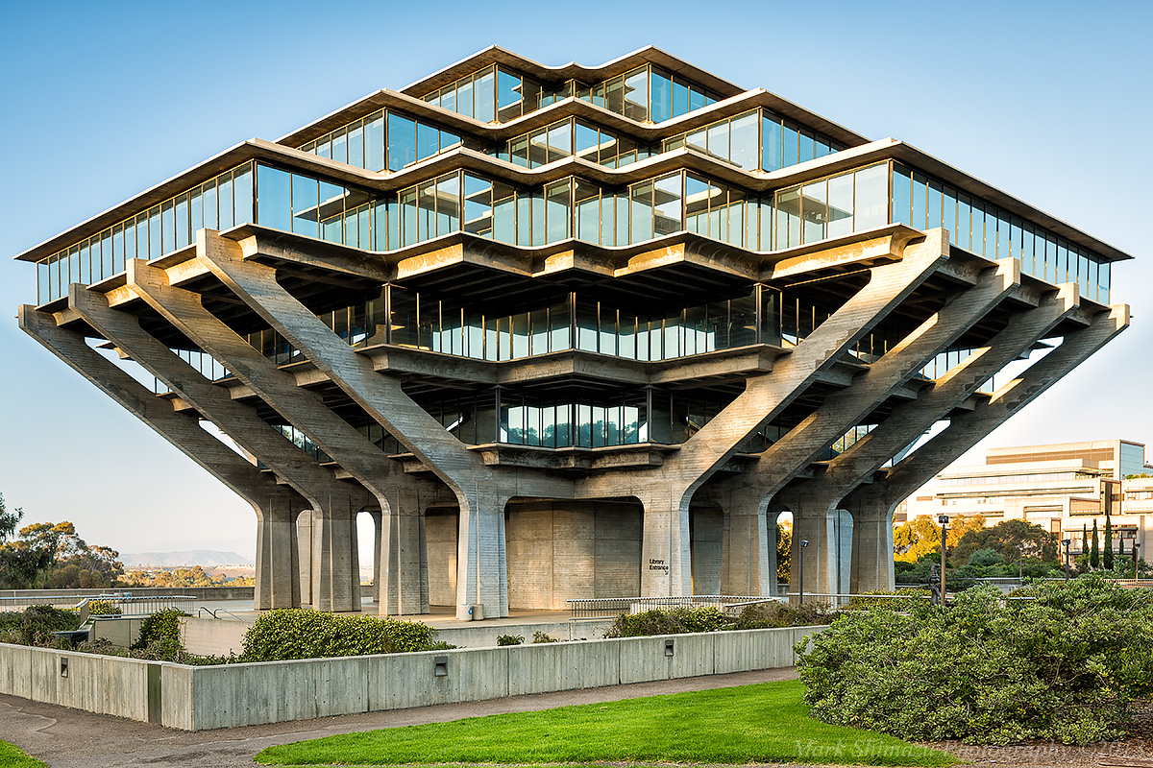
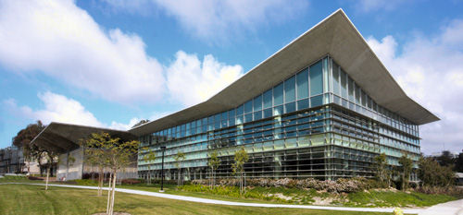
Library
-Hours (Geisel)
-Sunday: 10:00AM-midnight
-Mon-Thurs: 7:30AM-midnight
-Friday: 7:30AM-6:00PM
-Saturday: 10:00AM-6:00PM
-Hours (Biomedical)
-Sunday: noon-midnight
-Mon-Thurs: 8:00AM-midnight
-Friday: 8:00AM-6:00PM
-Saturday: 10:00AM-6:00PM

Slide 20
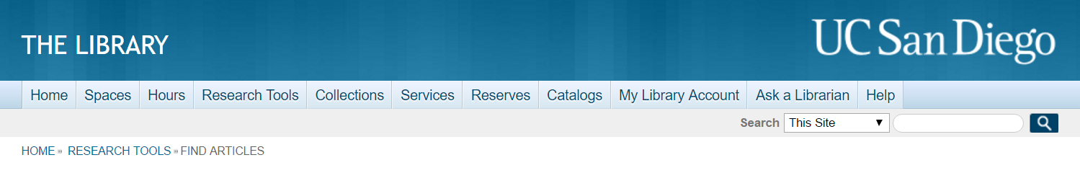
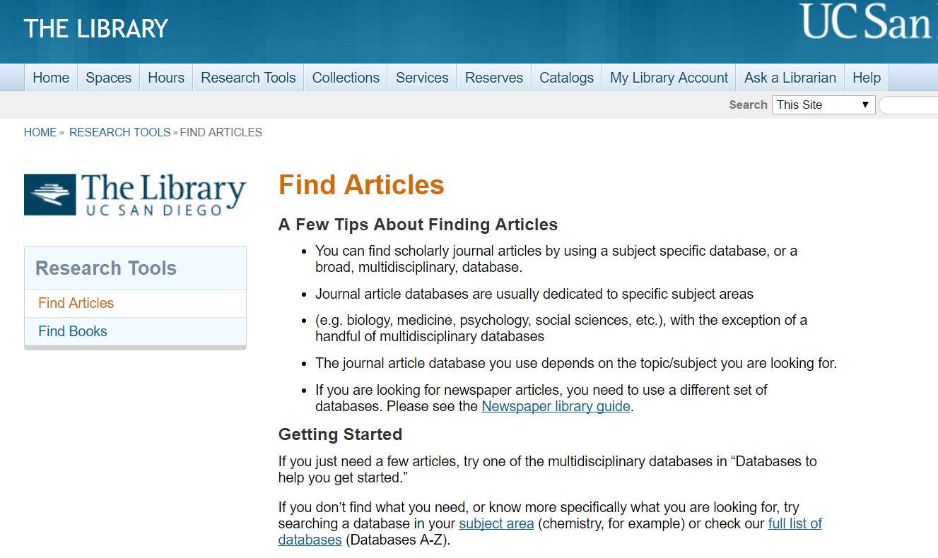
Library - Research Tools
select “Find Articles”

Slide 21

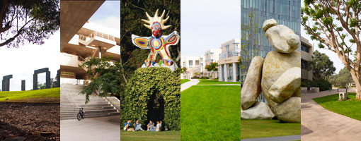
CAT Writing Studio
-Location: PCH 257
-Hours: Mon-Fri 8:00AM-4:30PM

Slide 22
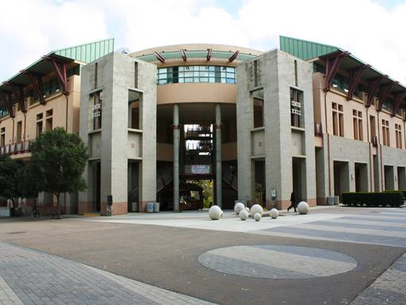

OASIS
-Location: Center Hall, 3rd Floor
-Phone: (858)534-3760
-Email: oasis@ucsd.edu
-Offer:
-Math/Science tutorial program
-Language Arts tutorial program
-2Connect: provide support into your 2nd year at UCSD

Slide 23


Calc Lab
-Location: The Teaching + Learning Commons
-Hours depend on math level, but most common are:
-Mon-Fri 12PM-7PM
https://math.ucsd.edu/undergraduate/undergraduate-resources/tutoring/index.html

Slide 24


Physics Tutorial Center
-Location: Mayer Hall 2218
-Fall 2018 Hours:
-Sunday 1:00PM-7:00PM
-Mon-Fri 11:00AM-7:00PM

Slide 25
Questions

Slide 26
Q&A
advice about buying textbooks, better places to buy textbooks than the bookstore?
advice on keeping track of all community events
advice on managing a minor/when to declare a minor/how to add a minor
are professor reviews posted online an accurate reflection of the professor
balancing study and fun
how active we should be in extracurriculars
how can I avoid procrastination
how can I make the transition to college easier on me, as well as my family
how to adjust to college
how to buy cheap textbooks (other books)
how to manage class well -- what do you think is the best schedule to have
how to manage finances in college, esp cheap textbooks
how to obtain the right courses

Slide 27
Q&A
how to use what we learn in this class in the real world
if you could go back to your freshman year, what would you do differently
is there any advice you have for someone in the math department considering an art minor
printing papers and making photocopies
should we "teacher shop"/ should we choose our courses based on others' impression of the instructor
what are some good study habits that lead to success in college
what are some things that made your first year easier that you didn't expect
what are your most significant regrets in college
what is a good way to study effectively
what would be the advice you wish you knew were a first year student
when is the easiest time to change my major
where is the best place to study
https://students.ucsd.edu/campus-services/technology/campus-study-locations.html

