Slide 1

Week 3

Slide 2
Today
Quick Write
Organizational Involvement
- Student Organizations
- Student Government
- CSI
Study Abroad
Internships
Volunteer work
Websites

Slide 3
Quick Write

Slide 4
Organizations

Slide 5
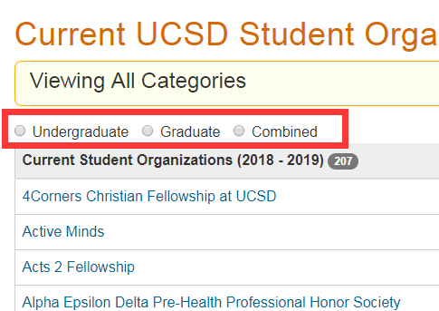
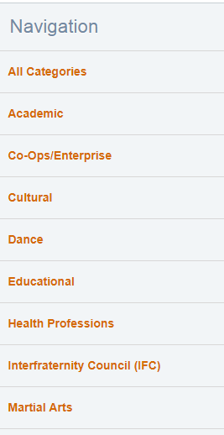
Student Orgs
General Student orgs:
https://studentorg.ucsd.edu/

Slide 6




Professional Student Orgs
Rady School of Management:
https://rady.ucsd.edu/programs/undergraduate-programs/organizations

Slide 7


Professional Student Orgs
Jacobs School of Engineering:
http://jacobsschool.ucsd.edu/idea/studentlife/undergradorgs.shtml

Slide 8
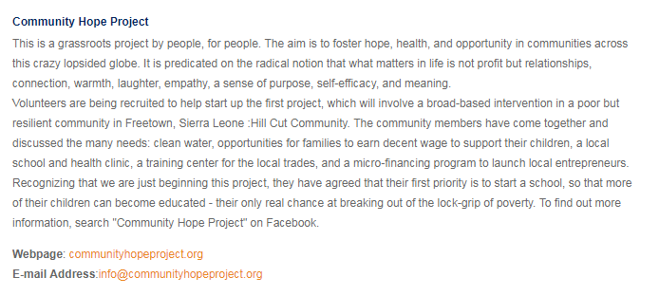
Professional Student Orgs
UCSD Global Health Institute:
http://globalhealth.ucsd.edu/resources/Pages/student-organizations.aspx
Brief Intro
Contact Info

Slide 9
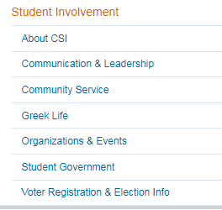
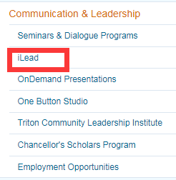
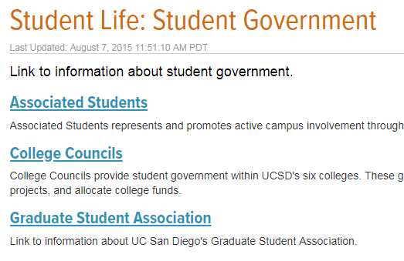


CSI: Center for Student Involvement
https://students.ucsd.edu/student-life/involvement/index.html

Slide 10
College Opportunities

Slide 11
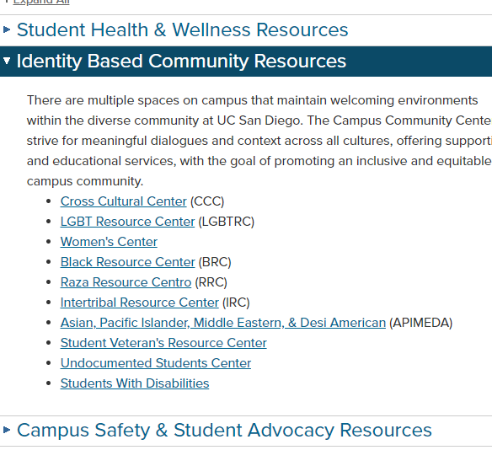
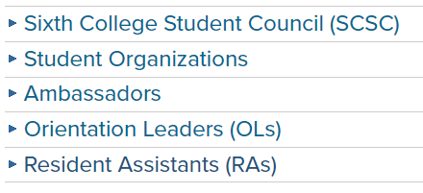
Sixth College Involvement Opportunities
http://www.sixth.ucsd.edu/student-life/involvement-opportunities/index.html

Slide 12
Study Abroad

Slide 13
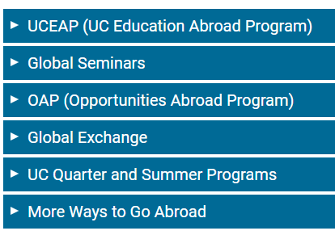
Study Abroad
https://studyabroad.ucsd.edu/
Practice Second Language
Make friends from other countries
Gain global insights
Have fun

Slide 14
Internship

Slide 15
Internship
When should I consider an internship?
Where can I find an internship?
  Career Service Center:
  Academic Internship Program:
  Handshake:
  Company Website
  LinkedIn
  Facebook Group:
    Jobs & Internships: Open group within UCSD
- I’m not sure about my career path, should I still consider for an internship?
https://career.ucsd.edu/
https://aip.ucsd.edu/
https://ucsd.joinhandshake.com/

Slide 16
Websites

Slide 17
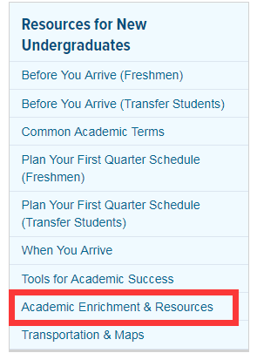
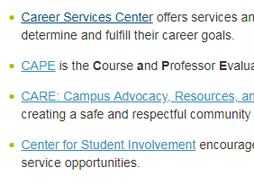
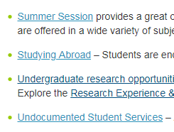
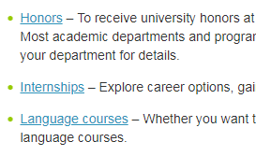
Resources for New Undergraduate
https://students.ucsd.edu/sponsor/new-students/index.html

Slide 18
Campus Community Centers
http://community.ucsd.edu/
Black Resource Center Cross-Cultural Center Lesbian Gay Bisexual Transgender Resource Center Raza Resource Centro Women’s Center are collectively known as the Campus Community Centers. Along with these partnerships, we build and sustain a socially just campus climate.

