Slide 1

Week 4

Slide 2
Today
Form Groups
Google Drive
CAPS
The Zone
Importance of Sleep
Stress
Student Wellness Program
Side Note: WIFI: endurom

Slide 3
Form Groups

Slide 4
Google Drive

Slide 5
Team Drive
For future assignment
No need to print out → save money!
Due before discussion
No late homework accepted

Slide 6
CAPS

Slide 7

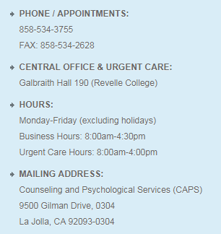
CAPS
https://caps.ucsd.edu/

Slide 8
The Zone

Slide 9

The Zone Programs
https://wellness.ucsd.edu/zone/Pages/default.aspx
Programs:
https://wellness.ucsd.edu/zone/programs/Pages/default.aspx
Therapy Fluffies:
Thursdays 1:30-2:30

Slide 10
Importance of Sleep

Slide 11
Importance of Sleep
Video about scientific studies: https://www.youtube.com/watch?v=xxxWv6PM4EM
Personal experience
  Stay up all night before finals doesn’t make me do better on the exam
  Don’t stay up all night unless you really don’t know anything about the course

Slide 12
Stress

Slide 13
Signs of stressful
Can’t sleep
Eat a lot
Anxious
Somehow want to cry
Watch YouTube all day
Don’t want to do anything but lying on the bed all day

Slide 14
Tips to deal with stress
Running
Yoga/Mediation
Cooking
Listening to music
Drawing
Go to La Jolla Shores and watch sunset
Take a walk by the sea
CAPS
ANYTHING is better than lying on bed all day
Side Note:
Talk to your professor if you did great on Final but poor on Midterms

Slide 15
Student Wellness Program

Slide 16
Student Wellness Program
https://rec.ucsd.edu/Program/GetProgramDetails?courseId=4f17dc18-a0a0-4e1a-8f3e-4d907dd08531&semesterId=d59b0732-8588-476a-8e59-2a3f8207dc6c
FREE for UCSD students
Get personal assessment before and after the program for comparison
Once per week
Total of 8 weeks
Topics include: cardio, lifts, free weights, food choices, stretch, stress, balance, etc

