Slide 1

Week 7&8

Slide 2
Today
Week 8 paragraph due next week before discussion, upload on FYE Teamdrive
Integrity Resources
Writing and Citing
Understanding Identities

Slide 3
Integrity Resources

Slide 4
Integrity
Academic Integrity Office
https://students.ucsd.edu/academics/academic-integrity/
Get Involved
http://academicintegrity.ucsd.edu/take-action/get-involved/AI%20Proctor%20Program.html

Slide 5
Writing and Citing

Slide 6
Writing and Citing
Always cite
  Both in-text and on the last page
Master MLA format
Quotation vs Paraphrase
  Quote at most one line at a time
Plagiarism Checker
https://smallseotools.com/plagiarism-checker/

Slide 7
Understanding Identities

Slide 8
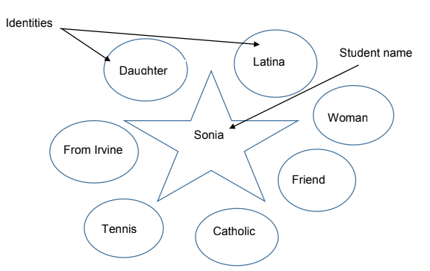
Group Activity
Write things that you feel comfortable to share!!!
Pull out a paper
Write your name in the middle
7 identities of your choosing in the bubbles (son, brother, gay, Asian, male, etc)
On the back of sheet, list 6 your experiences that if taken away from you, you will not be the same person you are today.
  Growing up in Orange County.
  My parents work hard to support me.
  Working through college.
  Go to UCSD.
  Playing tennis

Slide 9
Group Activity
Get into a group of 2
Share your identities and experiences with your partner
  Why are the experiences important to you?
  How do these experiences shape you as a person?

Slide 10
Group Activity
Now swap identity sheets with your partner
Identify one as Student A and the other as Student B
A remove one identity and one experience for B
B retell the story of his/her life without the identity and the experience removed
Continue to remove until 3 identities and experiences remain
Notes:
The purpose of this section is for students to realize that various identities and
experiences shape their personas therefore removing (or not acknowledging)
certain identities and experiences limit people with their self-expression and
individuality.

Slide 11
Discussion
How did the activity make you feel?
What were the feelings when I asked you to remove someone’s identity and experiences?
Was it easy or difficult to remove other person’s identity?
What have you learned from this activity?
What are some things that would cause your identities or experiences to
feel ignored or not acknowledged?
How do we prevent yours or others identities or experiences from being ignored or not acknowledged?
Notes:
The purpose of this section is for students to realize that various identities and
experiences shape their personas therefore removing (or not acknowledging)
certain identities and experiences limit people with their self-expression and
individuality.

