Slide 1

Week 9

Slide 2
Today
Week 8 paragraph due
Video due
Final reflection essay
Co-curricular records
Internships
  Linkedin
  Resume
  Cover letter
  Jobs
Q&A from lecture index cards and Week0 quick writes.

Slide 3
Final Reflection Essay

Slide 4
Final Reflection Essay
Due Friday of Week 10 @ 3:30pm
Also can turn it in Week 10 discussion
Printed, double spaced, 12 font, 1 inch margin, 2-3 pages, work cited page, no title page required
Sixth Admin offices (Second floor Pepper Canyon Hall, through the main front doors)

Slide 5
Final Reflection Essay
Topics covered:
  Week 6: Enhancing Your Communication Skills and How to Ask for Help
  Week 7: Academic Integrity and How We Make Failure Productive
  Week 8: Understanding Yourself and Others: Valuing a Multicultural Campus
  Week 9: Research Opportunities, Internships, and Beyond
  Week 10: Lessons Learned and Planning Forward
Topics covered:
  Week 1: University Life: Opportunities, Challenges, and Expectations
  Week 2: How Learning Works
  Week 3: Campus and Community Involvement
  Week 4: Personal Well-being
  Week 5: Choosing and Committing to a Major

Slide 6
Co-curricular records

Slide 7
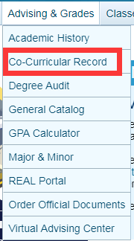
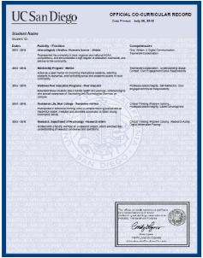
Co-curricular records
Research and Academic Life
Student and Campus Engagement
Community-Based and Global Learning
Professional and Career Development
http://elt.ucsd.edu/ccr/ccrapprovedopportunities.html#Academic-Integrity-Office

Slide 8
Internships/Jobs

Slide 9
Build a Resume
Education
Experience
  Work
  Volunteer
  Mentorship
  Leadership
Awards/Achievements
Skills
Honors

Slide 10
Build a Cover Letter
Audience
Position you are applying
Why you are a good fit
  Roadmap
Expand your experience/skills
Maximum 1 page
3-5 paragraphs

Slide 11
LinkedIn
Not only profiles
Connect with alumni
Send cold emails
  By school
  By organizations
  By company email address
Connect with professor

Slide 12
Handshake
Best place to find jobs/internships for students
Most intern positions don’t require experiences
More exclusive to college students
Build a profile similar to LinkedIn
Other useful tools
  UCSD Portfolium
  REAL Portal
  CCR
Notes:
The purpose of this section is for students to realize that various identities and
experiences shape their personas therefore removing (or not acknowledging)
certain identities and experiences limit people with their self-expression and
individuality.

Slide 13
Q&A
How to prioritize classes on webreg?
Why build 7th college when 6th college is not named yet?
How people fit on this campus, financial aid?
Printing at the library?
Distressing?
Time management?
Should we choose our courses based on others' impression of the instructor?
What are some good study habits that lead to success in college?
What is a good way to study effectively?
What would be the advice you wish you knew were a first year student?
When is the easiest time to change my major?
Where is the best place to study?

