Slide 1

Using Bibliometrics and Altmetrics to Communicate Your Scholarly and Research Impact
CC-BY 4.0
Teri Vogel
Karen Heskett
Allegra Swift
February 7, 2018
Notes:
Welcome.
Introductions.

Slide 2

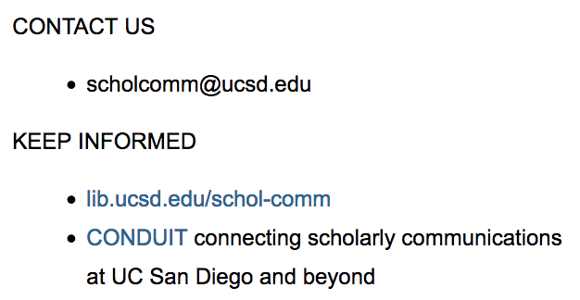
Copyright & Author Rights
Research Impact & Reputation
Funder & UC Policies
Publishing Opportunities
Notes:
There is an accompanying guide for this workshop, with additional resources about these topics, or if you want to refer back to something we cover today. We’ll also post the slides.

Slide 3
Learning Outcomes
Research Metrics to Tell the Story of Your Impact
Quantitative Metrics Tools
So What?
  Metrics → Telling the Story
Visibility
Notes:
This is what we’re going to cover today
Quantitative metrics you can obtain for your research outputs, that can help you tell the story of the impact of your scholarly work.
At the end of this session, you’ll be familiar with the major tools to get these metrics, both traditional bibliometrics and the new altmetrics tools.and the some of the newer ones
What they can offer, what are their limitations? And how to select the appropriate ones.
We’ve added some time at the end of this to give you a chance to try these out, so you can start working with them immediately.
Where to go to find more metrics that may be of use.
You will have some ideas on how to give context to these metrics, the “So what” factor. What does it mean if something was viewed/cited (etc.) X number of times? How does this metric help you tell the story of your impact as a scholar/researcher.
Identify some possible ways to increase the visibility of your research. The more people can find your work, ……
This is a new workshop for the library, so your feedback will be invaluable as we offer more of these workshops in the future.

Slide 4
Outputs
Journal articles
Books/book chapters
Patents
Conference papers
Policy papers
Presentations, lectures, posters
Interviews
Collaborations
Educational materials
Clinical protocols
Datasets
Software, code
Performances, exhibitions
The tangible products, goods, and services that are produced (supplied) directly by a program’s activities.The use of outputs by beneficiaries contributes to changes in outcomes.¹
https://openknowledge.worldbank.org/bitstream/handle/10986/25030/9781464807794.pdf
Notes:
So when we talk about metrics, we have to talk about Outputs and Outcomes
Outputs are those products, goods, and services produced or supplied by your activities, like research, teaching.
The first outputs that come to mind may be journal articles, or books or book chapters, but any of these can be your scholarly outputs. Things you produce, things you want to get credit for.

Slide 5
Outcomes
Advancement of knowledge²
Clinical implementation
Community benefit
Legislation and policy
Economic benefit
The specific changes in a program participants’ behavior, knowledge, skills, status and level of functioning.¹
Change in understanding of a disease, disorder or condition³
Change in clinical or research practice
Enhancement of community health, culture
Collaboration patterns
Extent of interdisciplinary research
Increased public awareness
https://www.bttop.org/sites/default/files/public/W.K.%20Kellogg%20LogicModel.pdf
https://becker.wustl.edu/impact-assessment/how-to-use
http://www.phcris.org.au/phplib/filedownload.php?file=/elib/lib/downloaded_files/publications/pdfs/phcris_pub_3236.pdf
Notes:
Outcomes are the specific changes in a program participants behavior, knowledge, skills, status and/or level of functioning. These are the things you want to see improved, expanded.
These came from several health sciences groups, so there are some desired outcomes that may not be applicable to other disciplines.
What you value, what you want to demonstrate?
What are the outcomes you value? Your department? UC San Diego? What are the goals, missions?

Slide 6
Impact?
Measurement/assessment of changes in outcomes.
Is impact measurable?
Metric as Indicator (evidence) of the impact of your Output(s) on Outcome(s).
Notes:
So then what is impact?
How do the programs activities and outputs change the outcomes? What are you trying to do is measure or assess those changes.?
Can you measure or quantify impact?
Probably not, but you may be able to provide indicators or evidence of possible impact in these areas through the metrics.
Metrics can serve as indicator of your impact, quantitative to provide evidence of the story you’re telling about the impact of your work (qualitative).
Metrics, if chosen appropriately, used correctly, and given context...can help you show evidence of your impact.

Slide 7
Who cares about metrics and/or impact?
YOU
DEPARTMENTS & INSTITUTIONS
FUNDERS
POLICY MAKERS
GENERAL PUBLIC
Notes:
Who uses and cares about metrics and impact?
You - employment, promotion and tenure, grant funding, how you compare w/ peers
Institutions/Departments - also considering these for employment, P&T. How do you compare against your peers, and how do they compare with similar departments, institutions.
Funders - also interested in your impact, including broader impacts (NIH, NSF, etc)
Policy Makers
Public - I’m including the media here as well. They may be looking for experts..

Slide 8

Selecting Metrics?
The Story / Outcome
The Audience
The Output
Notes:
What metric do you use?
Depends on story you’re trying tell (outcome), the audience you’re trying to reach -- and what they care about, and the output in question.
For example: if you’re talking about immediate, public engagement outside your research peers, then how useful is the number of times your article was cited in the scholarly journals in your field?
Just like any information need, figuring out what you need can help you decide what’s the best tool.
Will show you a new resource to assist you with this selection, along with more metrics than we’ll be able to cover.
Librarians can assist you with this.

Slide 9



Times Cited: 4
BIBLIOMETRICS
Based on Citation Counts
ARTICLE A
Citing Articles
YOUR ARTICLE
ARTICLE B
Cited Article
ARTICLE C
ARTICLE D
Notes:
These metrics generally fall into 2 categories. We’ll start with bibliometrics.
Bibliometrics - based on citation counts...when your scholarly work is subsequently cited in another scholarly work. We tend to think of journal articles getting cited in journal articles, but this can also include some other sources like books and book chapters, and conference proceedings, patents, and dissertations.
There are 3 key tools for bibliometrics: one is free, one we license here at UCSD, and one we don’t license but there’s some data they’ve made freely available.
With these, you can get metrics at the journal level, author level, and metrics for the specific article or other work.

Slide 10
Journal Impact Metrics
Metric | Source Citation Data | Access
Journal Impact Factor, Eigenfactor | Web of Science | Journal Citation Reports http://uclibs.org/PID/36787
CiteScore, SJR, SNIP | Scopus | Journal Metrics - Scopus https://journalmetrics.scopus.com/
h5-Index and h5-Median | Google Scholar | Google Scholar Metrics https://scholar.google.com/intl/en/scholar/metrics.html
Notes:
I’m starting with journal impact metrics, so we can get them out of the way.
There are a number of metrics for journal impact. The one you may already be familiar with is Journal Impact Factor, which is drawn from Web of Science citation data and easily retrievable in Journal Citation Reports, which we license. The other journal-level metrics come from Scopus (and this part you can access free), and Google Scholar.
All based on same principle, particularly the first 2: The frequency at which an “average article” can expect to get cited in the immediate years after publication.

Slide 11
Journal Impact Factor
Number of times that articles published in a journal for 2014 and 2015 were cited in 2016
____________________________________
Number of citable items (articles, reviews, proceeding papers) published in 2014 and 2015
2016 Impact Factor
Journal Citation Reports (Clarivate Analytics) - http://uclibs.org/PID/36787
Notes:
For example, the 2016 Journal Impact Factor for a journal is the total number of times that 2014-2015 articles were cited in 2016, divided by the total number of articles, reviews, proceeding papers that were actually published in 2014-2015.
200 articles published in 2014, 2015 issues, and those articles cited a total of 800 times in 2016, then the 2016 JIF → 4. On average, the articles were cited 4 times in the 1-2 years after publication.
CiteScore is similar, though they look at the last 3 years of published items (more than the “citable” items used to calculate the JIF, including letters, editorials).
Google Scholar’s H5-index is different. A value of 100 would mean that there were 100 articles published 2012-2016 that were cited at least 100 times.
Why used, especially JIF: traditional, well-known, tied to journal reputation. An easy number for people to recognize, journals to promote on their website.

Slide 12
Caveats with Journal-Level Metrics
Less coverage of arts/humanities.
Favors review journals.
Not an indication of article or author impact.
  Do not use journal-based metrics, such as Journal Impact Factors, as a surrogate measure of the quality of individual research articles, to assess an individual scientist’s contributions, or in hiring, promotion, or funding decisions. - Recommendation 1, San Francisco Declaration on Research Assessment
Subject comparisons - apples and oranges
Notes:
Criticisms of journal-level metrics.
Slanted toward science/social science journals. JCR doesn’t even cover arts/humanities journals.
Often favors review journals, as these articles are heavily cited.
There’s also the question of what’s going into these ratios? The JIF and CiteScores for NJEM vary widely because the denominators in that ratio are so different. Also, when do citations get counted?
Not meant to measure impact or influence of authors, institutions, or articles. But institutions may pressure researchers to publish in journals with high JIFs. Submission rates go up, acceptance rates go down. Measure of exclusivity.
San Francisco Declaration on Research Assessment (DORA) - editors, publishers, researchers calling for JIF and other journal-based metrics to be de-emphasized, that they not be used to measure value of articles or researchers for activities like P&T or funding.
Should not compare IFs across disciplines. Apples and oranges...or fish.

Slide 13
 | Journal Impact Factor | CiteScore | SNIP (Source-Normalized Impact per Paper) | SJR (SCImago Journal Rank)
New England Journal of Medicine | 72.406 | 12.82 | 14.683 | 15.736
Chemical Reviews | 47.928 | 42.79 | 10.369 | 19.282
Science | 37.205 | 14.39 | 7.688 | 13.535
Journal of the American Chemical Society | 13.858 | 13.18 | 2.584 | 7.368
IEEE Communications Magazine | 10.435 | 10.66 | 4.807 | 2.827
Quarterly Journal of Economics | 6.662 | 8.21 | 6.749 | 24.769
Astrophysical Journal (not ApJ Supplement) | 5.533 | 5.26 | 8.836 | 2.863
Economic History Review | 1.233 | 1.57 | 1.821 | 1.210
Notes:
I selected a few journals at the top or near the top of their respective subject categories. You can see the wide variation among the titles in these different disciplines. And any ranking among these titles is based on how the categories are defined.
The last 2 metrics are also part of the Scopus journalmetrics site. SJR tries to factor in the prestige of the journals citing the articles from the journal in question. While SNIP is trying to correct for differences in the citation potential that varies among the different disciplines and journals within a discipline.
But if you do look at these journal metrics and incorporate them into your CV or P&T dossier, will the person at the other end know what these are?

Slide 14

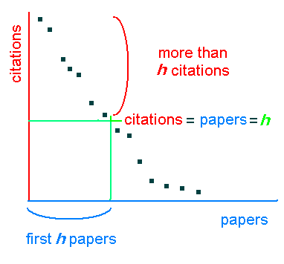
Free
Times Cited
Citation Alerts
H-Index
Google Profile*
https://scholar.google.com/intl/en/scholar/citations.html
https://commons.wikimedia.org/wiki/File:H-index_plot.PNG
Notes:
Starting w/ Google Scholar - free, so you don’t have to worry about losing access when you leave UCSD.
How many of you have searched this before?
Google, but limited to scholarly works
You can search to see how many times your works were cited, and set up alerts to keep track of when your works are cited (albeit one alert/article)
H-Index. - the number where the number of your articles and cites/article meet.
And you can set up profile to track all of your works in one place, and make it public so others can find your works.

Slide 15
Article/Author Metrics
Notes:
Search Emily Chin at SIO. Note that underlined authors go to profiles.
Default, sorts by cited by, change to year. Can go look at who cited each article, including dissertations, preprint servers like arXiv, patents (though for patents I’d also compare against the Google Patents entries)
Show the H-Index, i10-index (articles w/ at least 10 cites)
Link to create your own profile.

Slide 16
Profiles
Notes:
How many of you have set up your Google Scholar Profile?
Bring up my profile, logged in.
Creating a profile, “claiming” my work, addresses author ambiguity, confusion
Anything that can impact someone from searching for your works by name: Changed your name, inconsistent with using middle initials, suffix like Jr., compound last name
Can add articles and other works manually. Let new articles get captured automatically, then periodically check to see if any are not yours. H-Index shouldn’t be affected if you add works that that haven’t been cited.

Slide 17
Coverage
13,K+ journals, 80K books, 180K conference proceedings
Times Cited
Citation Alerts
Citation Reports/H-Index
“Top papers”
  Highly Cited Papers
  Hot Papers
Notes:
Our other principal resource for article/author citation-based metrics:
Web of Science
Indexes 13,000 journals fully, 80K books,180K conference proceedings - clearer sense of the coverage scope vs. Google Scholar
Includes bibliographies to track, to see cited and citing articles.
2 ways to check times cited - we’ll cover both
Can bulk export citing articles, create citation alerts (one/article)
“Top Papers”

Slide 18
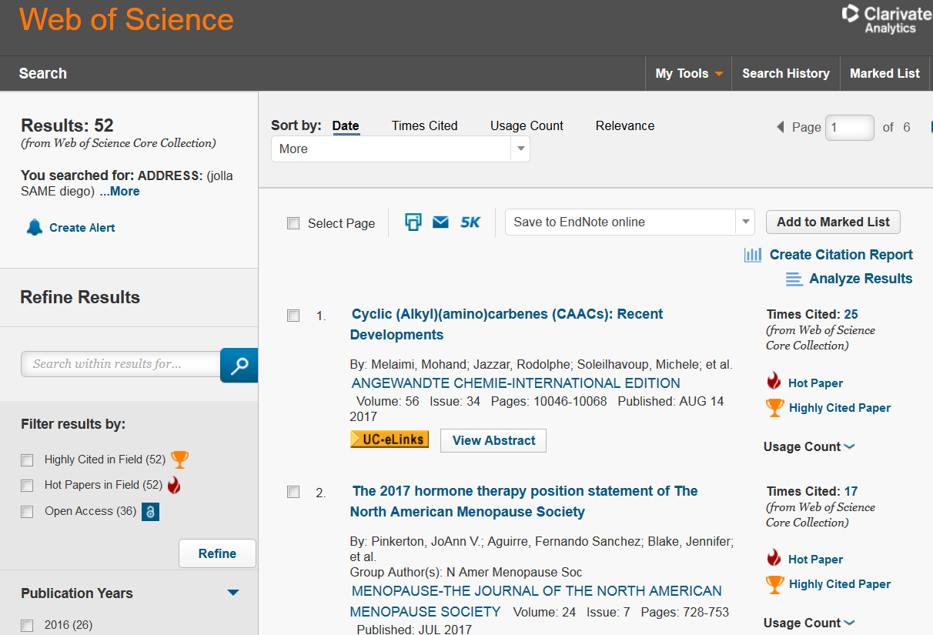
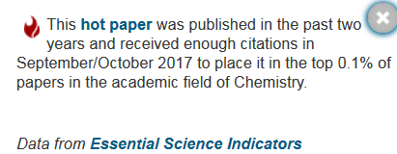
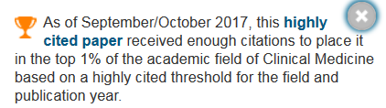
Article Metrics
Notes:
Search aerosols as a topic search.
Highly cited paper - for given months, paper cited enough times to put in 1% against that category (22 broad categories)
Hot papers - published in last 2 years, and those 2 given months, cited enough to put in top 0.1% of papers in that category and publication year.
Highlight Highly Cited and Hot Papers. Show what these mean. Based on what was indexed in WoS for those 2 months, not necessarily when your paper first went online. Hot papers recycles every 2 months. Note the “usage” and what that means (number of times that users--not just at UCSD have gone beyond reading the abstract. Linking out to full text, or exporting the reference)

Slide 19
Article Metrics
Notes:
Search author Cohen Seth M. Note times cited, and that some of these aren’t his papers (would have to limit by address). Go to #24, from Nature Reviews Materials. Bring up the (now) 30 citing articles, note the citation alert option.

Slide 20
Cited Ref Searching - Variations
Citation Variations
Article cited incorrectly
Article cited before article was indexed
  In Press, ASAP or Preprint
Web of Science errors
Can You Fix Citation Variants?
  Maybe
Why Fix Citation Variants?
  “Times Cited” heavily used
  “Times Cited” sorting option
  Could impact H-Index
Notes:
Use the Cited Ref Search for Cohen, SM and 2016. Look at the multiple (1st author) Denny references, how there possibly 4 variants that aren’t assigned to the official reference and times cited.
Possible reasons for citation variants that couldn’t be matched to “official” citation.
Article is cited incorrectly by citing authors. In this case, several authors entered the first author’s Jr like it was a first initial.
Article is cited as ASAP (as soon as published) and not yet assigned to an issue, when it would’ve been indexed for WoS.
Article is cited as a preprint or a discussion paper (Atmos Chem & Phys Disc vs Atmos Chem & Phys)
Typos and other errors in the reference as cited on the publisher’s website. For example, website has article number 110010 when it’s really volume 1, article 10010. Possibly correct in the PDF, but wrong in the HTML version.
Article cited correctly at publisher’s website, but error made when entered into Web of Science (Vanmart instead of Van Mart, for example)
Can WoS cited reference errors be corrected? Sometimes.
In fact, the example used here originally had a times cited of 26 and 8 citation variants. Four were reported the week before this workshop and and corrected the day before, so the times cited is now 30.
Use the feedback link at the end of the page. Submit data change for “cited reference.” Clarivate responds quickly, and if they approve the changes will make them in 3-5 days.
Why this matters?
Most WoS users only look at the Times Cited and not the Cited Ref Search. The Times Cited number is also sortable in the results.
Citation variants aren’t counted for H-Index.
Challenge here is going to be time involved in checking these. It might be something worth doing once a year. Do a cited ref search by name and a given year, and browse the results for variants.
Checking and updating likely more meaningful for early researchers with fewer papers and times cited.
If you want to get started with something like this, I think we could assist you.

Slide 21
Author Metrics & Researcher ID
Notes:
Author search on James Fowler. If too many, you can filter by organization. Go to Citation Report to see citing history and H-Index.
H-INDEX CAVEATS
Benchmark against researchers in same field/journal categories, and same career length
Weaker in disciplines that don’t publish heavily in journals
Based on what’s indexed in Web of Science, so you can get different H-Indexes elsewhere. The H-Index you get is also based on whatever search results you’ve retrieved, regardless of whether you have everything by that author (and just the author). You can even get an H-Index from topic research results.
WoS has its own system for disambiguating citations, that you can use to create public/private profile to get WoS metrics for your works. Use your WoS login (or create one) to set up your ResearcherID.
Connect to ORCID
Build publication list, using WoS and/or uploading from EndNote RIS file

Slide 22
Why different citation counts?
  GS includes dissertations, theses, preprints
  GS identifies citing articles not yet indexed in WoS (ASAPs)
  Possible duplicate references in GS
  Variant citations in WoS
  Some citations unique to WoS
  Missing citations in WoS
Notes:
What you’re going to discover pretty quickly is that you’ll likely see different times cited (and possibly an H-Index) in Google Scholar vs Web of Science
The times cited counts will probably be higher in Google Scholar. For example, the Cohen paper in Nature Review Materials has been cited 30 times per Web of Science, and 48 times per Google Scholar.
Since you can see what papers cite your paper, you can bring up the lists, exclude the citing articles captured in both Web of Science and Google Scholar, then see what’s left. You may come across a few citing articles only captured in Web of Science, but more will be unique to Google Scholar, because:
Google Scholar covers sources that may cite your work not covered by Web of Science like dissertations, theses, and preprints.
Web of Science doesn’t index articles until they’re assigned to an issue, so many of the citing articles that only come up in Google Scholar will eventually appear in your Web of Science times cited list.
There can be duplicates in the Google Scholar results.
There may be citation variants in Web of Science that you can check for in a Cited Reference search, and possibly get corrected.
Sometimes, a there are missing references in Web of Science.
Google Scholar shows that my paper A was cited in article 4 times, while Web of Science says 3 times. That 4th article had 50 references (including mine) and is indexed in Web of Science, but the article’s cited reference list in Web of Science only displays 49 references.
This does happen and you can report these. This is the best way to catch missing citations.
Which times cited count to use?
Most would say to use whichever is higher, but some researchers will include both (Times cited: __ Google Scholar, __ in Web of Science)
But it’s good to know why these are different.
Is it worth it to do this kind of review, cleanup?
It depends. Again, it might be of more value to an early career researcher with fewer papers. And we would be willing to assist you, or at least get you started.
You may be able to speed this up by exporting the cited references from WoS into EndNote. GS only allows you to export one reference at a time, unless you use something like Zotero that can “scrape” the references from the Google Scholar page. The quality of deduping in the reference manager will depend on that manager.

Slide 23
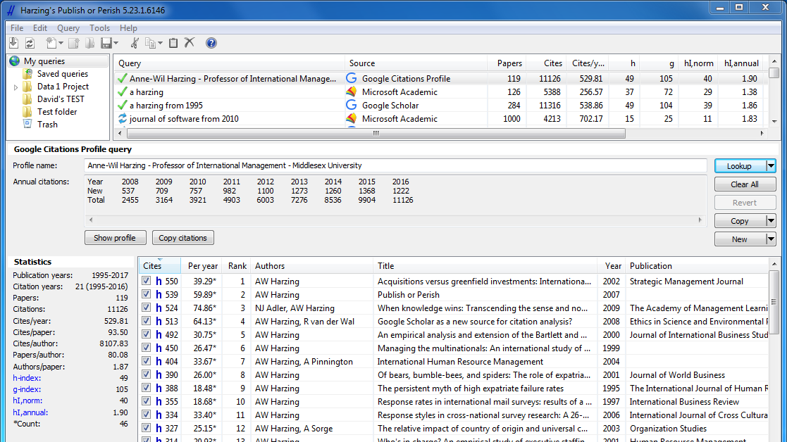
Publish or Perish - www.harzing.com
Total number of papers and total number of citations
Average citations per paper, citations per author, papers per author, and citations per year
Hirsch's h-index and related parameters
Egghe's g-index
The contemporary h-index
Three variations of individual h-indices
The average annual increase in the individual h-index
The age-weighted citation rate
An analysis of the number of authors per paper.
Notes:
Publish or Perish - software that allows for citation analysis from Google Scholar and Microsoft Academic Search, and possibly Web of Science through an EndNote or BibTeX file. I haven’t had a chance to work with this myself. Here are the metrics you can receive.

Slide 24
Limitations of Bibliometric Data
Immediacy?
Data sources, categories?
Citation bias?
Improper use, comparison?
Why are the works cited?
Author disambiguation?
Gamification?
Has to be cited?
Notes:
There are limitations to using bibliometric data
Immediacy - you have to wait for articles to get cited, published, and for those articles to get indexed. Waiting for your work to get cited in books? Even more time.
Data sources?
What’s being indexed/crawled, and when (WoS has time lags and sometimes citation variants)? Are your research outputs not getting indexed in WoS or GS, or are the sources that cite or use them not getting indexed?
Citation bias? - mentioned before that review journals/articles are heavily cited? Other disciplines cite journals more heavily. Do highly cited papers become self-perpetuating? As they filter or sort to the top of any list based on citation counts, do their visibility add to their times cited at a faster rate?
Are you using these metrics correctly, comparing correctly? Overusing impact factor? Comparing across different subjects, researchers at different career stages?
Why or how are your works being cited? Is it for positive reasons? Is your work just mentioned with a few dozen other sources as a “literature review,” or is your work being discussed in greater detail?
It also cannot capture if your work is being used but not being cited. Are people reading it, using or incorporating it into their teaching, etc.?
Author disambiguation? Are you tracking all (and only all) of your works?
Gamification? - pressure/encouragement to cite extra articles from the journal where you’re submitting your paper?
Works have to be cited somewhere in the first place, and not every article is cited.

Slide 25


BIBLIOMETRICS
Based on Citation Counts
ALTMETRICS
Based on Online Tools, Engagement
Notes:
Now we’re going to look at a different set of metrics, collectively called alternative or altmetrics

Slide 26
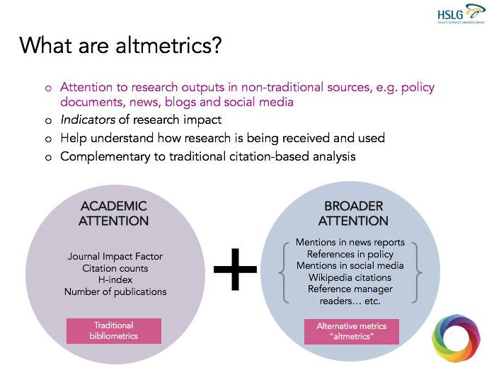
Jane Burns, MBA, MLIS, MPhil, FLAI
School of Nursing & Midwifery, RCSI
School of Info & Communication Studies, UCD
Notes:
How many have heard of “altmetrics” or alternative metrics before this workshop?
Provide a more coherent understanding of research attention, by taking into account the broader attention your work might receive.
By taking a look at non-traditional sources where your research outputs may be getting attention, as well as research outputs with metrics that aren’t captured as well in bibliometric tools.

Slide 27
Why Altmetrics?
Books
Book Chapters
Journal Articles & Preprints
Presentations
Theses/Dissertations
Reports
Conference proceedings
Reviews
Data Sets
Working papers
Grey literature
Track engagement, attention for a broad range of research outputs, as soon as they’re online.
Track engagement, attention outside immediate circle of research peers.
Identify communication channels
Discover potential collaborators
Notes:
Potential and value of altmetrics
Can track engagement and attention (and possibly get credit) for research outputs, as soon as they’re online. In that respect, that immediacy is complementary to bibliometrics where you do have to wait until the research works are cited in the journals, books, conference papers, dissertations. Which can also help early career researchers.
It can also track outputs that aren’t well represented with the bibliometric tools...presentations, datasets.
Track engagement/attention outside your immediate circle of research peers, including policy makers, general public, other researchers.
Showcase influence that you could then include: In Promotion & tenure, In grant applications, On your faculty profile.
Identify the most effective channels for communicating your research
Discover potential collaborators

Slide 28
Challenges of Altmetrics
NEW
Social media engagement
Correlation: altmetrics → bibliometrics?
Attention positive...or negative
Gamification
Disciplinary differences
Online attention needed to get metrics.
Notes:
Limitations, or Challenges
New, which means
Evolving standards, confusion and unfamiliarity and what altmetrics are, what falls within that category.
Since social media attention is a big part of altmetrics, it may mean having a presence on social media yourself, as a way of increasing your visibility. So if you’re not ready for that, something to consider.
Downstream effect: Does the altmetric attention you receive for one of your works translate down the road into more citations in Web of Science/Google Scholar?
Maybe. There’s been research on both positions, and it might be something we need to start tracking on our guide.
The other challenges or limitations are similar to what you’d find with the bibliometrics
Why is your work getting attention? Is it positive, or not?
Gamification, just like bibliometrics.
Attention isn’t distributed evenly among subjects. Think about the science you see most covered in the popular news and social media: medical topics, environment/climate change, space, articles about social media (impact of FB on voting behavior, for example)
And just like an article needs to be cited to get metrics, your work will need to get some online attention to get any metrics, starting with a tweet.
Doesn’t capture uses that aren’t being tracked by altmetrics tools, including anyone reading or using your work who isn’t on social media.

Slide 29




SOCIAL MEDIA
  Twitter
  Facebook
  Google+
  Reddit
  LinkedIn (historical)
Notes:
Just like we did for the bibliometrics part, I’m going to highlight two big names. Both have fee-based services requiring institutional licenses, but also free products.
First is Altmetric (uppercase, vs the broader altmetrics). Altmetrics.com
What they mine:
Social Media, which most people associate with Altmetric. They track the networks, not just tweets, retweets, shares, etc, but who’s doing it.
Outputs have to have established identifiers: DOIs, PubMed IDs, arXiv ID, ISBN. But Altmetric.com can work with organizations that can at least offer a unique identifier like a URL for each work.

Slide 30




















SOCIAL MEDIA
  Twitter
  Facebook
  Google+
  Reddit
  LinkedIn (historical)
Public policy documents
Mainstream media (2,000+)
Online reference managers
Post-publication peer-review platforms
Open Syllabus Project
Wikipedia
Blogs (9,000)
Youtube
Stack Overflow
Notes:
But the also track a lot more than social media
Public policy documents
2,000+ mainstream media outlets: TV, radio, newspapers, newswires, from broad to very subject specialized trade magazines and websites.
Online reference managers (Mendeley - is someone saves your work to their library)
Post-publication peer-review platforms
Wikipedia - TMV: I just found one of my articles referenced in a Wikipedia article
Open Syllabus Project (evidence of impact on teaching/education)
9,000+ blogs
Youtube
F1000
More on their website about how they track.
KEY THING: These sources are not given the same weight.
What would have more weight: A single Tweet that the journal Geophysical Research Letters pushes out when they published an article about mercury reserves in permafrost and what that could mean if they thaw, or a write up about the article in a science news website called Tech Times, who in turn tweets that out to their followers, who in tweet it out to their followers, etc.
The more qualitative and substantial the mention, the greater the weight it’s given. This helps to address the gamification issue.
So the mentions get weighted scores, and what you typically get…..

Slide 31
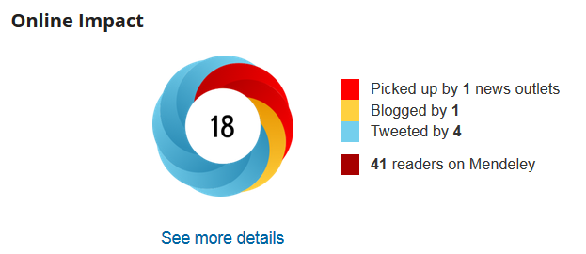
“The Doughnut”
Altmetric Bookmarklet
Altmetric Explorer (Library)
Notes:
….. A doughnut with what they call is an Altmetric attention score, a breakdown from the sources, and a link back to altmetric.com for more details about the attention. Which news outlets, who blogged or tweeted, which wikipedia entries are citing your work, etc.?
Or it might be a smaller badge with a link back to Altmetric.com
3 free tools to help measure online engagement
Will show you all three, with examples.
Doughnut, in many cases, is already embedded on the publisher websites.

Slide 32
Altmetric in action
https://academic.oup.com/icesjms/advance-article/doi/10.1093/icesjms/fsx225/4745800
http://journals.sagepub.com/doi/abs/10.1177/0956797617702003?journalCode=pssa&
http://www.pnas.org/content/113/21/5797
https://doi.org/10.1017/CBO9780511664335
https://figshare.com/articles/Main_Dataset_for_Evolution_of_Popular_Music_USA_1960_2010_/1309953
http://science.sciencemag.org/content/332/6034/1163/
Notes:
Show you a few examples of publisher embedded Altmetric doughnuts/badges. This data is free, so you can check on works from non-UCSD people, or journal articles that we don’t license.
First two, highlight the sources, and what they’ll find on altmetric.com
Note: will need to disable privacy badger and possibly ad blockers
ICES article - https://academic.oup.com/icesjms/advance-article/doi/10.1093/icesjms/fsx225/4745800 - Top 5% percentile per Altmetric. Look at the news sources. Picked up the UCSD press release, Journal pushed out a tweet
Psychological Science article https://doi.org/10.1017/S0003055417000144 - They use the badge with a score, but you can still link back to Altmetric for more info.
PNAS - http://www.pnas.org/content/113/21/5797 also a good example of where the hell did they put the metrics. It was easier to find before they revamped their website. It’s now under Authors and Info. But what’s nice is that they integrate bibliometrics as well, plus some monthly download data for the article. And if you can’t find the embedded Altmetric info, you can always use the bookmarklet
Altmetric isn’t limited to journal articles:
Cambridge Univ press ebook, has the DOI. - Referenced in multiple syllabi
Figshare - non journal formats like data (can also see views and downloads)
BUT the attention score doesn’t tell you what kind of attention the work is getting.
Science arsenic life article - attention can be positive and negative. Look at the sources that are giving attention to output, why is it getting that attention.
Came across another article w/ high altmetric score. Saw from the tweets and news articles that the authors are suing authors of another paper which had challenged their findings. This affected the 2nd article’s altmetric score as well.

Slide 33
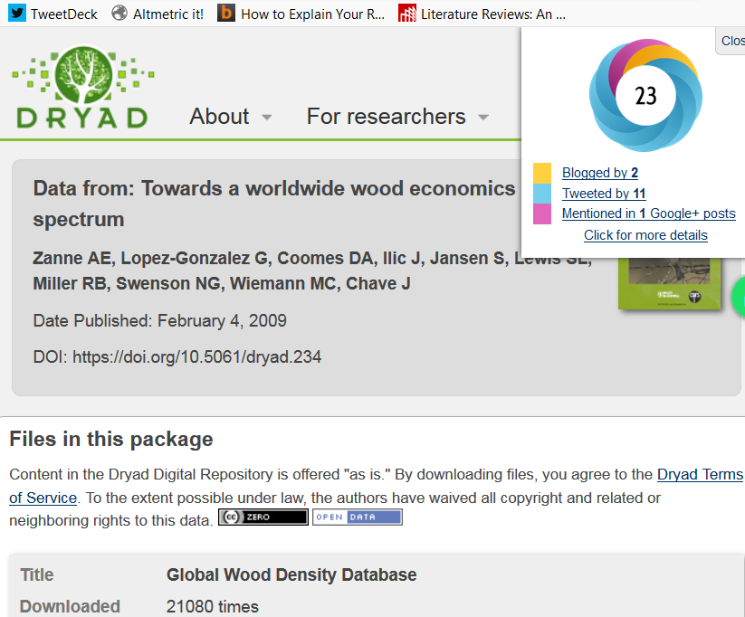

Altmetric Explorer for Librarians
https://www.altmetric.com/products/free-tools/bookmarklet/
Notes:
And you can get the attention score and detail even if there’s nothing embedded on the website.
If you go to the Altmetric website, under products you’ll see Altmetric bookmarklet. You can scroll down, drag that Altmetric It button to your bookmarks.
Then when you’re on the page of an article or other output, just click that Altmetric It on your bookmark bar.
For example:
http://datadryad.org/resource/doi:10.5061/dryad.234 - There’s no embedded data from Altmetric, so I just bring up the page and click Altmetric It.
Also see downloads. Link to the article, where you can check the altmetric score there.
Click see details here, get a different Altmetric score--likely because the DOI is slightly different. I would suggest this is a good example of when you’d want to compare the sources behind the attention scores for overlap or lack of. Data citations/mentions are harder to come by.
SSRN, another site w/o Altmetric scores.
https://papers.ssrn.com/sol3/papers.cfm?abstract_id=2595096 to see the score. They also have their own download/citation data.

Slide 34
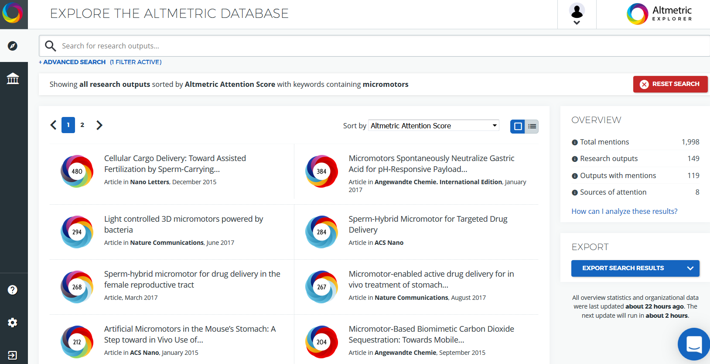
Altmetric Explorer for Librarians
Notes:
Altmetric Explorer for Librarians - we have free access to part of the fee-based Altmetric for Institutions.
Search by keyword, output, author. Can export 1st 50 outputs into Excel or screenshot.
Can search by topic to find articles with high attention, then filter by particular attention source like Wikipedia
Look at the search options, including ORCID - what’s ORCID https://orcid.org/
Identification system like Researcher ID. It’s important here because unlike Web of Science, I can’t disambiguate an author search by limiting with an institution.
More journals publishers requiring that authors create ORCID IDs. Can set up for auto updating your publication list, then review periodically for errors.
Search on Daniel C. Hallin - note that books are included here as outputs
Found this more useful for books that aren’t on scholarly press platforms like Cambridge Univ Press. Got nothing with the bookmarklet on the publisher’s website, but could enter the ISBN here.

Slide 35

Usage - clicks, downloads, views, holdings
Captures - favorites, readers, subscribers, watchers
Mentions - blog mentions, news mentions, reviews, links
Social Media - likes, shares, tweets, ratings, +1s
Citations - citation indexes (Pubmed, CrossRef, USPTO, etc.), clinical citations, policy citations
Notes:
Plum Analytics - Doesn’t have as many free tools
Provide insights into the ways people interact with individual pieces of research output (articles, conference proceedings, book chapters, and many more) in the online environment
No bookmarklet, but you can embed code to get the display data on your own webpages. There’s no single score. Breaks out to 5 categories, including the more bibliometric data, and on their site you can get more info. But this is how the attention metrics break out

Slide 36
Plum Analytics in action
http://search.ebscohost.com/login.aspx?direct=true&db=a9h&AN=124559361&site=ehost-live
http://search.ebscohost.com/login.aspx?direct=true&db=a9h&AN=112675980&site=ehost-live
http://www.cell.com/cancer-cell/fulltext/S1535-6108(17)30469-5
https://www.sciencedirect.com/science/article/pii/S0169409X15000575
Notes:
Embedded in the EBSCO databases, and Elsevier journals. With the EBSCO databases, you could also link out to the publisher websites and compare to get the Altmetric score to compare the attention/sources. Same with the Elsevier and Cell Press journals with the Altmetric bookmarklet
Same article from Psychological Science, Are You Smiling.
Thomas Levy archaeology article
Cancer cell article
Advanced Drug Delivery Reviews

Slide 37
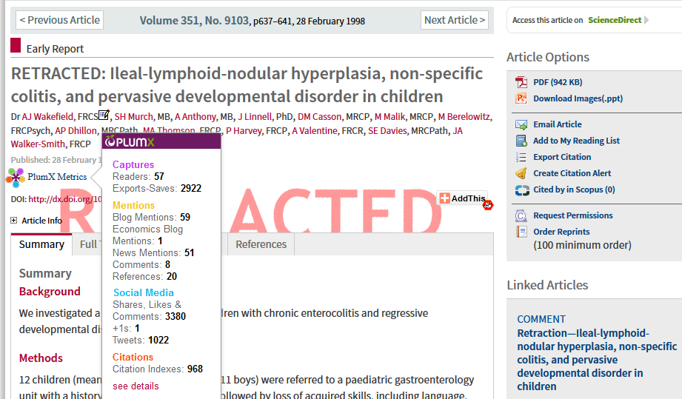
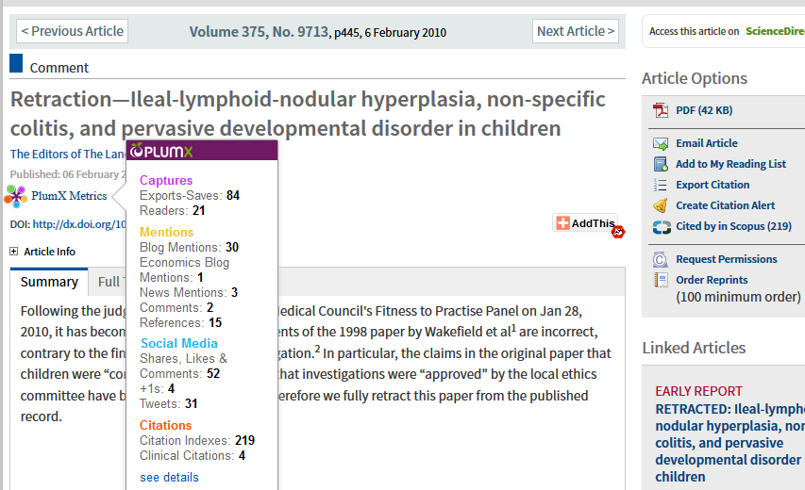
Notes:
As with Altmetric, must look at context. Is it good attention or bad attention?
Wakefield article linking MMR vaccine to autism and bowel disease. Lots of attention, a lot negative, and eventually retracted, which also got online attention/engagement.

Slide 38

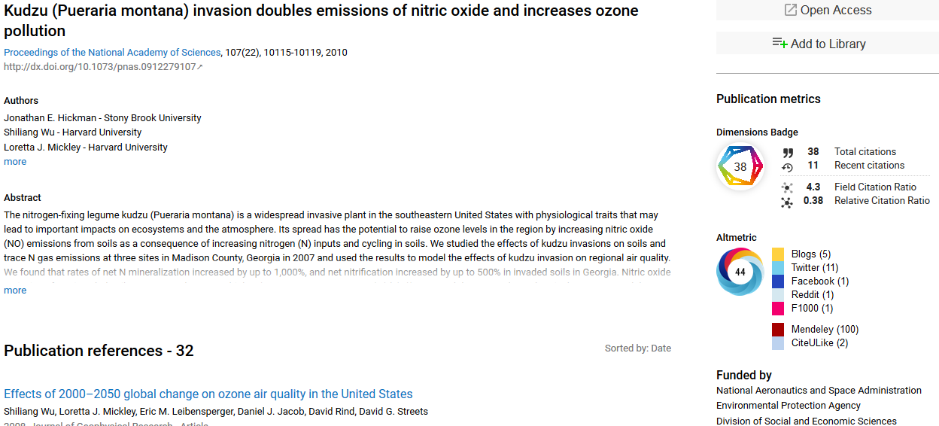
https://app.dimensions.ai/discover/publication
Notes:
New - Dimensions https://www.dimensions.ai/
Dimensions brings together funding data, publications, altmetrics, citations, clinical trials and patents in a richly linked discovery platform.
UCSD may be signing a license for institutional access, but you can search for free at https://app.dimensions.ai/discover/publication.

Slide 39
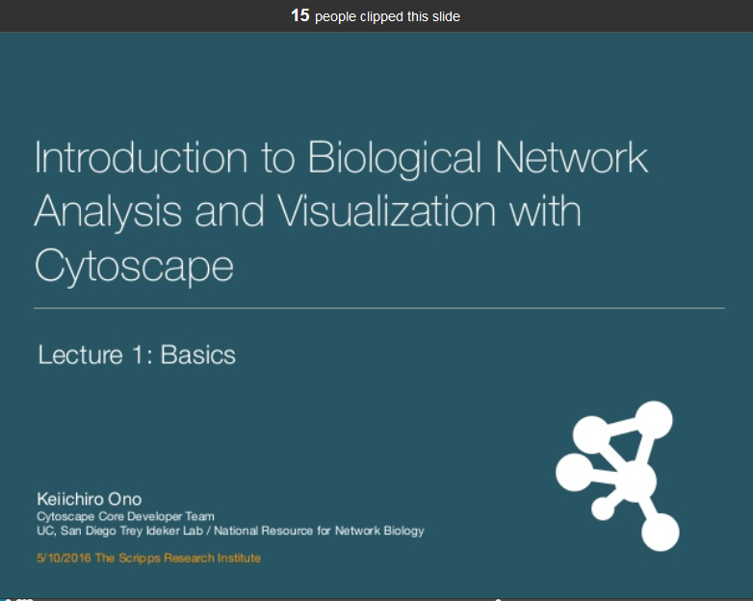
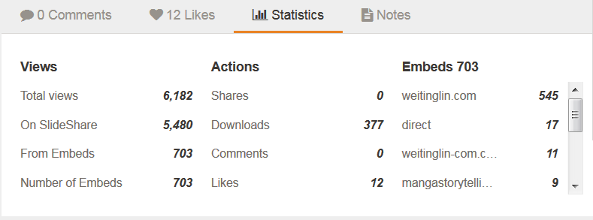
Alternative Outputs
Notes:
And if there’s no Altmetric/PlumX option, then see what is available.
What does that platform offer?
Some metrics useful, some not. Quality of reviews can be a particular problem.
From Slideshare, you can see views, downloads, likes, clipped slides
Figshare and Dryad - views and downloads, along with Altmetric
Github and Depsy - stars, following, forks (copies), software/code downloads, citations, reuse
Researchgate reads
Worldcat - libraries that own your book
Amazon/Goodreads - sales info, readership, reviews
Youtube - views, reviews
Some of the data gathering is still diffuse. You may still need to do some searching in Google, Google Scholar, Google Books for:
Citations of your works (including books/book chapters) in books not indexed in Web of Science, or syllabi that aren’t in Open Syllabus Project
Book reviews (also some of our scholarly databases)
Acknowledgements of non-author contributions like laboratory facilities, datasets, and software/code. This can be done in Web of Science and Google Scholar, but the challenge is figuring out what to search. You may have to do multiple searches to create as complete a list as possible.
Do you need to look for acknowledgements by name; the output, facility, or service provided (and what names to use), or some combination? Do you need to limit by institution as well?
In Google Scholar, will you have to disambiguate the name searching to exclude others with that name (or works where the person you’re searching isn’t acknowledged but an actual author)?
In Web of Science, use the “funding text” field in the advanced search. For example: FT=Teri Vogel OR FT=Biomolecular and Proteomics Mass Spectrometry. Then scan the results since your results could include other facilities. If you run the search with AND, you’ll exclude articles that didn’t mention both your name and the facility.

Slide 40
Using the Metrics¹
Identify priorities
  What is your case? Your story? What statements do you need to support?
Choose tools/platforms
  http://www.metrics-toolkit.org/choose-metrics/ [NEW]
Gather and store the data
Select
  Presenting data in context
    Timeframe, scope, source/authority, reliability/accuracy, relevance ²
  Providing a range of evidence - metrics + qualitative
Visualize
https://www.slideshare.net/goldenphizzwizards/metrics-for-team-science, CC-BY-NC-SA 4.0
https://www.slideshare.net/goldenphizzwizards/coates-evidence-demonstrateimpactreputationoverview20120906, CC-BY 4.0
Notes:
Using the metrics to get to that story
ID priorities:
Where are you in your career?
What’s the story you’re trying to tell?
What are the impacts of your work where you want to find that support to make your case?
What are your outputs?
Choose appropriate tools
Metrics toolkit just launched. Particularly good because it covers key non-journal objects.
Can browse the metrics, or use the filter to select. Note they categorize impact differently.
A chance for you to browse the various tools on your own, then contact us for additional assistance.
Get appropriate use cases, where to go to get that information, and any limitations or caveats.
Gather, and storing the data from WoS, Altmetric.com, PlumX, Google Scholar, publisher websites, repositories, etc.
Spreadsheet with article AND non-article outputs and associated citation and altmetrics (w/ qualitative), views and downloads
Time-consuming, messy (where we can help)
Setting up workflows. What can you check yearly, what should you check more frequently, etc?
Now you have some data. You still have to how to evaluate, select, make sense of it. Not everything will be useful for the case you’re making.
Visualize - how you’re going to present it on your website, P&T documents, grant applications.
How are you going to add the context to the data.
What’s the “so what” factor. Why does this matter?

Slide 41
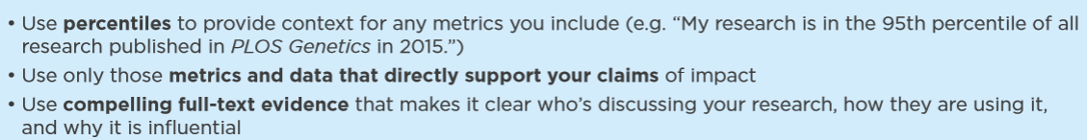
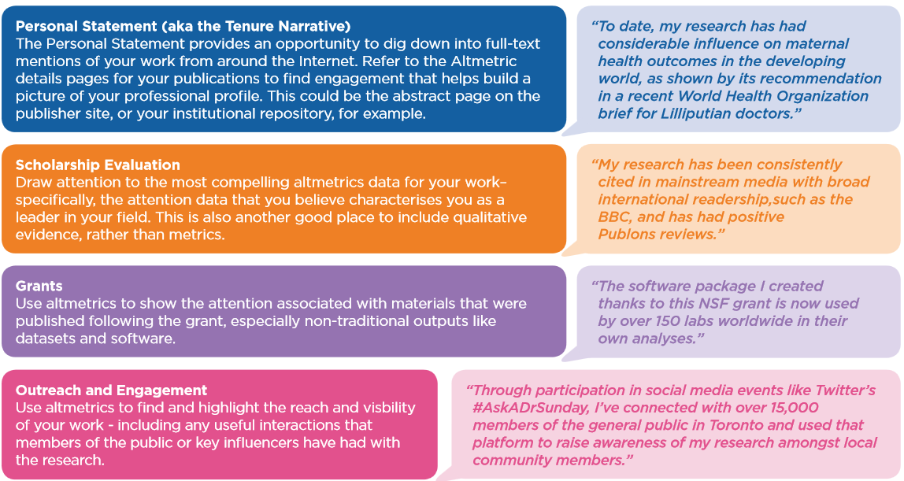
Engineering, Altmetric (2017): How to Use Altmetrics for Promotion and Tenure. Figshare. https://doi.org/10.6084/m9.figshare.5271985.v1
Notes:
Altmetric has some suggestions to adding that context.
Percentiles (and timeframe)
Metrics/data that directly support the case you’re making about impact.
Relevance. Back to the public engagement vs article citations
Not just the numbers - why it matters, how people are using your work.

Slide 42
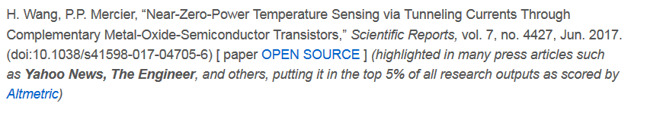
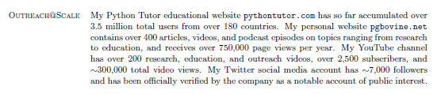
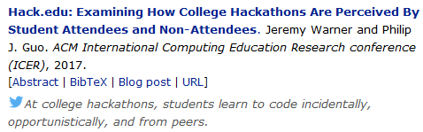
Use Cases
http://efficiency.ucsd.edu/publications/
http://www.pgbovine.net
Notes:
A few specific examples of presenting on the web.
Mercier group in ECE - mentions 2 articles highlighted in many press articles such as Yahoo News, The Engineer, and others, putting it in the top 5% of all research outputs as scored by Altmetric. Second one has fairly high score, could be embedded on the page.
Philip Guo in Cog Sci. That summary of his reach/metrics. Code on his website that you can post links to his articles on Twitter.

Slide 43
Use Cases
https://www.ess.uci.edu/~sjdavis/index.html - Steven Davis, UCI
https://faculty.washington.edu/sr320/?page_id=246 - Steven Roberts, Univ of Washington
  Impact Story - https://profiles.impactstory.org/u/0000-0001-8302-1138
https://maestrelab.blogspot.com.es/2014/11/how-i-use-altmetrics-data-in-my.html - Fernando Maestre, Universidad Rey Juan Carlos
Notes:
More examples of presenting on the web.
Steven Davis at UCI, embedding Altmetric and google scholar badges, but also note Twitter presence and where their work has been covered in the media. Part of establishing that scholarly, public profile to help facilitate engagement. On his CV, he notes highly cited articles, and articles that were identified by those journals as “highlights” of their publication that year.
Steven Roberts at Univ Washington - Altmetric badges on his CV, Lists all of his profiles, from GS to Github to Slideshare
Impact Story, uses ORCIDs, adds some contextualization.
Fernando Maestre at Universidad Rey Juan Carlos - Shows how he incorporated metrics as impact indicators for several articles for a grant application (highlight 5 relevant papers). He links to the Altmetric profiles to highlight the news coverage, including some specific outlets. Also includes Web of Science and Google Scholar times cited.

Slide 44
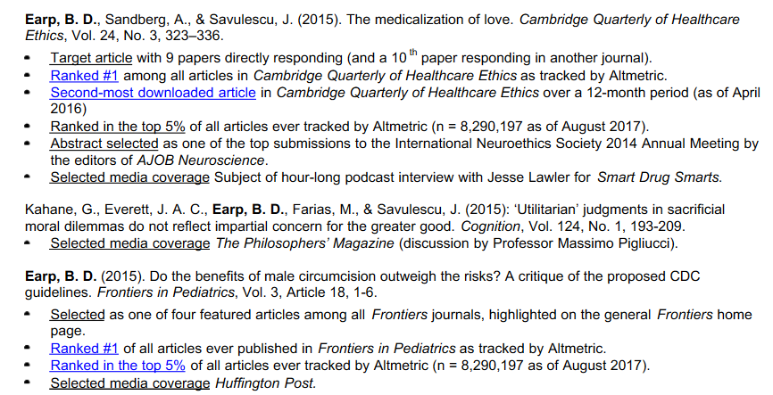
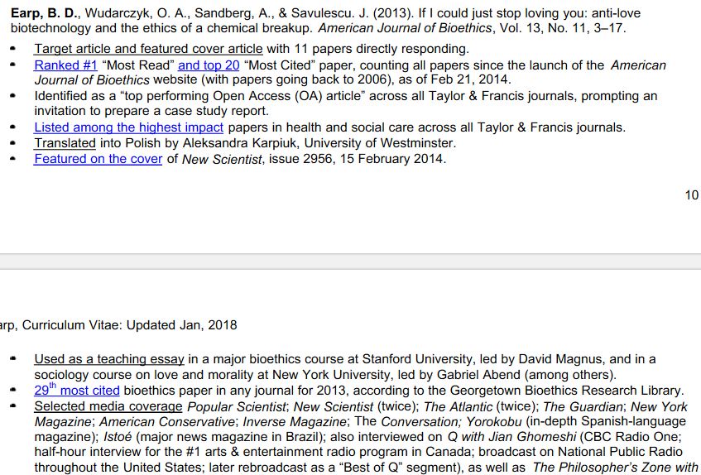
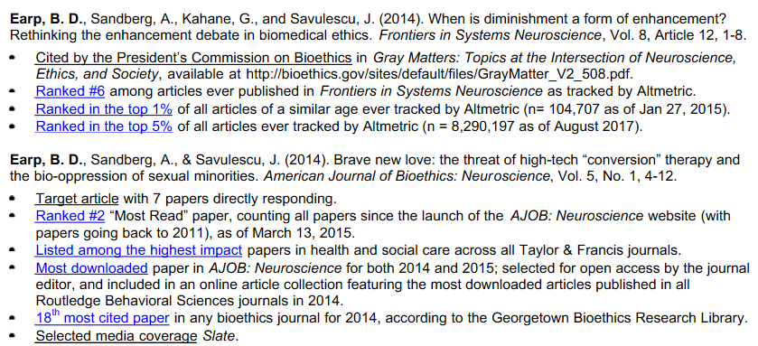
Use Cases
https://oxford.academia.edu/BrianDEarp/CurriculumVitae
Notes:
Brian Earp, at Yale
Metrics for each article, plus highlights (used in teaching, policy, mainstream news)

Slide 45

Use Cases - Promotion & Tenture
https://drive.google.com/file/d/0BzVyoVbp68fZU2tqTVNfZHlaMDlVczRJb0VZWXB1VjdDMHBV/view - Trevor Branch, University of Washington
https://github.com/sr320/LabDocs/blob/master/Roberts_SB_Tenure_2.pdf - Steven Roberts, University of Washington
Notes:
A few specific examples of presenting on the web.
Trevor Branch at Univ Washington - The section of his P&T that deals with metrics and outreach
Citation Metrics on pg. 2
Highlighting articles w/ high altmetric attention scores
Outreach section: Website views, Social media outreach: followers, viewed tweets + highlights, including qualitative feedback
More in personal statement
Steven Roberts, Univ Washington, outreach/engagement core part of his program’s work.

Slide 46
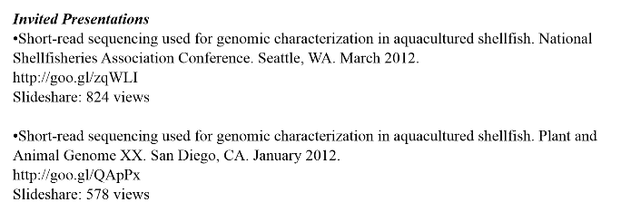
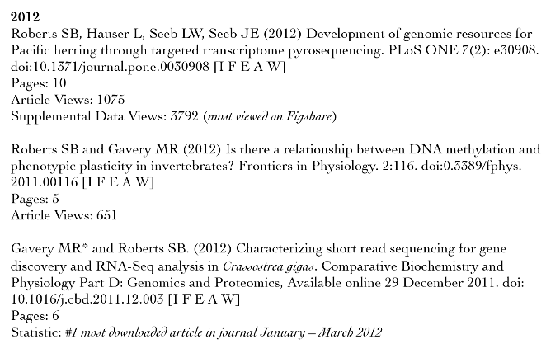
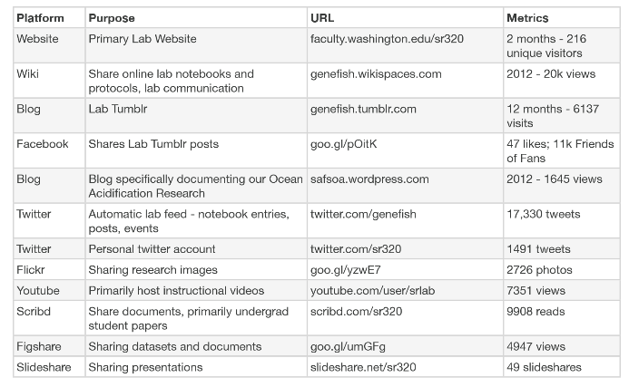
https://github.com/sr320/LabDocs/blob/master/Roberts_SB_Tenure_2.pdf
Notes:
Screenshots from Prof Roberts’ dossier.
As evidenced by downloads over specific period of time.
Slideshare views, article level metrics (including times cited for other articles)

Slide 47
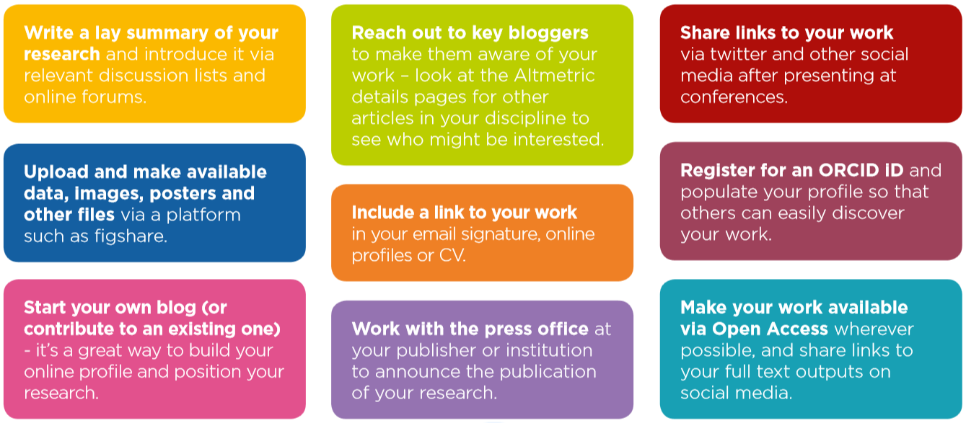
Next Steps - Promoting Your Work
Engineering, Altmetric (2017): Tips & Tricks: Promoting your research online. Figshare.
https://doi.org/10.6084/m9.figshare.5271979.v1
Notes:
What many of these researchera have in common. Active steps to increase visibility of their work
Promoting your work….more attention...metrics/qualitative to show evidence of impact.
Several of the authors I mentioned do include lay summaries of their articles on their websites.
Open Access - accepted copies of manuscripts in eScholarship (we can help)
Other outputs like datasets, presentations
Connecting with campus press office, or press person for division or school (nearly all of the UCSD examples were drawn from press releases)
Developing, curating your scholarly identity
Identifiers like ORCID, setting up your Google Scholar Profile - Start here!!!!
Using your CV, website well
Using social media to share, engage
Sharing links via Twitter and Facebook. Are there prominent people in your field in these spaces that can amplify your announcements.
Don’t jump into everything at once.
UCSD researchers with active social media profiles: Philip Guo (https://twitter.com/pgbovine), Bradley Voytek (https://twitter.com/bradleyvoytek), Brian Keating (https://twitter.com/DrBrianKeating), Alie Caldwell (https://twitter.com/alie_astrocyte)
Jacobs School of Engineering (https://twitter.com/UCSDJacobs)
Keeping in mind
What’s the story you’re trying to tell
Matching the values of your department, institution, funders.

Slide 48
Questions?
Guides : https://ucsd.libguides.com/Impact
Contact your liaison or scholcomm@ucsd.edu
Scholarly communications webpage for workshops http://ucsd.libguides.com/ScholComm/events-workshops
Updates and scholarly communications news https://knit.ucsd.edu/scholcomm/

